Slide 1
Ballston Spa Central School District Student Spaceflight Experiment Program The Development of Tilapia Eggs in Space
By:
Jordyn Catherall
Kate Yager
Dana Betti

Slide 2
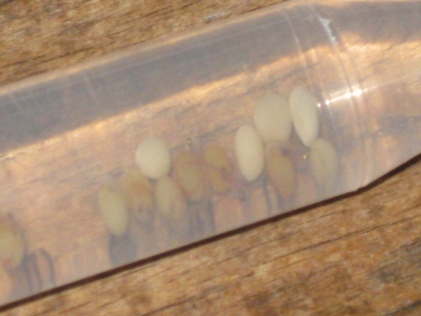
Question
How does microgravity affect the development of Tilapia eggs?

Slide 3
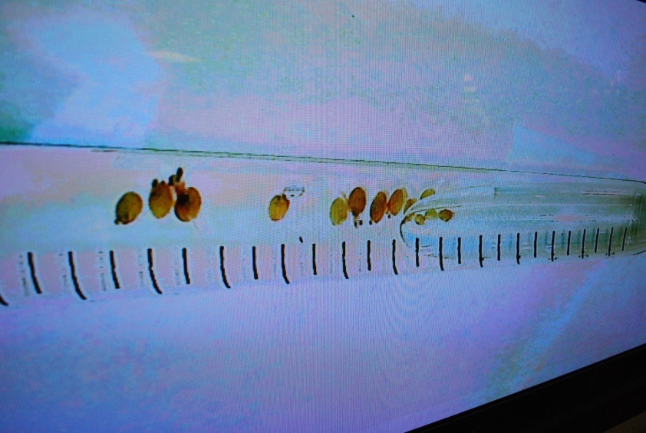
Hypothesis
If eggs are sent to space, an environment with microgravity, then the parts of the fish might be in different locations than those that develop on Earth.

Slide 4
Background Information on Tilapia
Tilapia are mouth breeders. They roll the fertilized eggs around in their mouth to prevent fungus from growing on the eggs.
Eggs hatch in approximately 5 – 7 days
Warmer temperatures around 85 degrees speed up the rate of hatching. Cooler temperatures slow down hatching.
Research has shown that gravity affects the turning on and off of genes during development

Slide 5
Trials
Water was collected from a fish tank and sent to ITA for fluids and compatibility testing. Eggs were sent in a large box directly from AmeriCulture for the test.
We received 4 shipments of Tilapia eggs to trial and test PH, temperature and the number of eggs to put in a vial.
Eggs were put in vials to test how cold/warm the environment had to be for them to survive
After our tests failed, we called a aquarium and they said that the water had to be about 80 degrees
We put eggs in a fish tank with a water heater and left them for the weekend . When we came back, there were Tilapia swimming in the tank. Water from this tank was used for all future samples

Slide 6
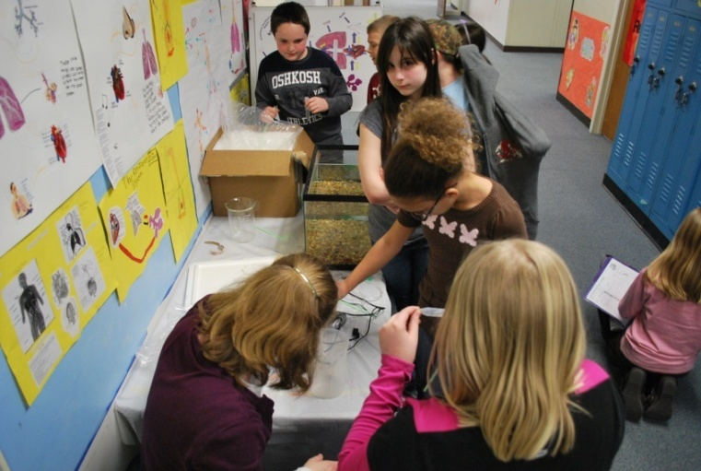
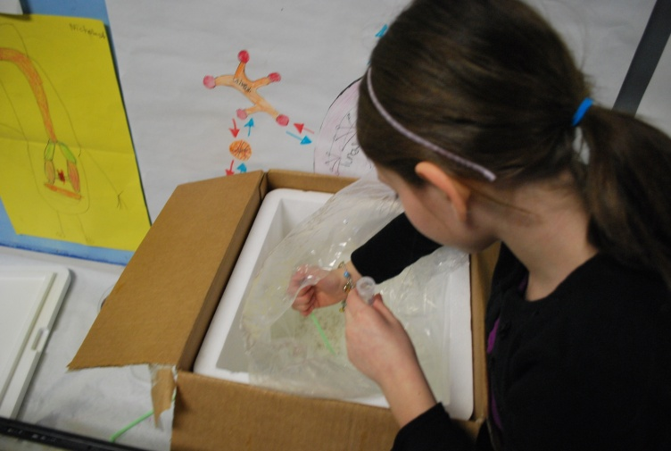
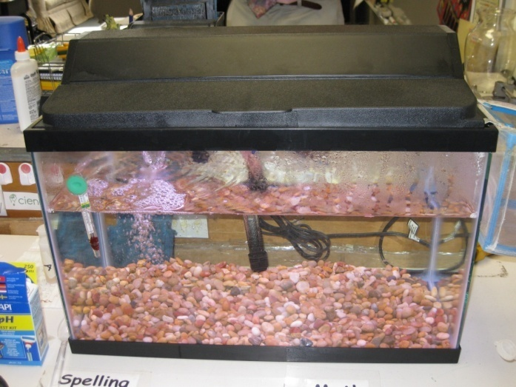
Trials

Slide 7
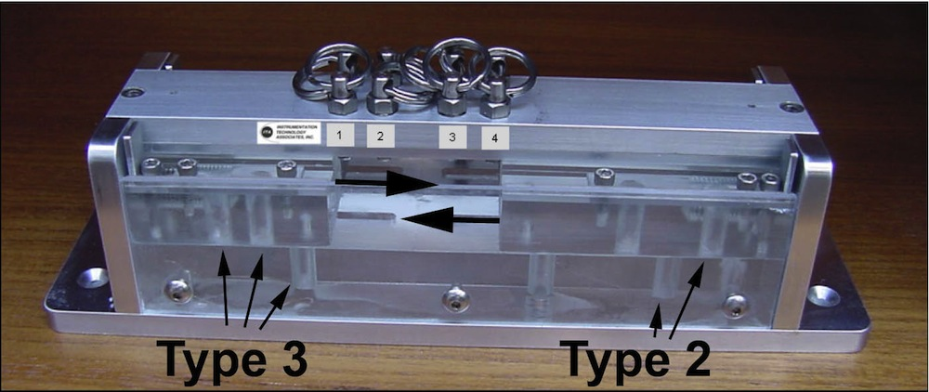
Procedure
We took water from the tank that had Tilapia fish living in it and filled the control MDA unit with water and 5 fresh Tilapia embryos.
Water from the tank that had Tilapia fish growing in it and approximately 10 eggs were put into 3 vials for the experimental sample. The water was aerated and oxygen added to the top of the vial. The vials were shipped to Kennedy Space Center
Some of the eggs developed during shipping. We received a phone call on Friday 5/13 and were asked if we wanted only embryos loaded into the MDA. As of Saturday morning 5/16 the samples were loaded as embryos.

Slide 8
Experiment Data
Data | Control | Experiment
Pre-shipping Activity | Eggs loaded from large sample directly into chamber | Water was aerated and oxygen added to the vials
Water Appearance | Clear but slightly cloudy | Milky white, has gotten more clear
pH | 7 | 6 -7
Egg Appearance | White, mushy | 3 out 5 developed 1 partially developed 1 that was white and mushy Fish were flatter
Odor | Very strong, dead fish smell | Moderate
Light Absorbance by Liquid |  | 430 - .197 470 - .149 585 - .159 635 - .191
Mircroorganisms | Bacteria and fungus | Bacteria

Slide 9
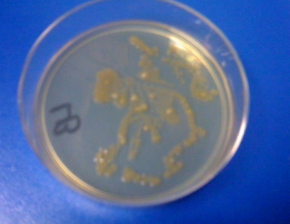
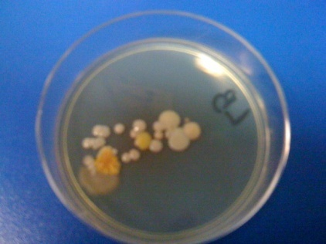
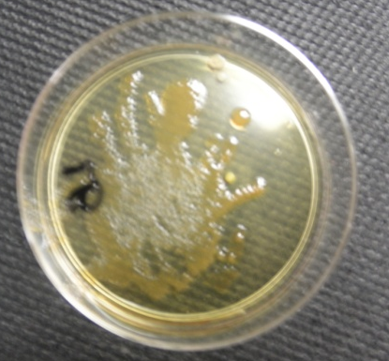
Images of Microorganism Growth
Control
Experiment

Slide 10
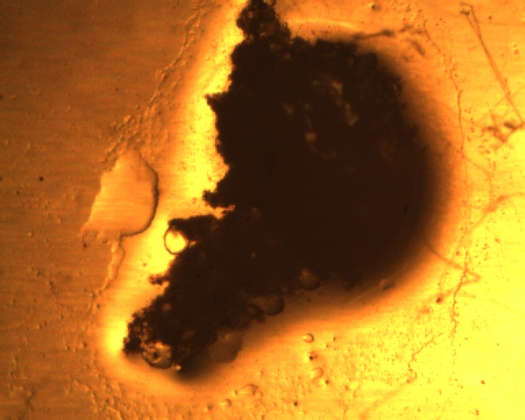
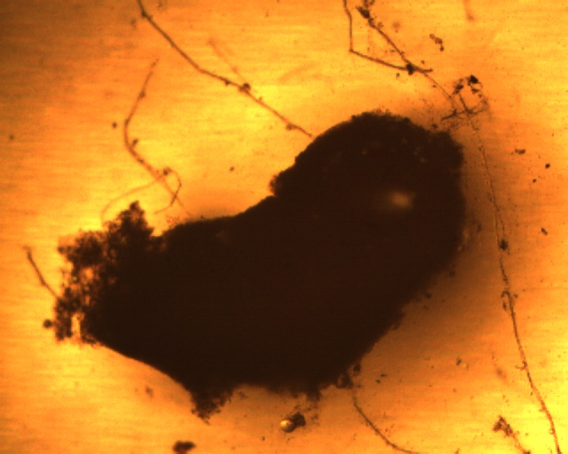
Images of Control Samples

Slide 11
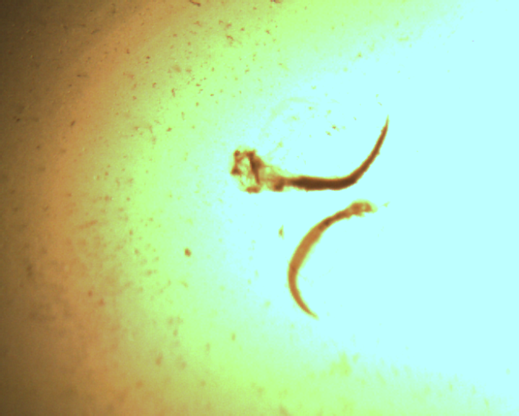
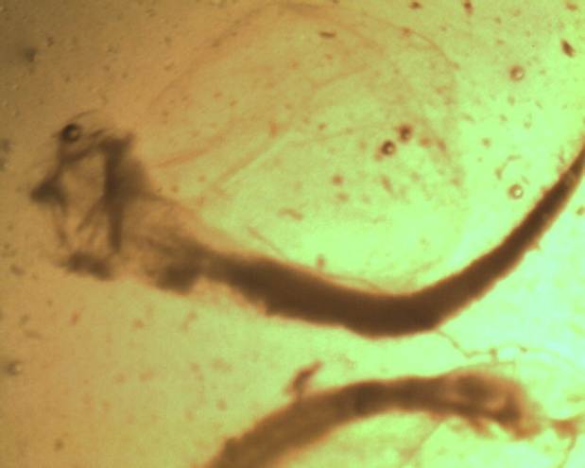
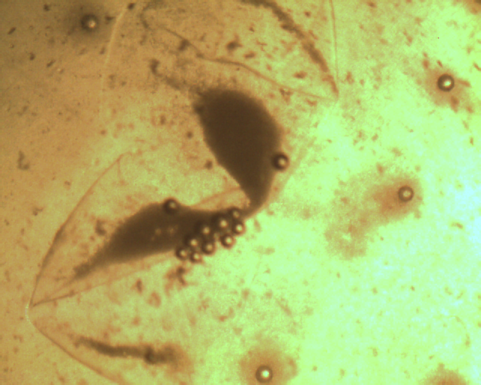
Images of Experimental Samples

Slide 12
Results – More Questions than Answers
None of the control embryos developed.
3 out of the 5 eggs sent to space developed. They did not survive. They probably ran out of oxygen.
Pressure and microgravity may have caused the particles to separate so that we could see the developed fish.
Less fungus growth in space. We could talk to one of the groups that did an experiment on bacteria growth to see if their findings were similar to ours.

