Slide 1



Investigating Antibiotic Susceptibility Profile Variation between E. coli K-12 Exposed to Microgravity and Full Gravity Environments using a SIEMENS Micro-Scan® Automated Bacterial Identification System
by
Cassandra Avila
Derick Kalt
Carlos Monserrat
Javier Delgado
Dr. Maria Alvarez, Faculty Mentor

Slide 2
Background and Introduction
Previous studies indicate that when cells are exposed to radiation, the most common form of damage is the deletion of certain DNA segments, which can lead to mutations
Mutations can lead to changes in gene expression
The effects of radiation-induced mutations in microgravity on the growth of bacteria and antibiotic susceptibility patterns has not been investigated
Escherichia coli is a bacterium found in the intestinal tract of humans and animals that can develop resistance to antibiotics.

Slide 3
Objectives
The objective of our project is to determine if the antibiotic susceptibility patterns of E. coli K-12 change after exposure to microgravity and space conditions.

Slide 4
Methods
E. coli K-12 was grown in LB Broth
Suspensions of E. coli at 1X10⁸ CFU/ml were kept at normal vs microgravity conditions
Samples were analyzed using the Siemens Microscan automated microbial identification system

Slide 5
Siemens Automated Microscan System
Automated microbial identification system
Based on biochemical reactions
Provides antibiotic susceptibility data and displays minimal inhibitory concentrations (MIC in mg/L) for commonly used antibiotics
Results in 24-48 h

Slide 6
Instrument Processing
Isolate bacteria
Gram negative vs. positive
Oxidase Test
Anaerobic vs. aerobic pathogens
Biochemical Assays
Compare results to database
Identifies probability and species

Slide 7
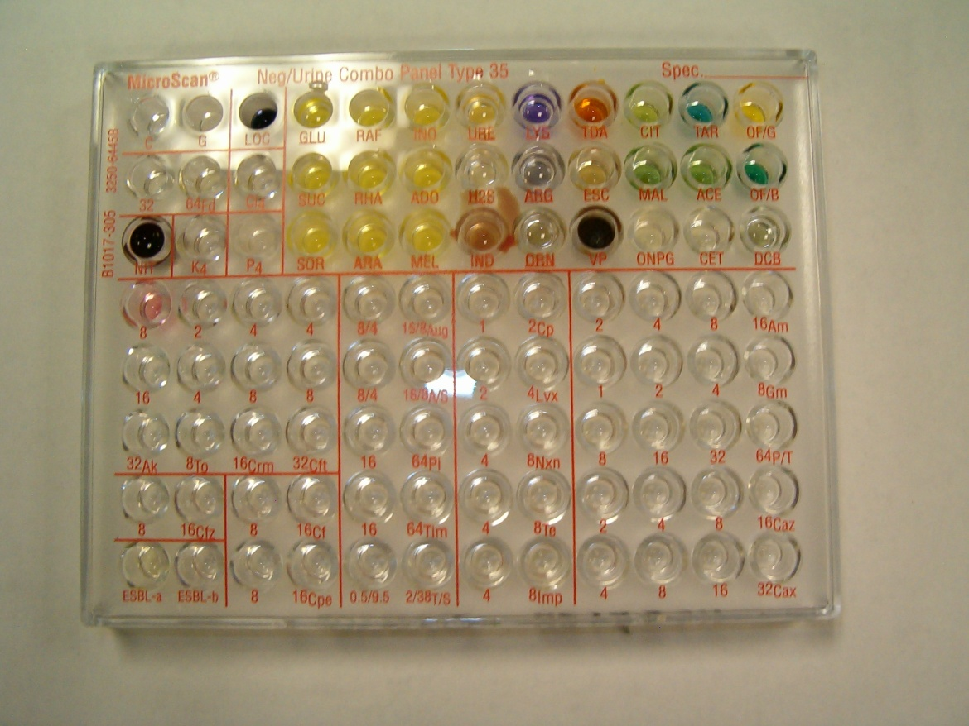
Select Biochemical Tests
Test | Positive | Negative
GLU | Strong Yellow | Orange to red
URE | Magenta to pink | Yellow, orange or light pink
H2S | Black precipitate | No blackening

Slide 8
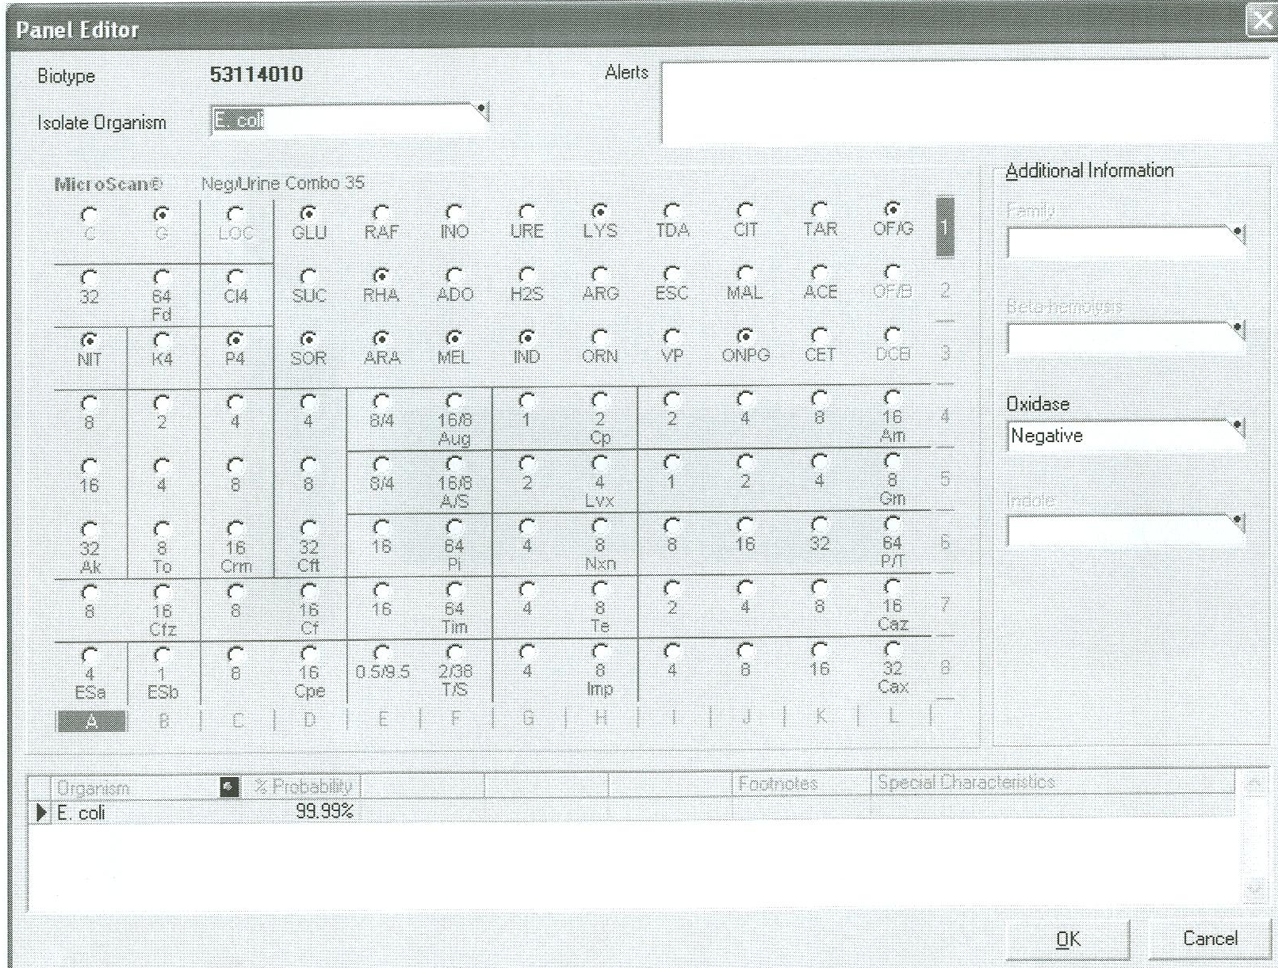
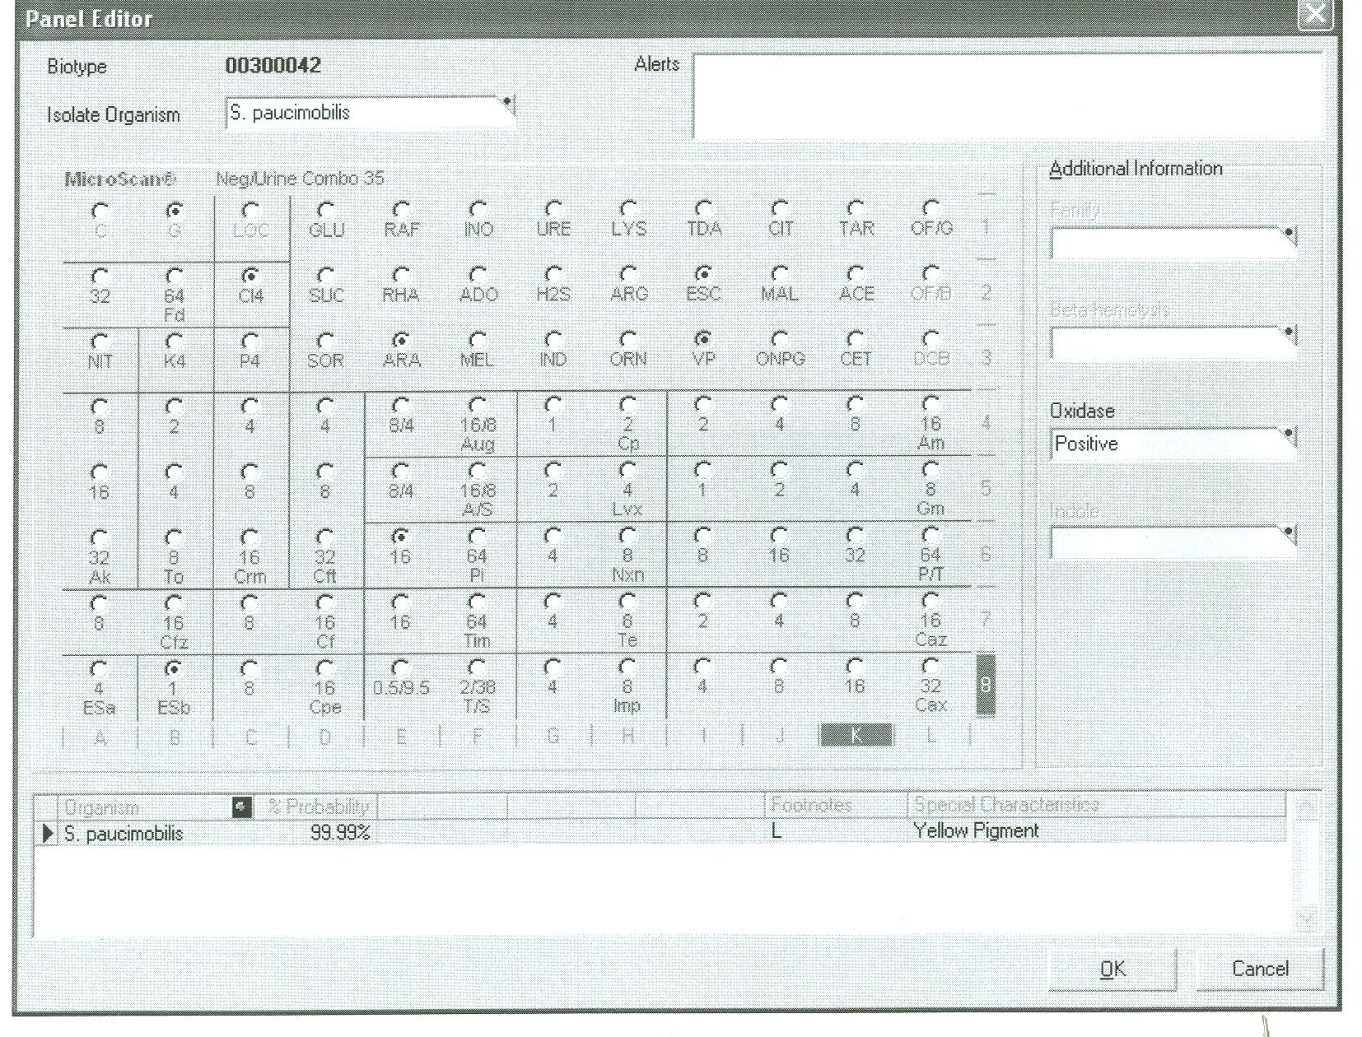

Ground Control Sample
E. coli at 99.99% Probability of Correct Identification

Slide 9
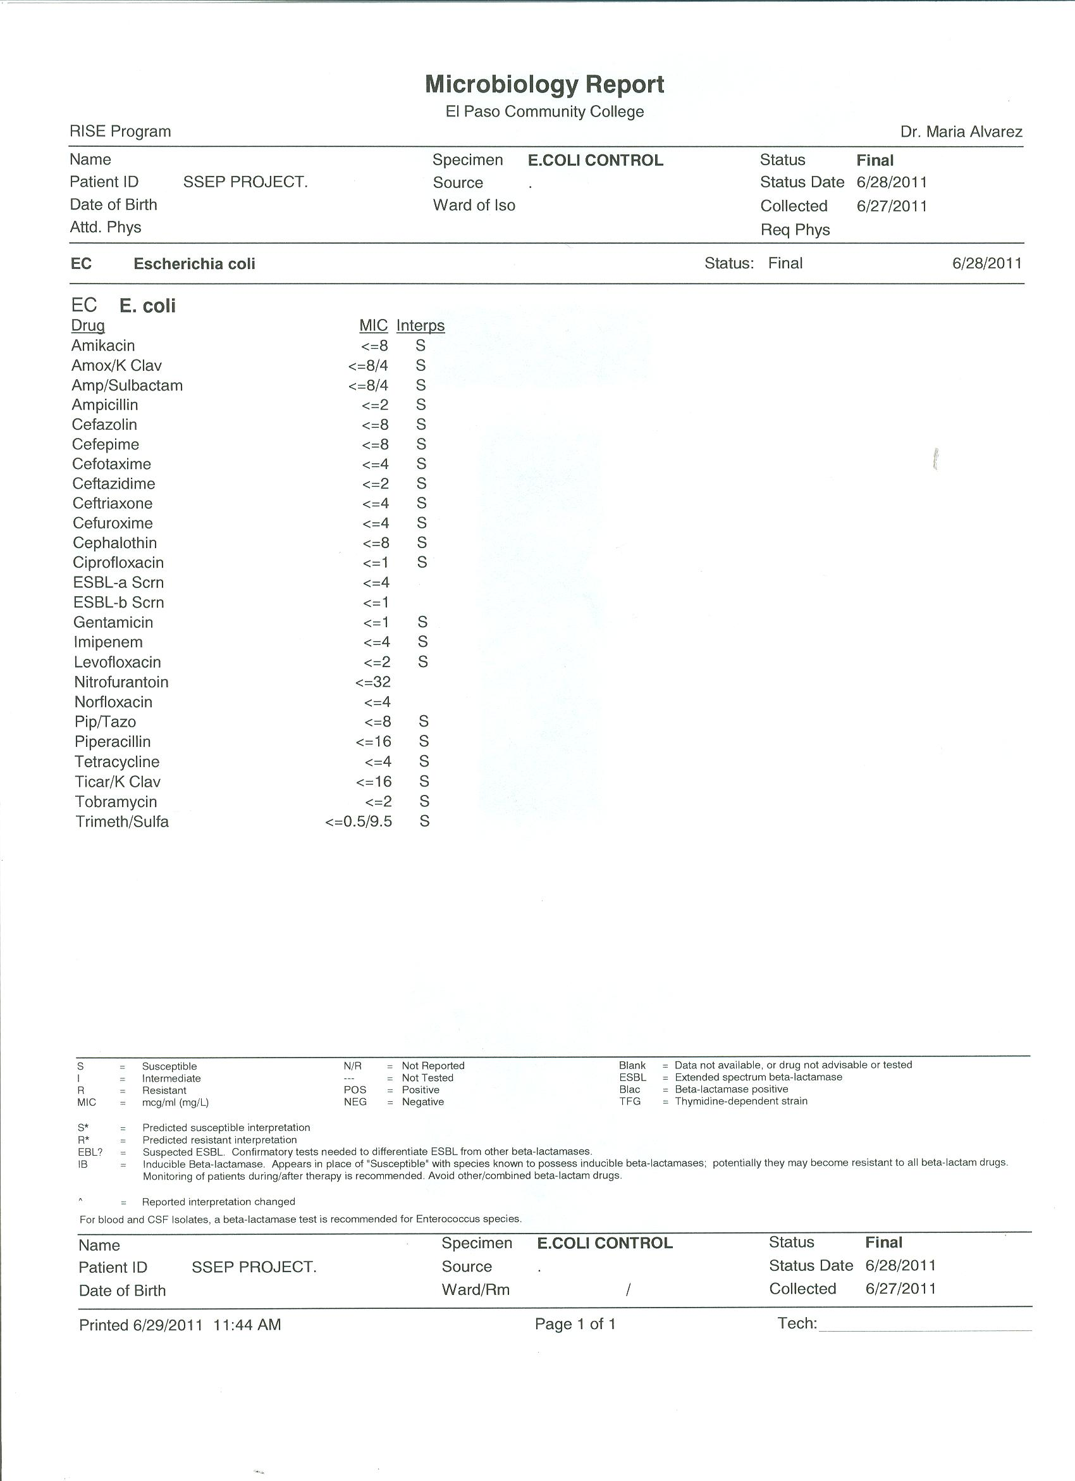
Ground Control Sample
Antibiotic Susceptibility Pattern

Slide 10

Experimental Sample (Microgravity)
Sphingomonas paucimobilis at 99.99% Probability of Correct Identification

Slide 11
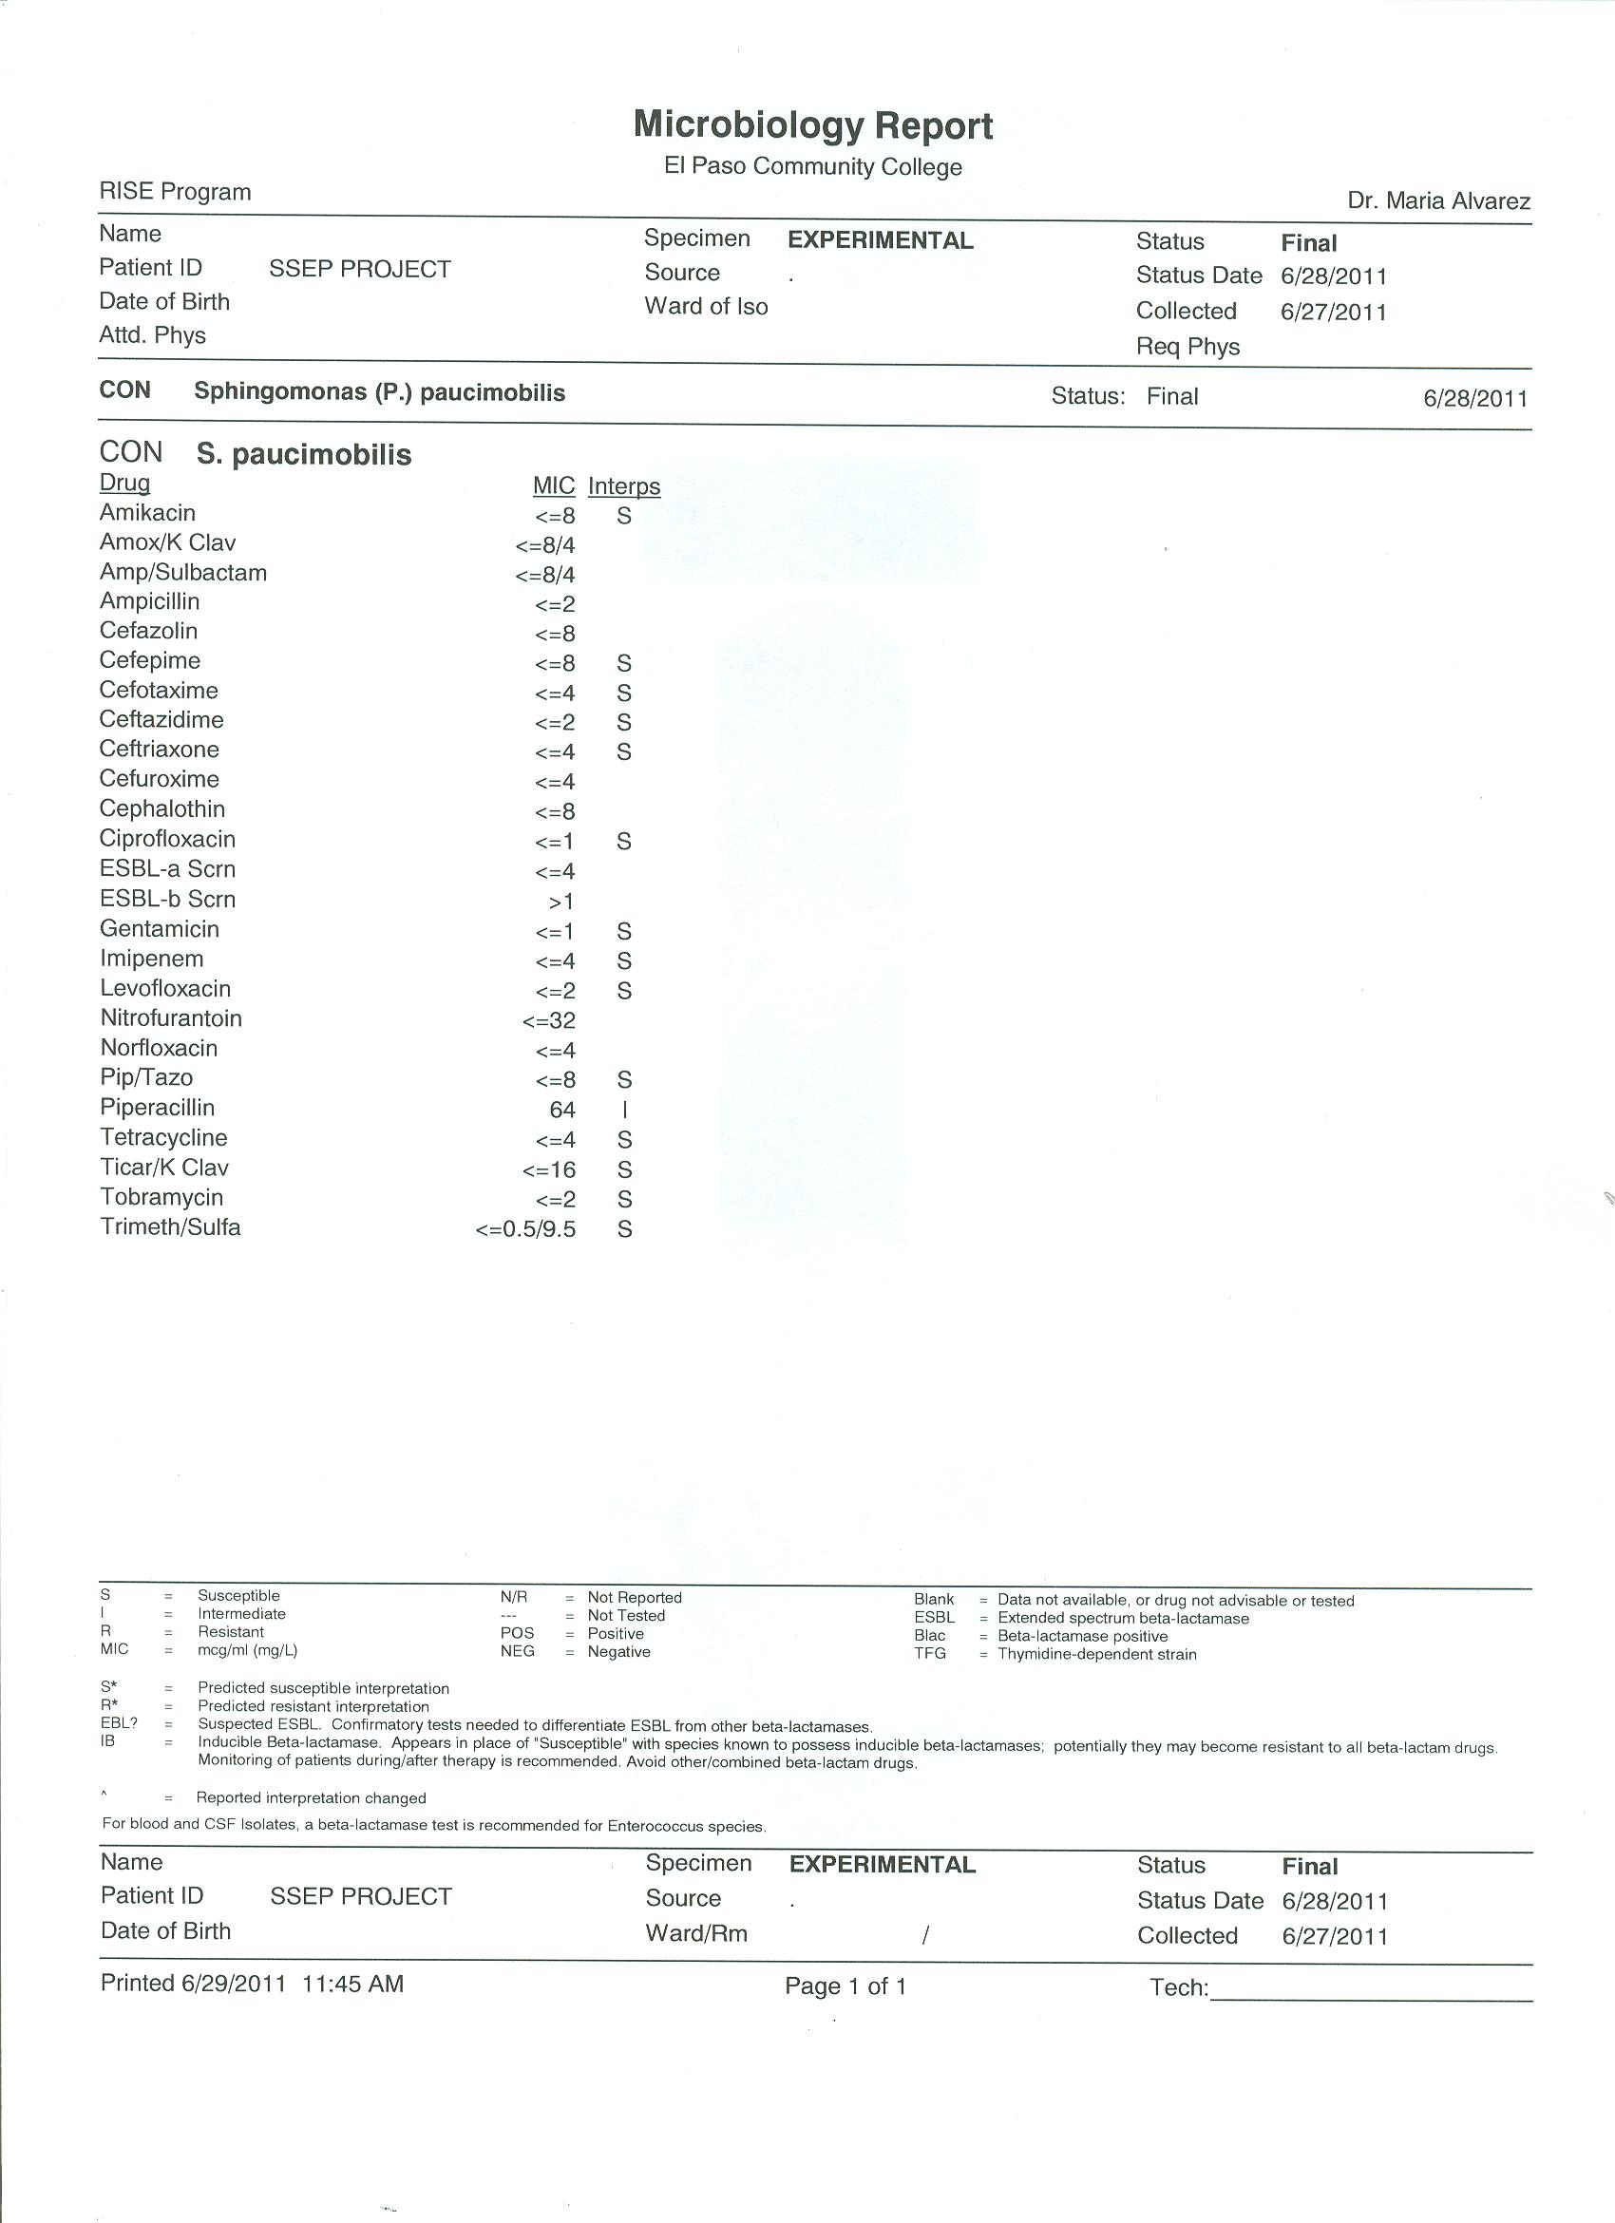
Experimental Sample Antibiotic Susceptibility Pattern

Slide 12
Conclusions
E. coli kept at regular earth’s gravity conditions (Ground control) displayed normal biochemical reactions and antibiotic susceptibility patterns
We were unable to recover E. coli from the sample exposed to microgravity
Bacteria that overgrew the E. coli was identified as Sphingomonas paucimobilis
Experiment will be repeated

Slide 13
Acknowledgments
Jose Mendoza
Gloria Anchondo
Dr. Violeta Chavez
Dr. Jeff Goldstein and SSEP Program
John Cassanto and ITA
This project was supported in part by:
Texas Space Grant Consortium
Foundation for EPCC
MSEIP Grant Number P120A080025
MBRS-RISE Grant Number 5R25GM060424
EPCC President’s Office

