Slide 1




The Effect of Microgravity on Biofilm Formation by E. coli on Polystyrene Particles
Jarisma Rodriguez
Michelle Holguin
Diana Pahman
Dr. Maria Alvarez, Faculty Mentor

Slide 2
Introduction
Bacterial biofilms are communities of bacteria surrounded with a slime-like substance that creates a protective shield and makes them resistant to a variety of environmental factors.

Slide 3
Objective
The objective of our study is to determine if biofilm formation by Escherichia coli K-12 on polystyrene plastic particles is influenced by microgravity conditions.

Slide 4
Hypothesis
Our hypothesis was that microgravity will influence the ability of E. coli to form biofilms on polystyrene particles

Slide 5
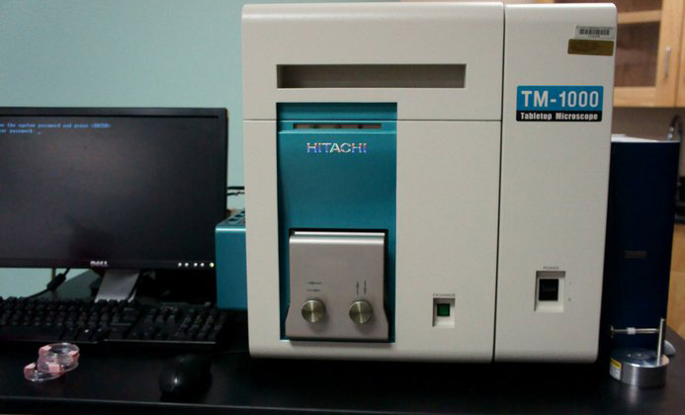
Materials
500µm Polystyrene beads
E.coli K-12 Strain
Luria Bertani (LB) Broth
0.85% Sterile Saline Solution
Pipettes
Hitachi ™ 1000 Scanning Electron Microscope
Notes:
by scanning it with a high-energy beam of electrons in a raster scan pattern. The electrons interact with the atoms that make up the sample producing signals that contain information about the sample's surface topography, composition, and other properties such as electrical conductivity

Slide 6
Methods
E. coli K-12 was cultured at 37 °C for 24 h and diluted to a final concentration of 1.4 X10⁸ CFU/mL
Experimental samples consisted of 60 polystyrene beads in 90 μl of 0.85% saline mixed with 125 μl of E. coli suspension
Bacterial experiments were set up for Microgavity & Ground-Control conditions
Microgravity experiment was on the Endeavour for 15 days, 17 hours
Samples were observed using a Scanning Electron Microscope (SEM).
Biofilms were located and measured by length, width, and thickness using the SEM measuring tool
Notes:
CFU-Colony Forming Units

Slide 7
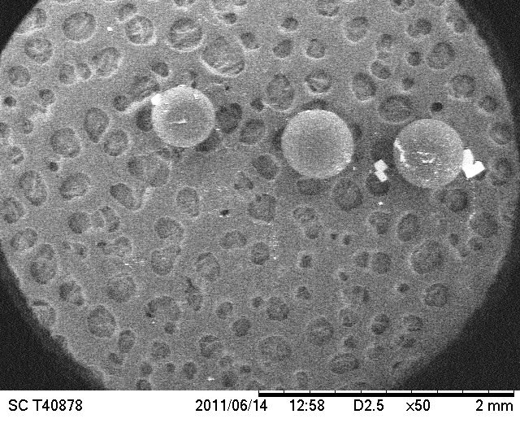
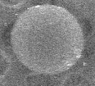
Ground Control Beads
A set of beads (50X Magnification)

Slide 8
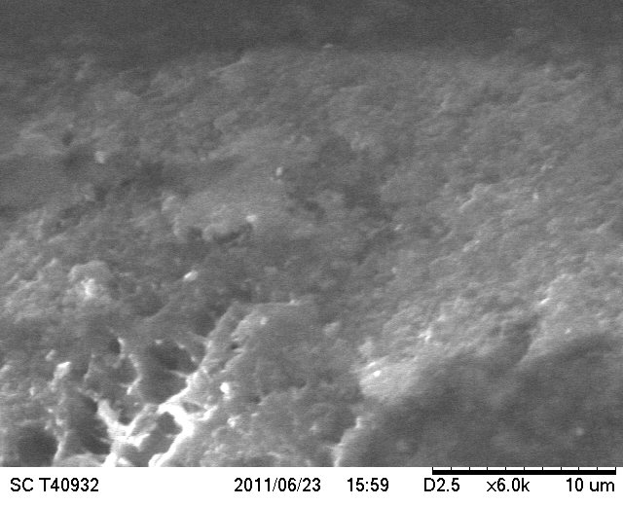
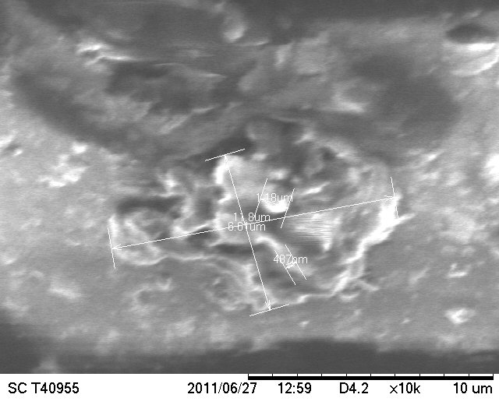
Biofilms at 6K and10K Magnification

Slide 9
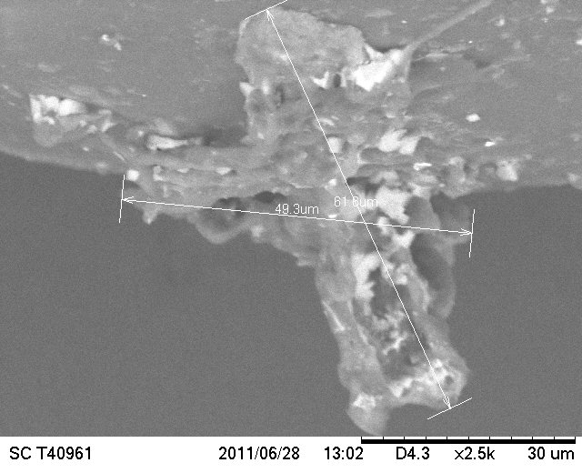
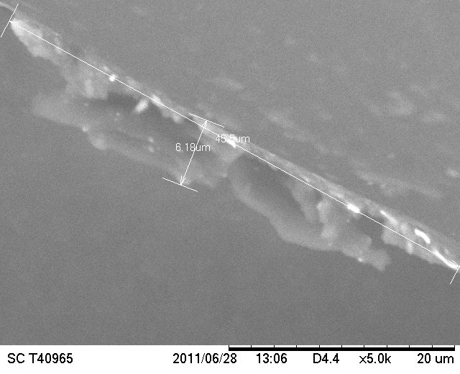
Ground Control Bead in Cross Section

Slide 10
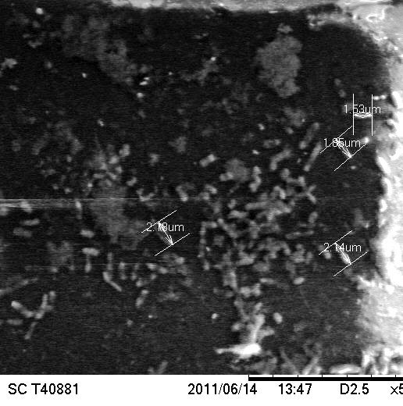
E. coli on Biofilms on Ground Control Bead at 5.0K Magnification

Slide 11
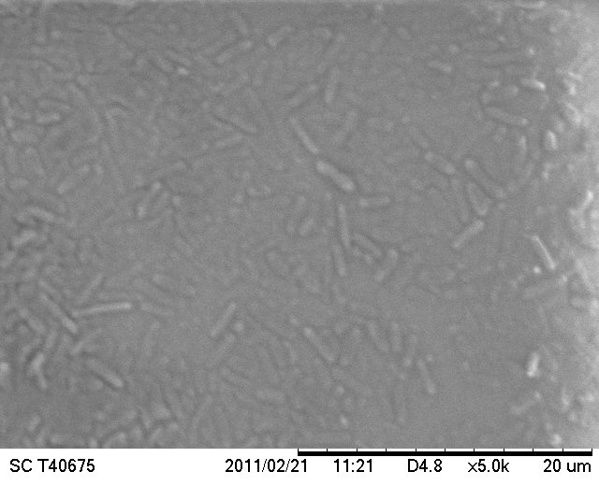
Biofilm Formation of E.coli at 5.0K Magnification
(Washed with Decolorizer)

Slide 12
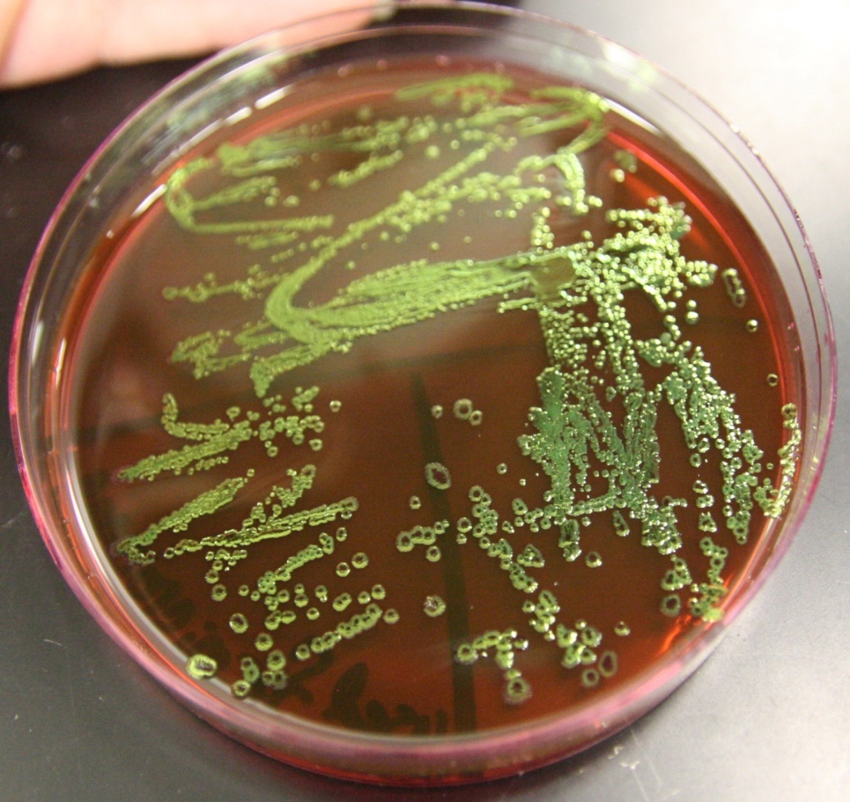
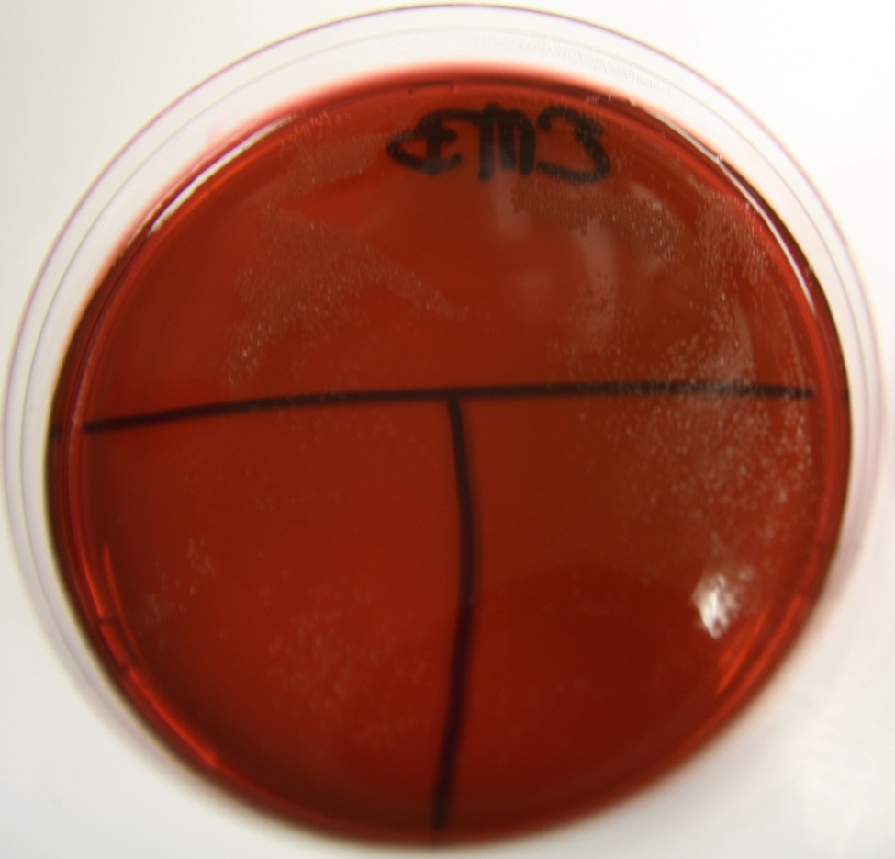
Ground Control (left), and Microgravity sample (right) Grown on EMB Media

Slide 13
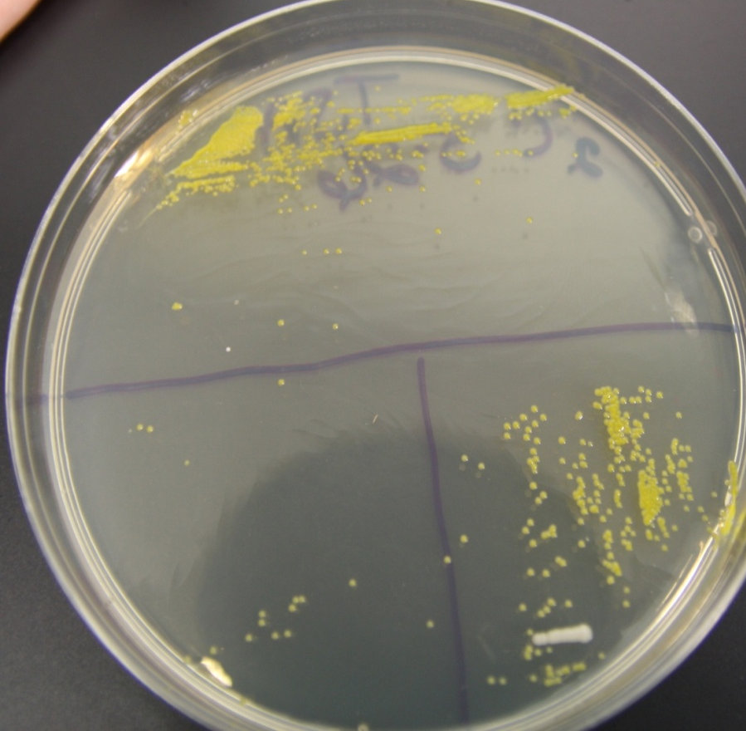
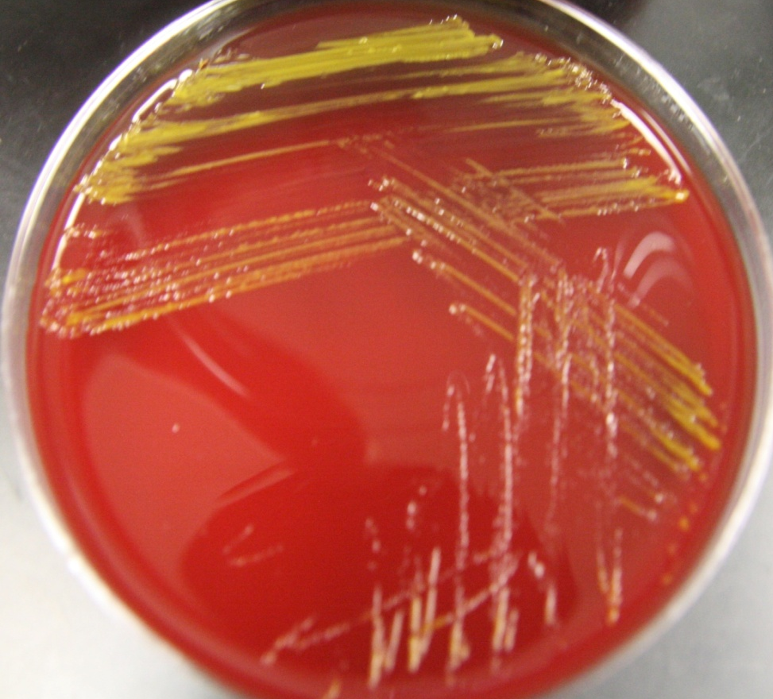
Bacteria from Microgravity Experiment on TSA Media (left), and Blood Agar (right)

Slide 14
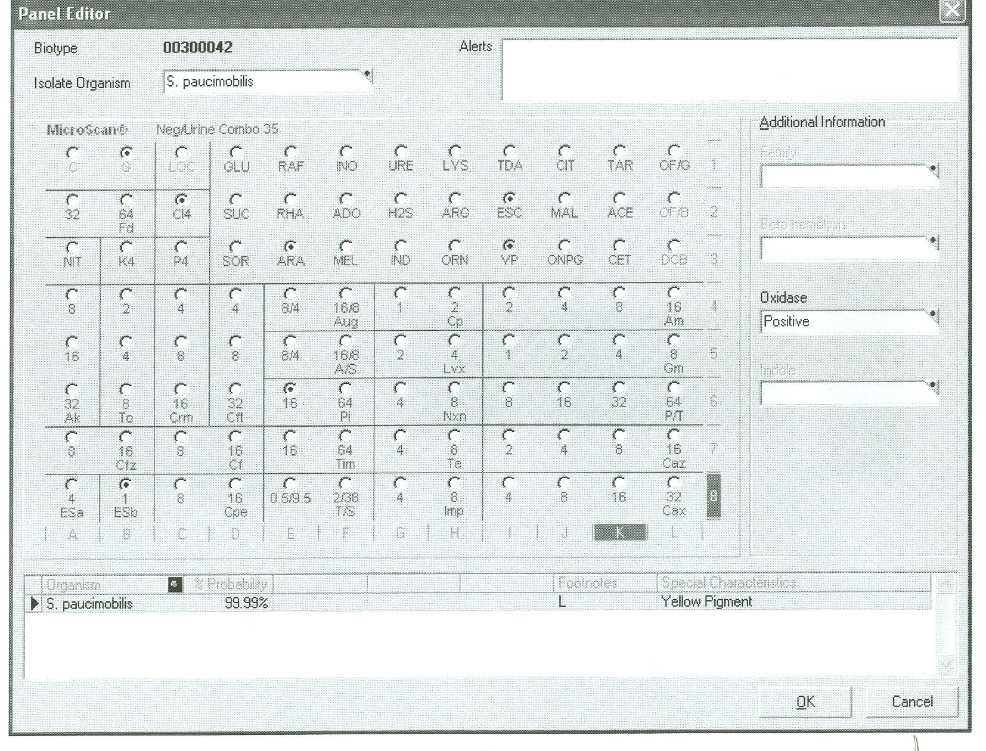
Identification of Bacteria that overgrew
E. coli
Sphingomonas paucimobilis at 99.99% Probability of Correct Identification

Slide 15
Results for Ground Control Samples
60% of the surface of the 500-µm polystyrene beads were covered by Biofilms
Biofilm size ranged from 11.6 X17.0 µm to 112X72.3µm
Biofilm thickness ranged from 267 nm to 6.18 µm
We were unable to recover E. coli from samples exposed to microgravity to determine biofilm characteristics
Experiment will be repeated on Atlantis

Slide 16
Acknowledgements
Jose Mendoza
Gloria Anchondo
Dr. Jeff Goldstein and SSEP Program
John Cassanto and ITA
This project was supported in part by:
Texas Space Grant Consortium
Foundation for EPCC
MSEIP Grant Number P120A080025
MBRS-RISE Grant Number 5R25GM060424
EPCC President’s Office

