Slide 1
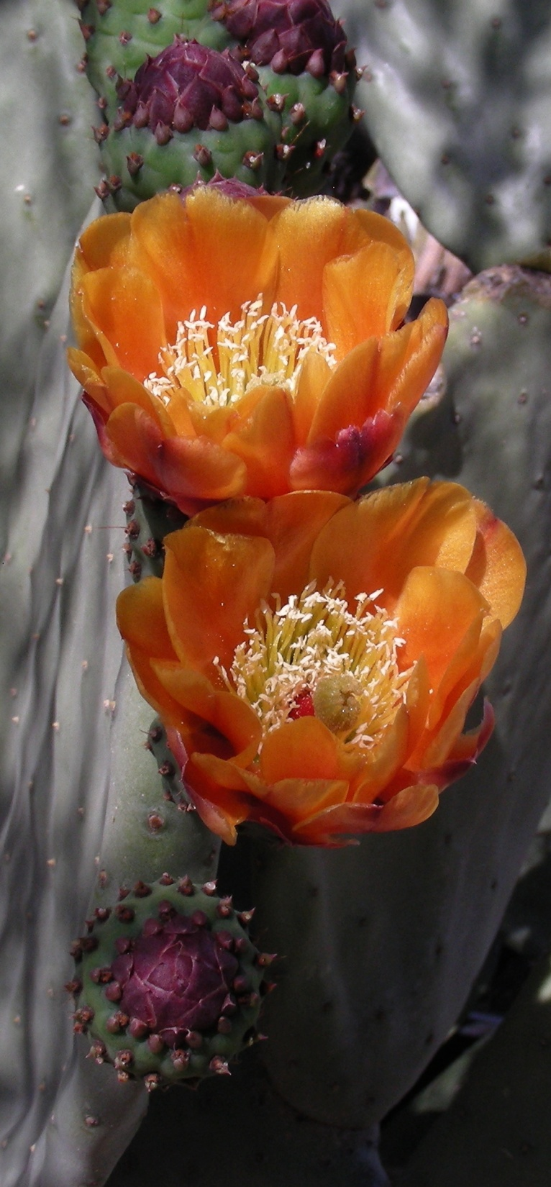
A Hobby Brings Unexpected Opportunities
By
Gertrud Konings-Dudin
El Paso Community College

Slide 2
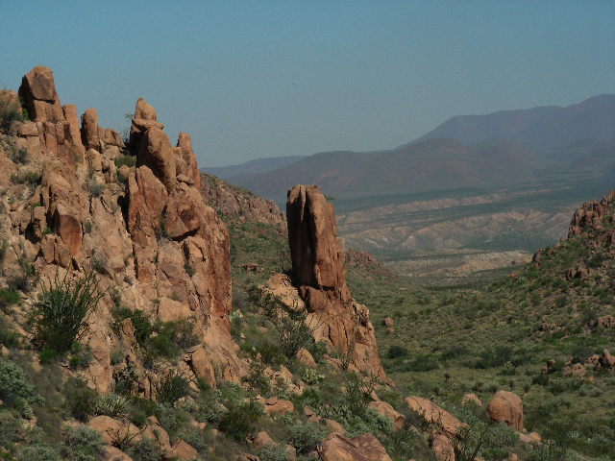
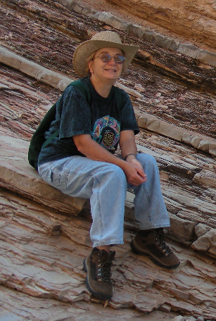

Slide 3
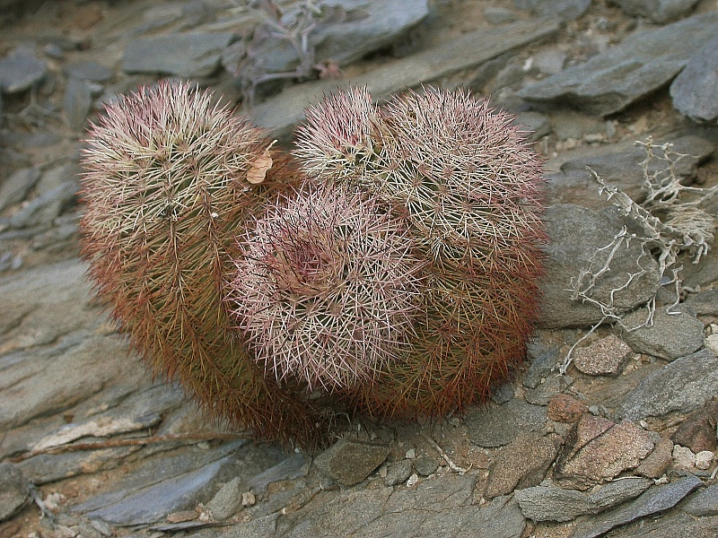
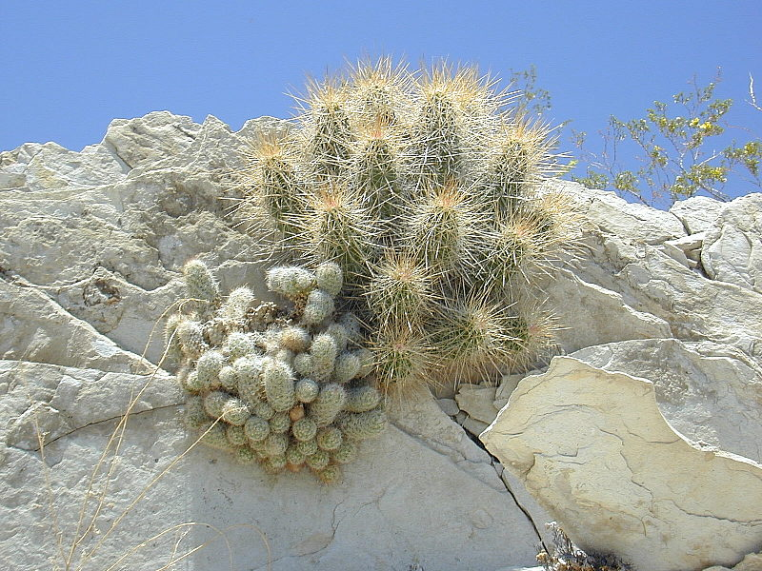
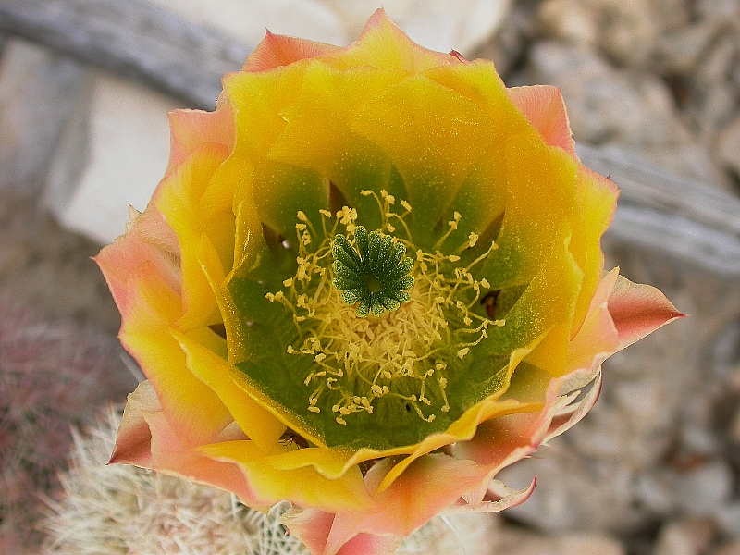
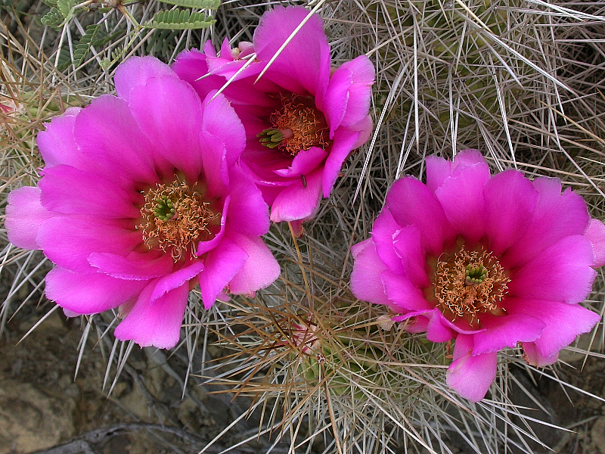
Echinocereus stramineus & Escobaria tuberculosa
Echinocereus dasyacanthus

Slide 4
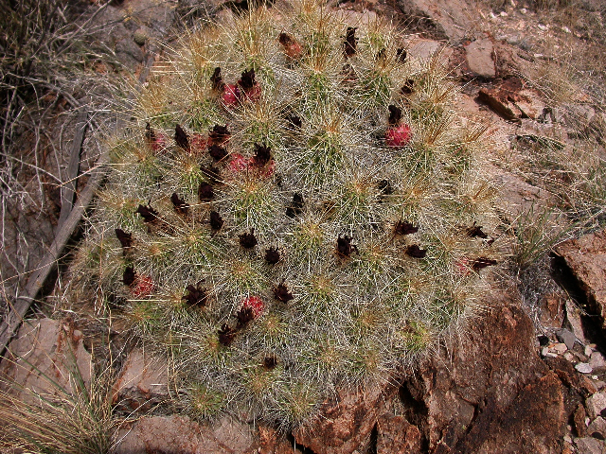
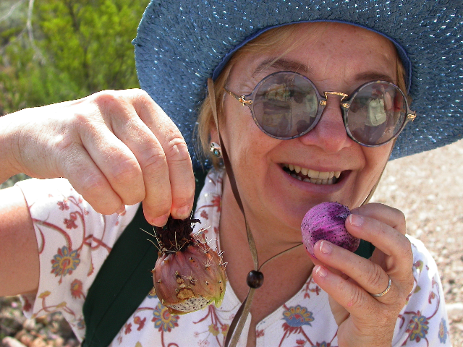
Common Name: Strawberry Cactus

Slide 5
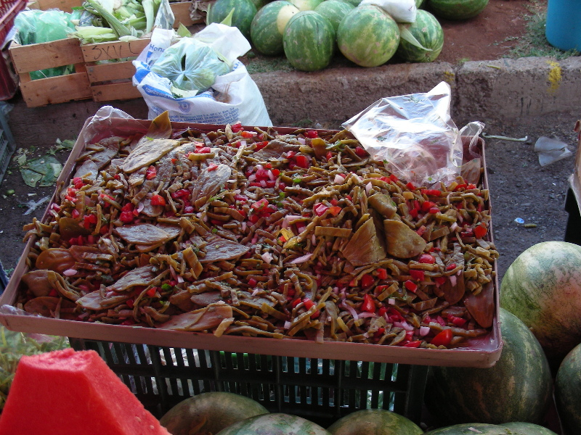
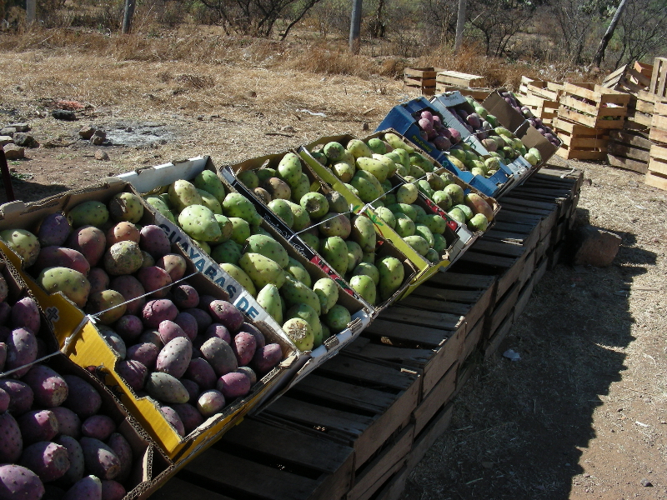
Markets in Mexico
Nopales
Tunas

Slide 6
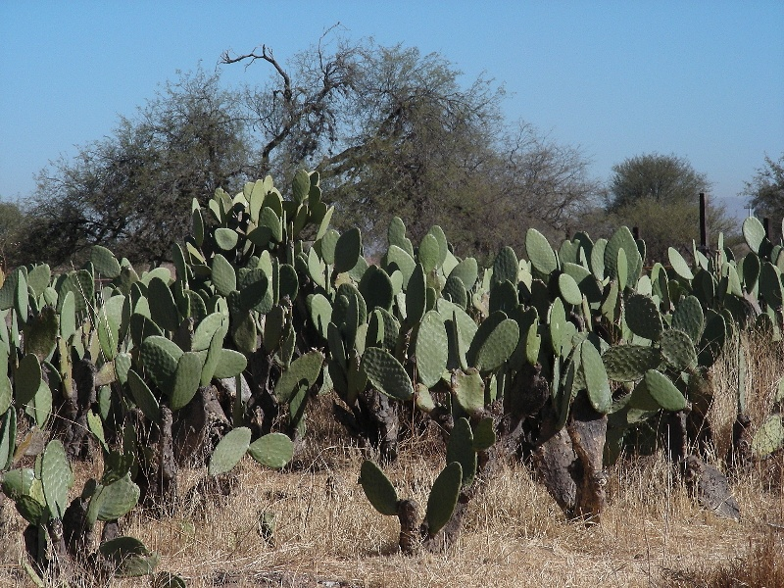
Yard with Indian Fig Prickly Pears

Slide 7
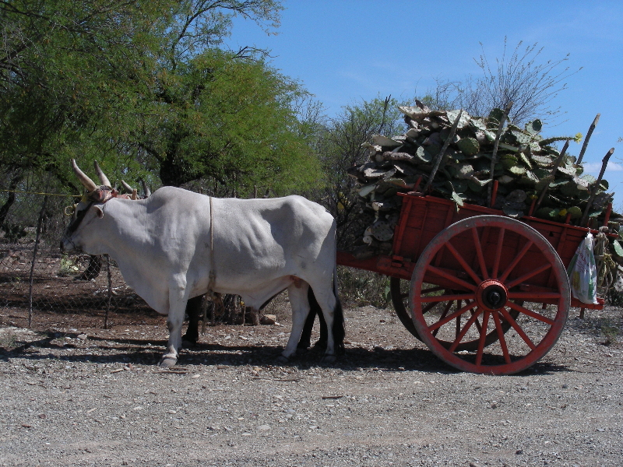
Fodder For Livestock

Slide 8
Specialties of Cacti
They tolerate poor soils and are pioneer plants
They tolerate extreme heat and sun exposure
There are high altitude cacti that tolerate freezing
Cacti need little water
Some cacti are very productive
Cacti are edible
Many have medicinal properties

Slide 9
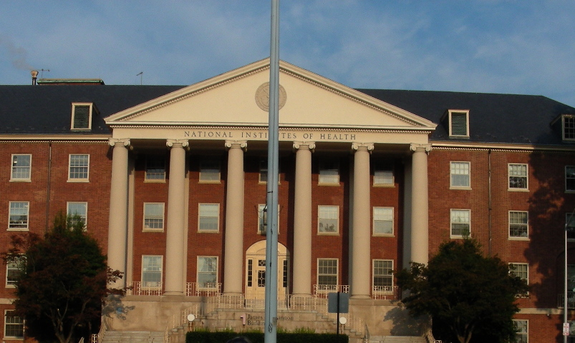
Short-Course in Genetics at NIH 2008

Slide 10
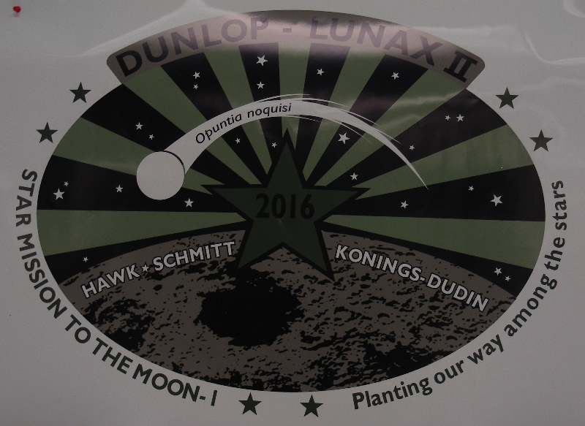
Providing an Atmosphere
NASA Project : "Carbon-Based Astronaut Advanced Life Support“
Principal investigator Dan Hawk, UW-Green Bay
In Collaboration with Cindi Schmitt, Divide, Colorado, High Altitude Agriculture

Slide 11
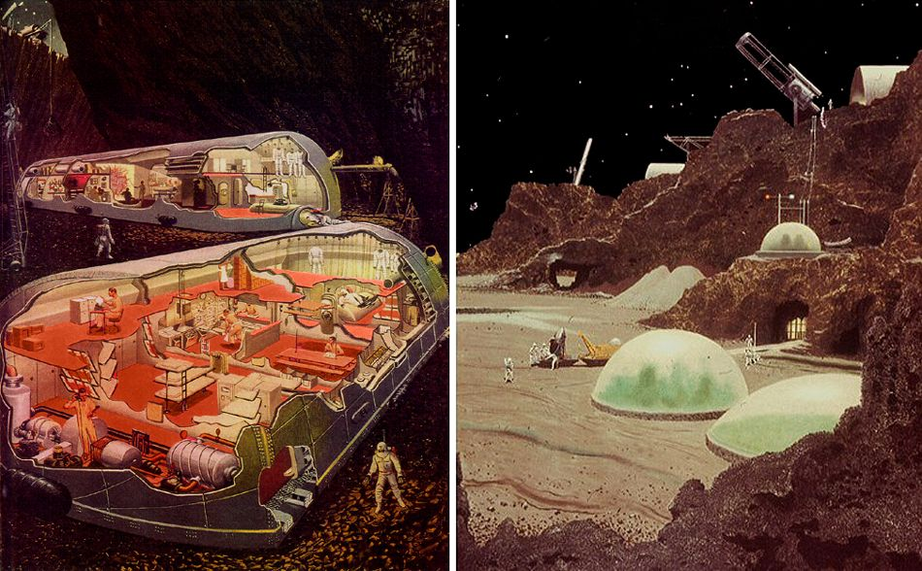
From: The Launch Pad – X Prize Foundation – Unknown artist design

Slide 12
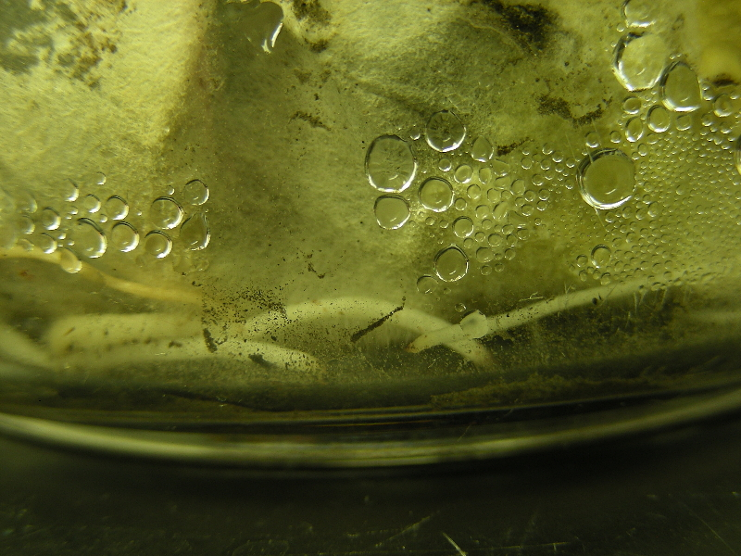
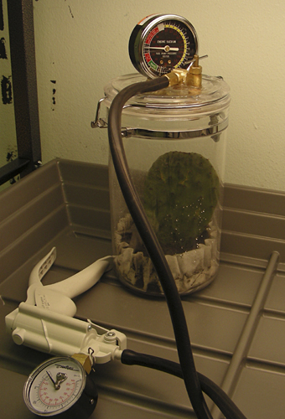
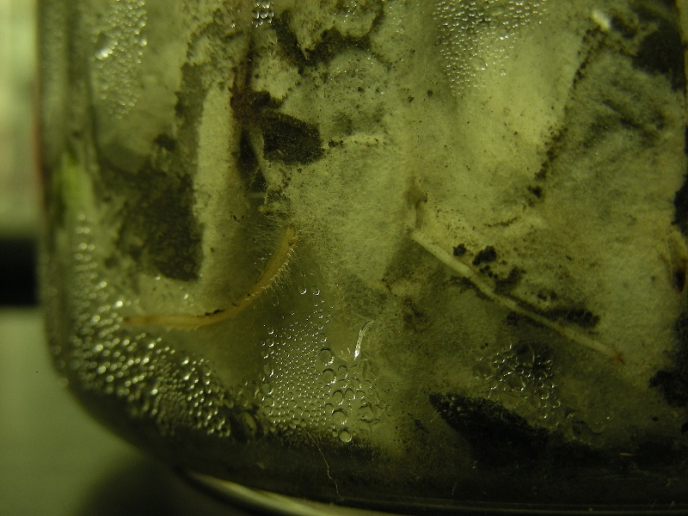
Opuntia ficus-indica in a Vacuum Chamber
Atmosphere of 13,245 ft altitude

Slide 13
Join A Club!
EPCC
Native Plant Club
Transmountain Campus

