Slide 1
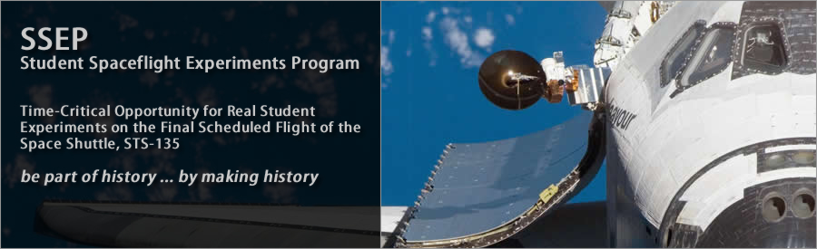
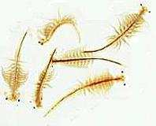
The Effect of Microgravity on Brine Shrimp Development
Northern Guilford
Greensboro,NC

Slide 2
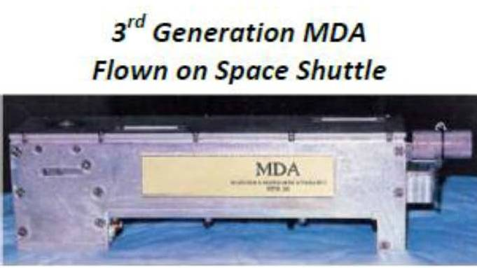
Scientific Background
Hypothesis: We believe that Brine Shrimp will grow larger in microgravity.
Materials: MDA type 2 slot(s)
123 microliters Distilled water
2 microliters Brine Shrimp Cysts
120 microliters 5% NaCl solution in distilled water
5 microliters Yeast Extract

Slide 3
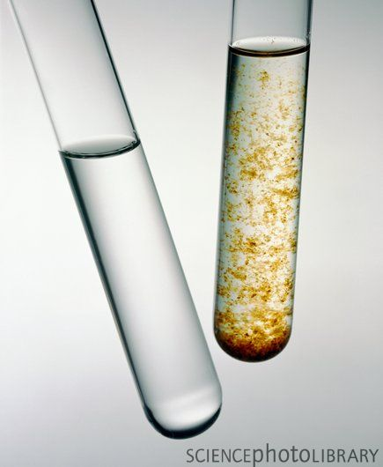
PROCEDURE:
Our research indicated that Brine Shrimp begins to grow in salinized water. Therefore we kept the cysts and the yeast/saline water separate until activated by the astronauts.

Slide 4
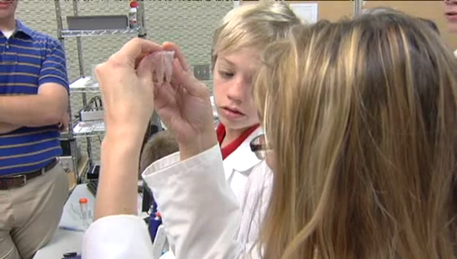
Data/Observations
Visual observations found:
space sample more clouded, slightly copper in color
Earth sample fluid was clear, less volume
remained

Slide 5
Optical Microscope Images

Slide 6
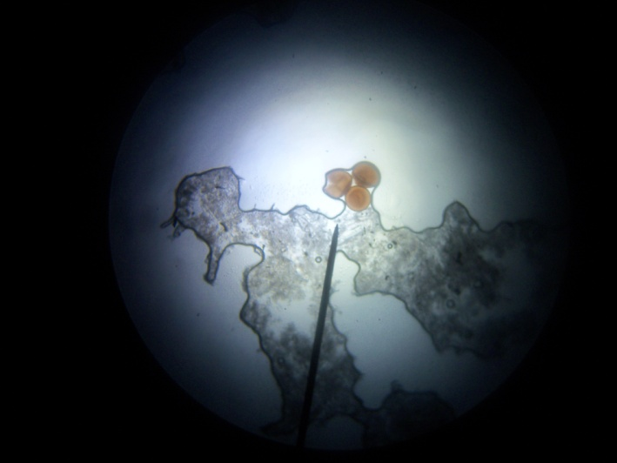
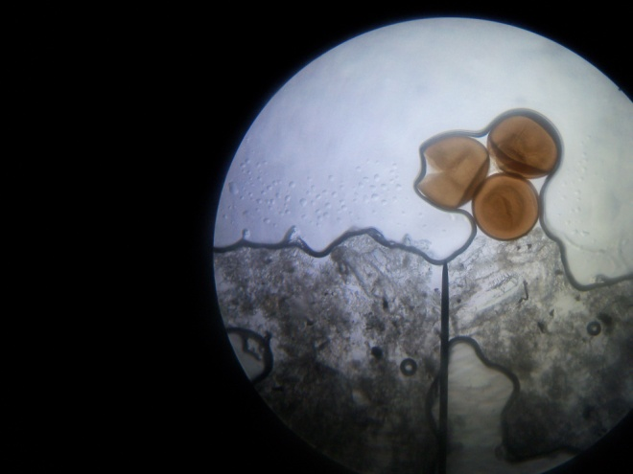
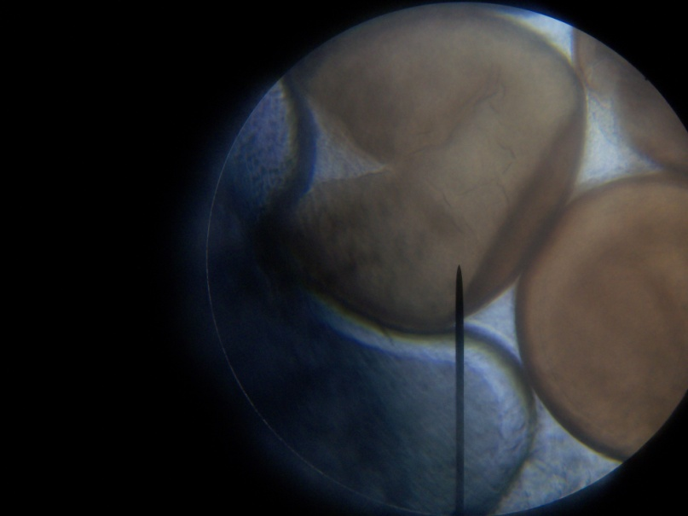
Optical Microscope Images

Slide 7
Helium Ion Microscope Image

Slide 8
Helium Ion Microscope Image

Slide 9
Helium Ion Microscope Image

Slide 10
Helium Ion Microscope Image

Slide 11
Helium Ion Microscope Image

Slide 12
Helium Ion Microscope Image

Slide 13

Conclusion
Our experiment results do not reflect the hypothesis we suggested. However, it did reveal many items of interest to us and we are continuing the inquiry process using duplicate earth experiments and further researching our microscopy images with professionals in marine biology.

Slide 14

Analysis
Based on our images of the “globules” in the space sample we are wondering if they could be the yeast that we put in as food for the Brine Shrimp. We have sent images to a lab on the NC coast for another opinion about what we are looking at.

Slide 15
Analysis
Based on our lack of hatchlings we are wondering if the water was too salty, the space was too small, the eggs were “duds” or if some did hatch and we were unable to retrieve them as whole creatures because of the size of the testing area.

Slide 16
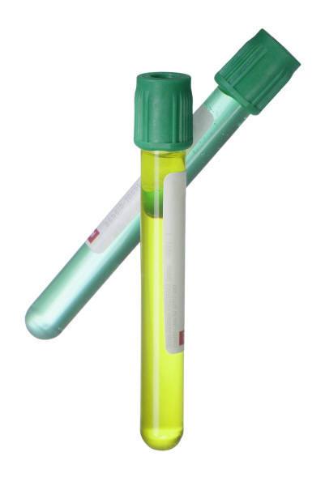
Moving Forward
To help answer some of our new questions:
We will test using the same salinity along with lower salinity environments (eggs from the same batch)
We will test dying the yeast so that we can track whether or not they are the “globules” in our results
We will test using standard 10 ml test tubes with the same salinity and lower salinity (eggs from the same batch)

Slide 17









Thank you

Slide 18
Data/Observations
Optical Microscopy observations:
Space sample: many “globule” like spheres clustered together, reddish tint, no detectible Brine Shrimp
Earth Sample: Clear fluid with white “stripes”, cysts :some intact, others broken open, no detectible Brine Shrimp

Slide 19
Data/Observations
Helium Ion Microscopy observations:
Space Sample: Broken/Cracked Cyst surrounded by “globules” They seem attracted to the opening in the egg
Earth Sample: Two Cysts that appear to be hooked together, one is more smooth on the exterior than the other.

