Slide 1
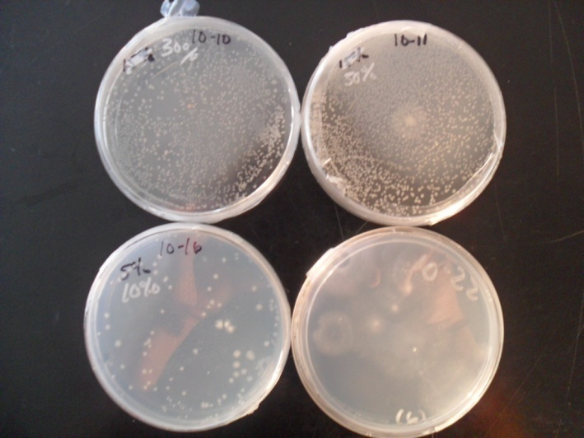
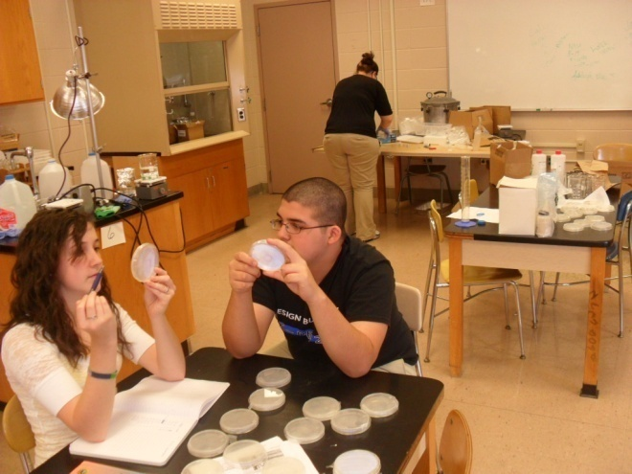
The Academy @ Shawnee Jefferson County Public Schools, Louisville, Kentucky
The Effect of Micro-Gravity on the Viability of Lactobacillus GG

Slide 2
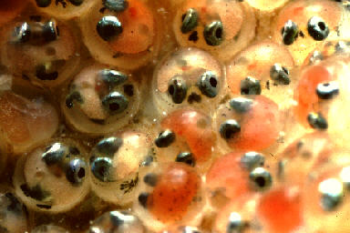
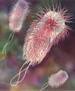
Working Toward Our Project
Crystals, E. coli, fish egg’s, penicillin
limitations- size, materials, food/nutrients and conditions/monitoring.
WHY?
Cosmonaut and bacterial research.
Used everyday, cultural bacteria, and acid resistant
Currently not implemented in NASA diet

Slide 3
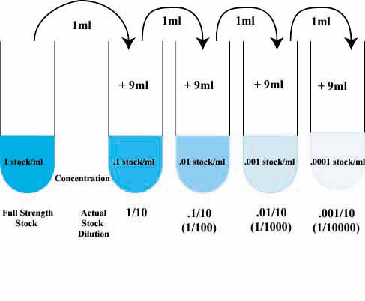
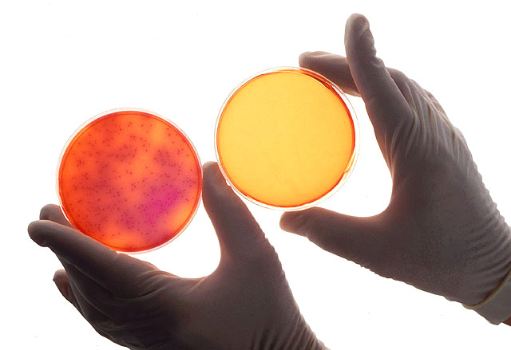
Experimental Methods
Serial Dilutions helped us get down to 9 million bacteria per milliliter.
Needed 9 million for optimal growth and counting without overcrowding
Plating the bacteria allowed us to view bacterial growth

Slide 4
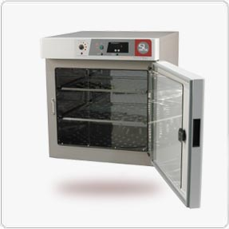
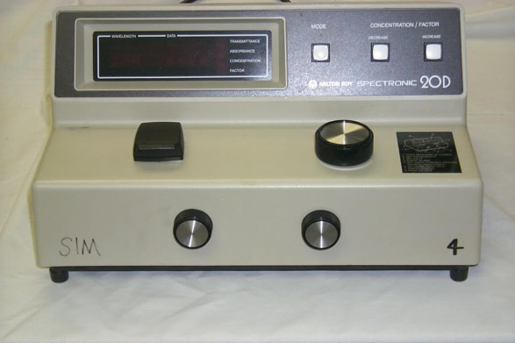
Experimental Methods cont.
The Incubator allowed us to control the environment of the bacteria
The Spec 20 was another form of counting bacteria, but only the presence of the bacteria was accounted for

Slide 5
Results
-curve for space growth is inconsistent
-curve for Earth growth is smoother, but counter to our expectation
-measurements appear to converge at -20 and -25

Slide 6
Results
-curve for space increased its count over two days, especially at -15, slower growing
-curve for Earth doesn’t show the same shape as before
-the convergence at higher dilution factors remains, beginning at -15 here

Slide 7
Limitations
Delayed delivery of Lactbacillus GG to school
Length of experiment time vs. actual time needed
Trouble with bacteria growth on R2A Broth
Inconsistent CFU count
Some plates were contaminated
No sterile environment

Slide 8
Conclusions
There is a slightly elevated growth difference in the space samples; however, the difference between the two is extremely small.
Taking our limitations under consideration, our experiment indicates that micro-gravity has little to no effect on the growth of bacteria.
How would our results differ if..
The experiment time was extended?
We had put the bacteria under stress?
We had up-to-date technology?

