Slide 1
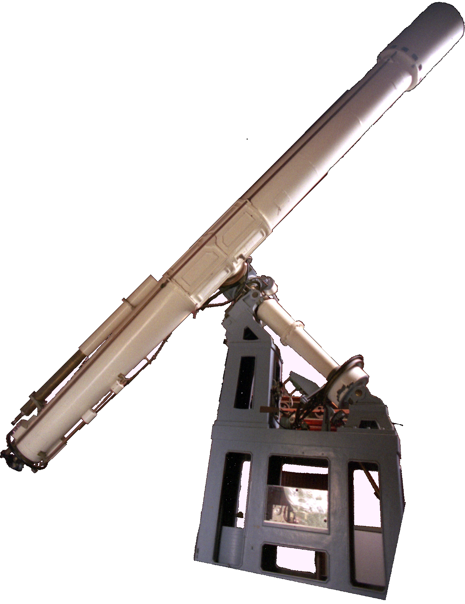
Tim Livengood
Observatory
apologies to Anne Tyler

Slide 2
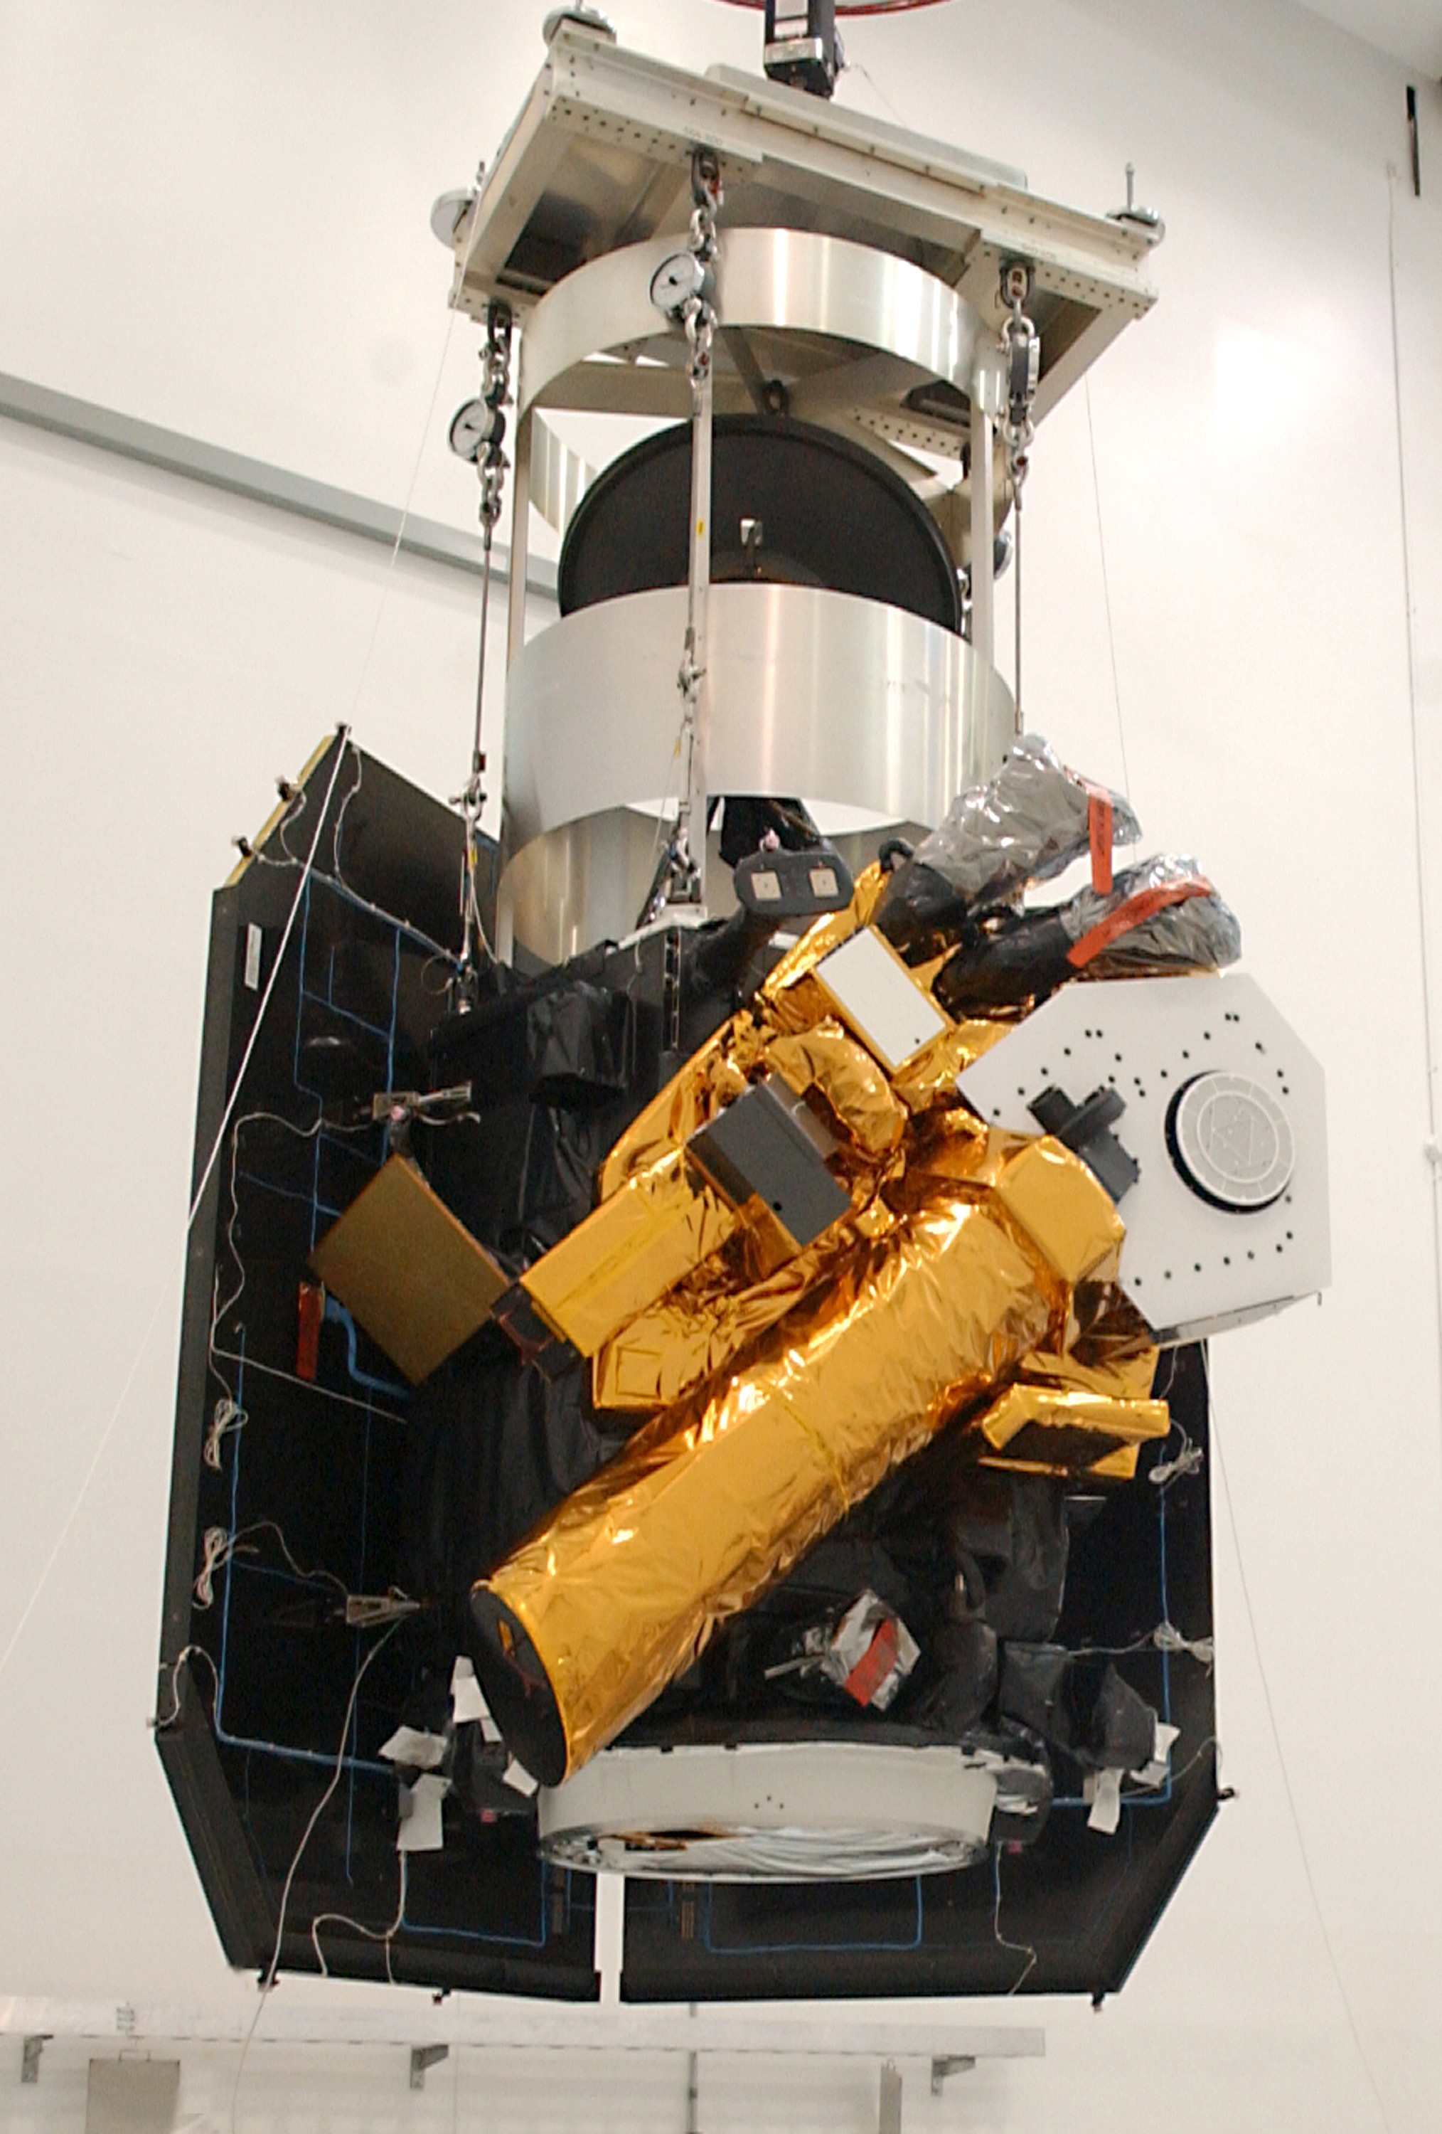
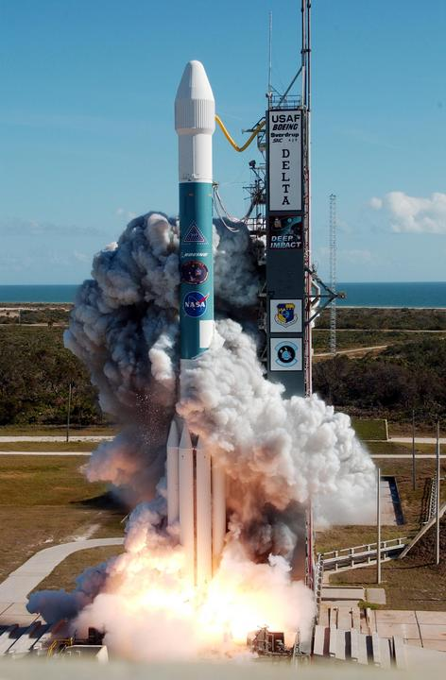
Deep Impact
Flyby
Impactor
12 Jan 2005

Slide 3
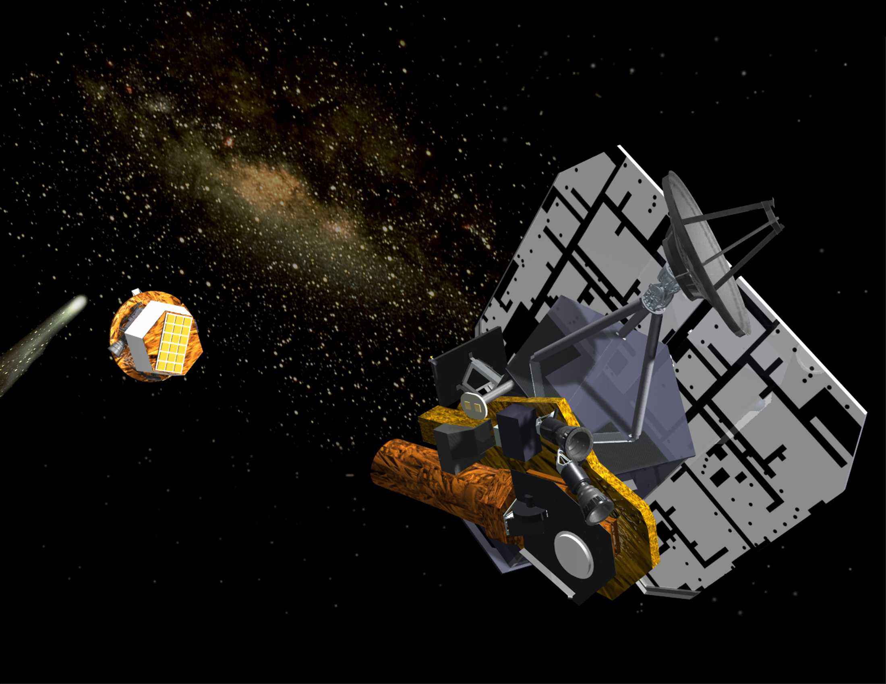

Slide 4
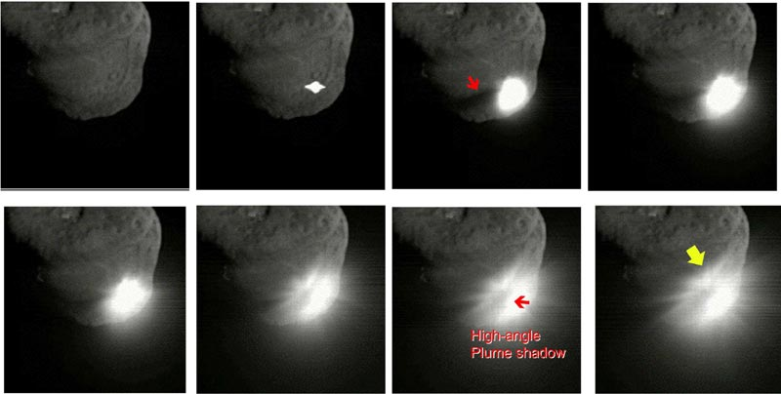
4 July 2005
BOOM!

Slide 7
Deep Impact Flyby Instruments
Medium Resolution Instrument (MRI): broad field of view, narrow-band filters
High Resolution Instrument, Visible (HRI-VIS): narrow field of view, 100 nm filters, sample whole visible spectrum, poorly focused
High Resolution Instrument, IR Spectrometer (HRI-IR): 1–4.8 µm low-resolution prism spectrometer

Slide 8
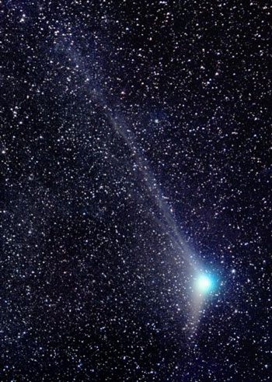
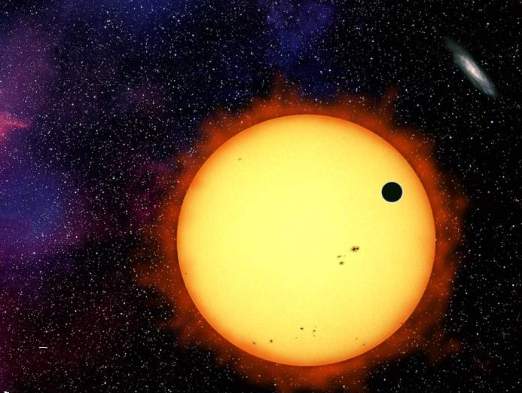
EPOXI is
EPOCh
+
DIXI
This is the EPOCh part
This is the DIXI part

Slide 9
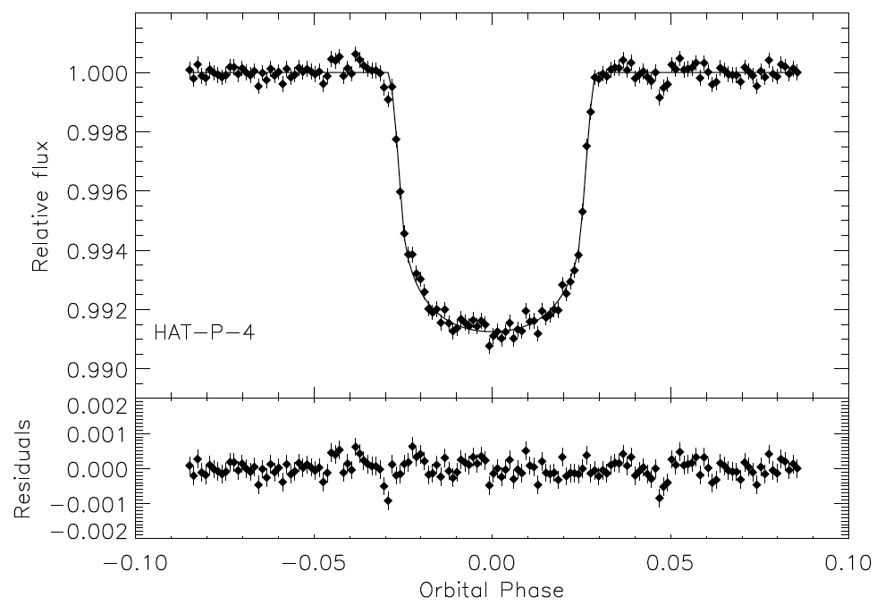
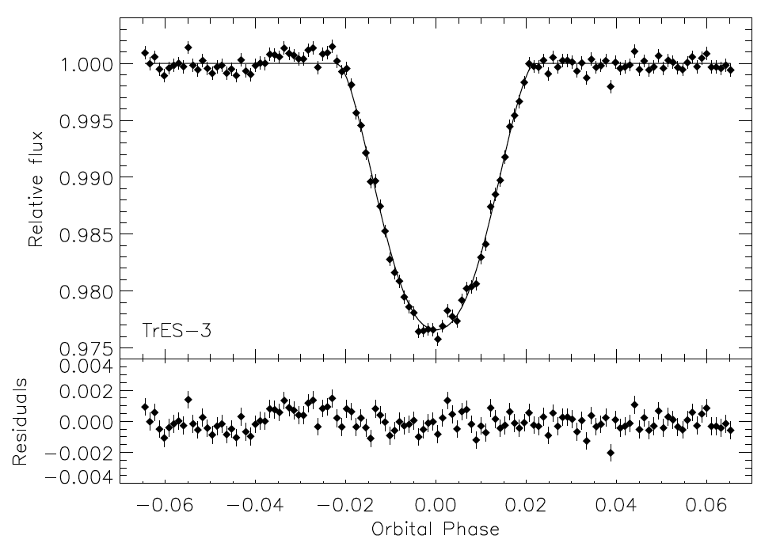
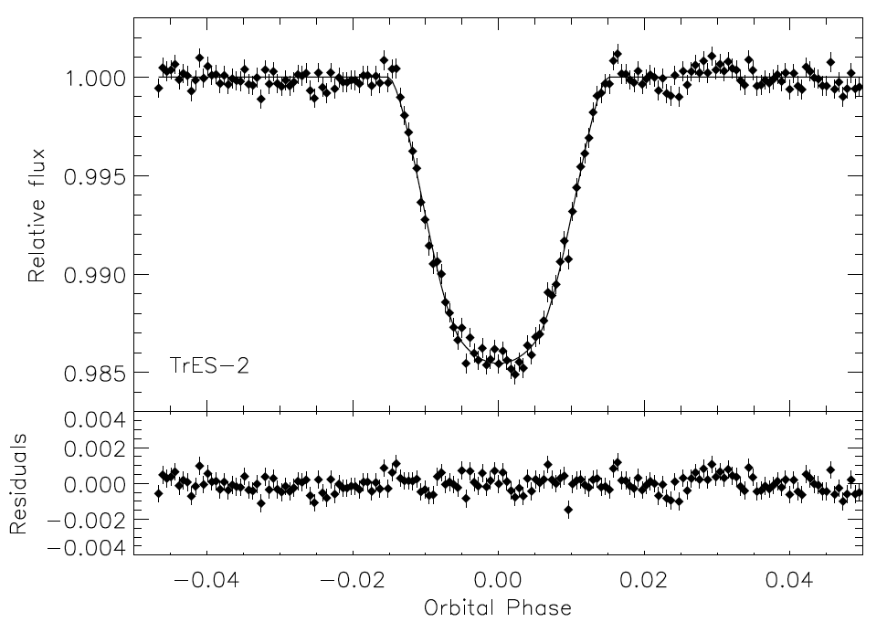
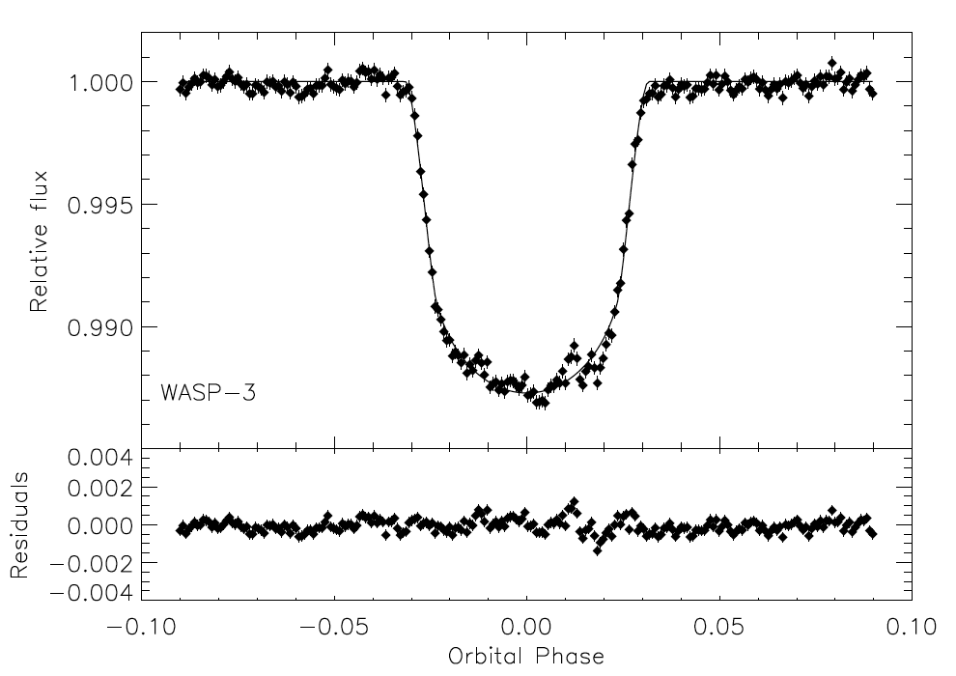

Slide 10
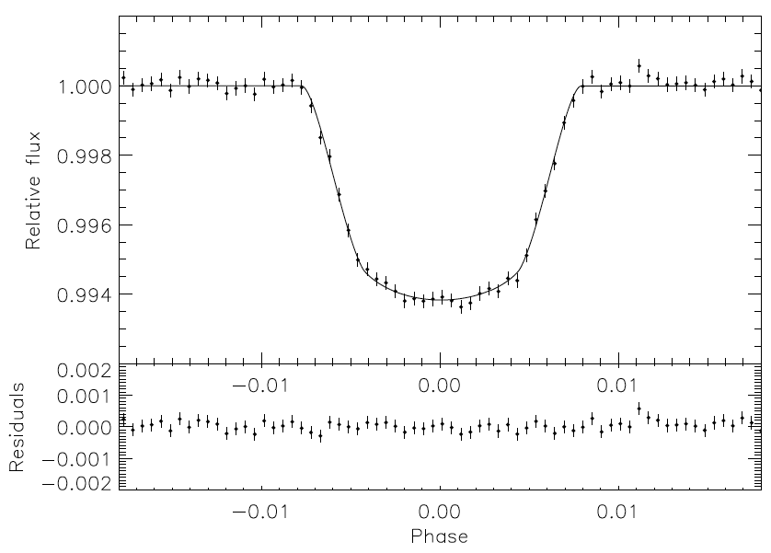
GJ436 phased and binned light curve

Slide 11
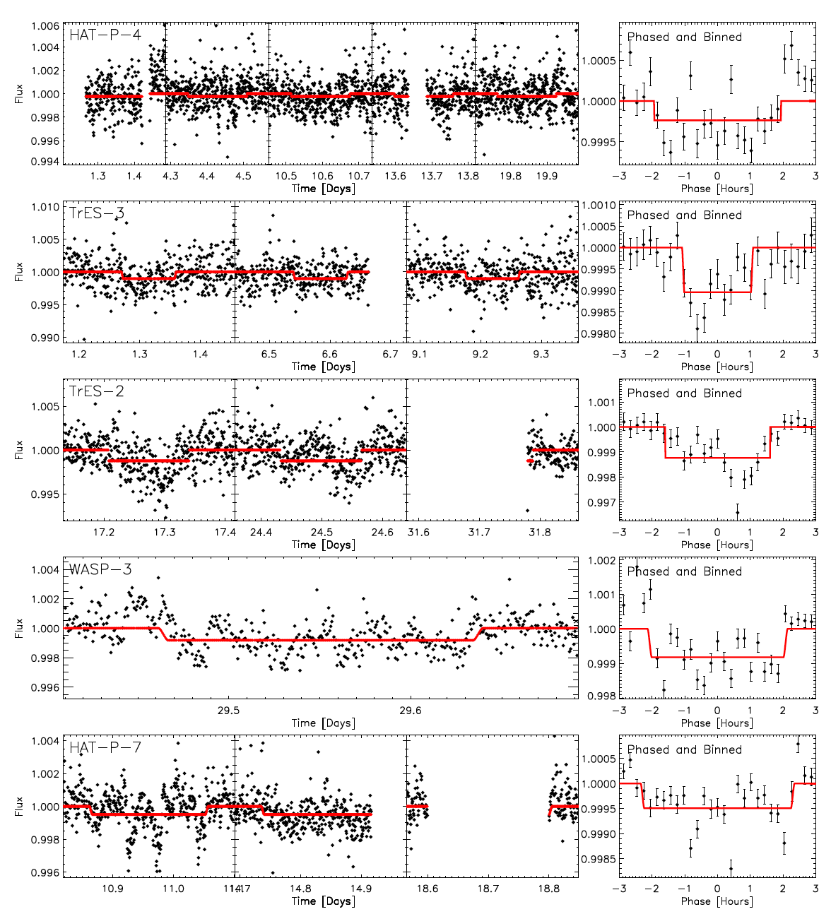

Slide 17
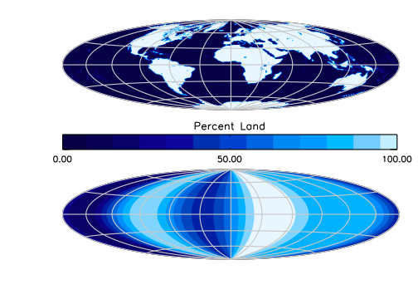

Slide 18
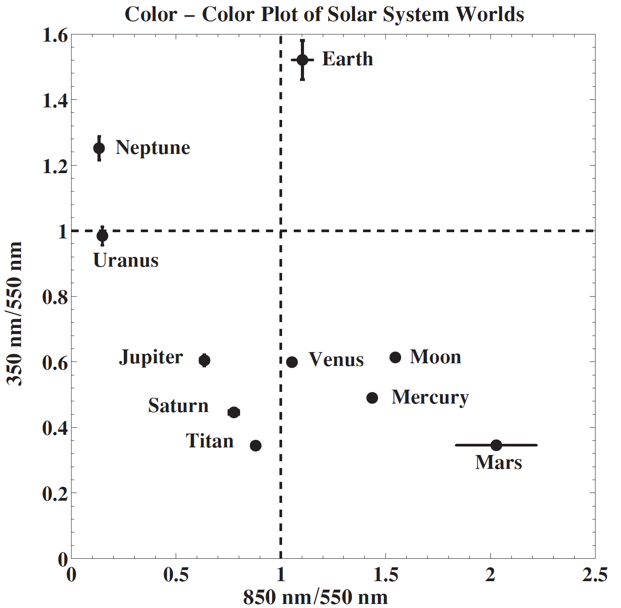

Slide 19
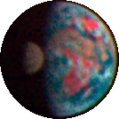
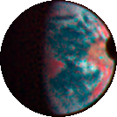
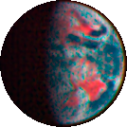
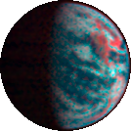
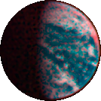
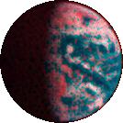
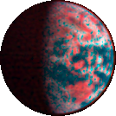
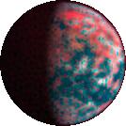
Lunar transit

Slide 21
Hydration

Slide 23
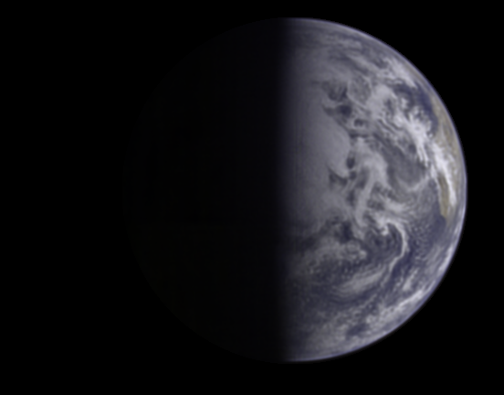
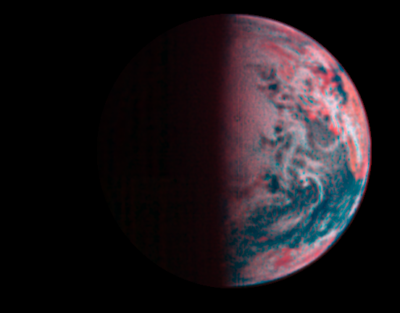
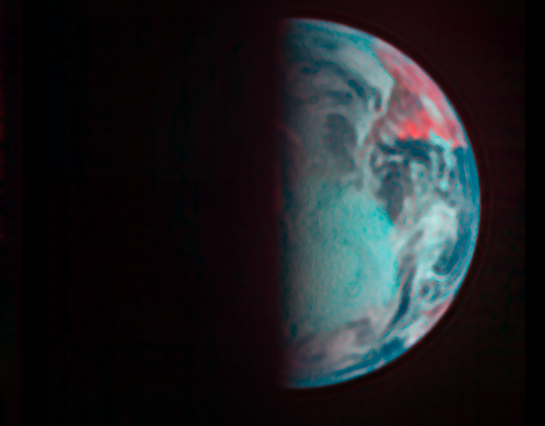
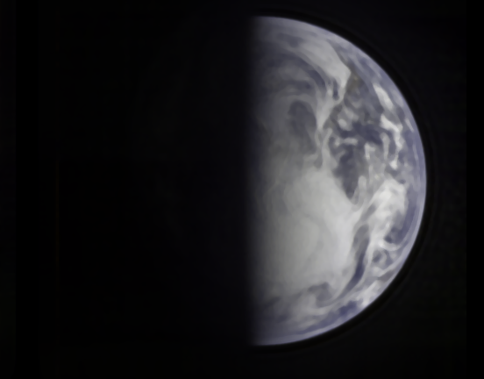

Slide 24
CO₂
CO₂
CO₂
CH₄

Slide 26
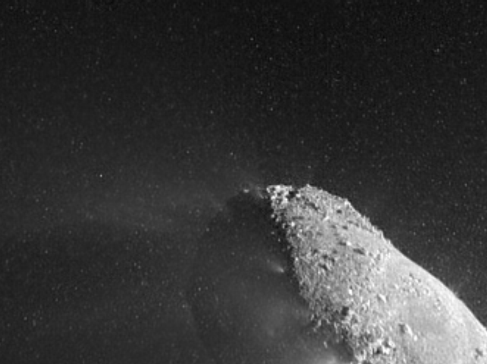
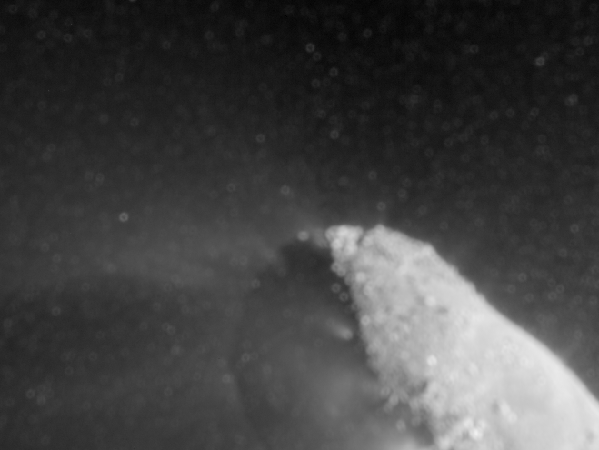

Slide 28
20 Mar – 19 Apr 2014
3 Jul – 14 Aug 2013
18 Dec – 14 Jan 2013
22 Oct– 30 Nov 2014
10 Mar – 20 Apr 2012
17 Sep – 13 Oct 2011

Slide 30
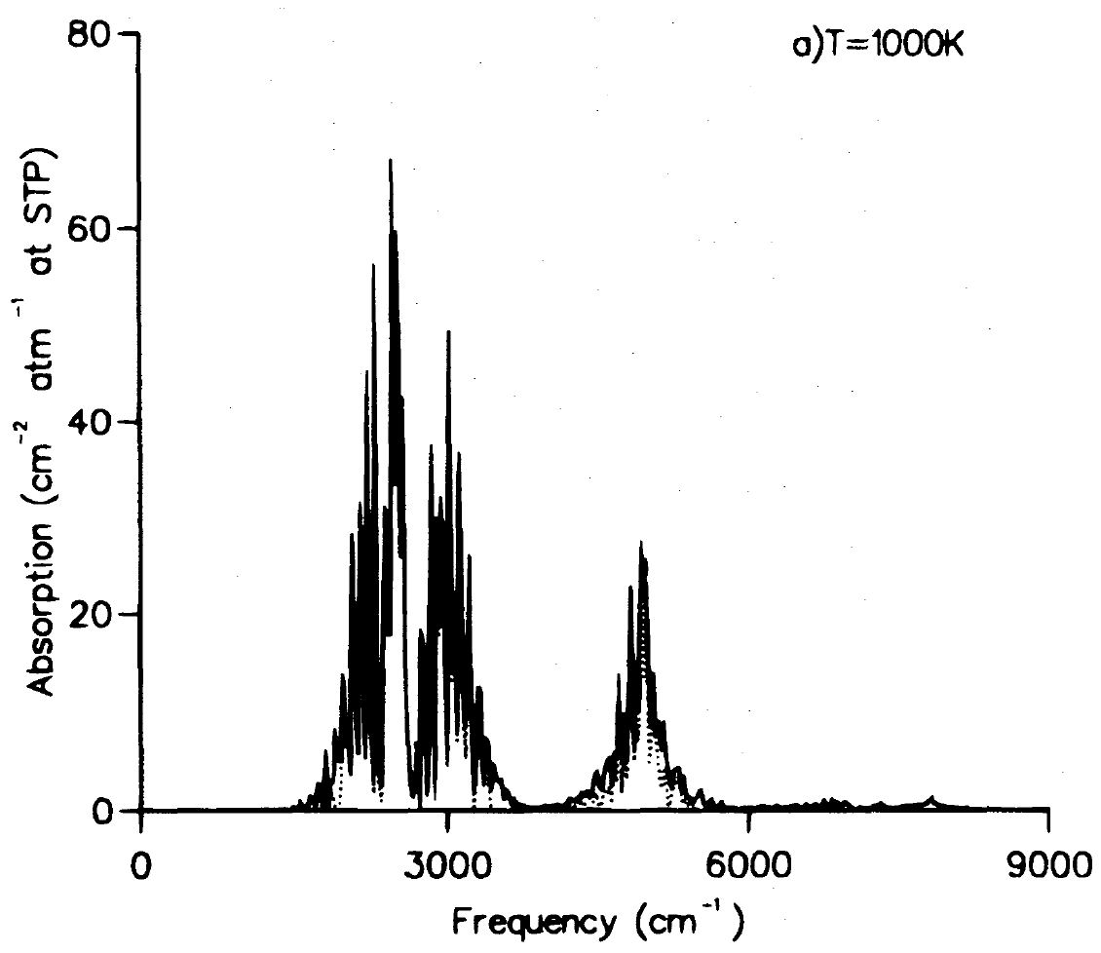
H₃⁺ at
3.3 µm
HRIIR Range

Slide 31
Deep Impact Astronomical Telescope Mission (DIATeM)
New access to planetary targets
Enabled by heliocentric orbit
Access to spectral regions not possible from Earth
Important science can be done with a space telescope that is smaller than Hubble
Why not build an Intentional Observatory like this?

Slide 32
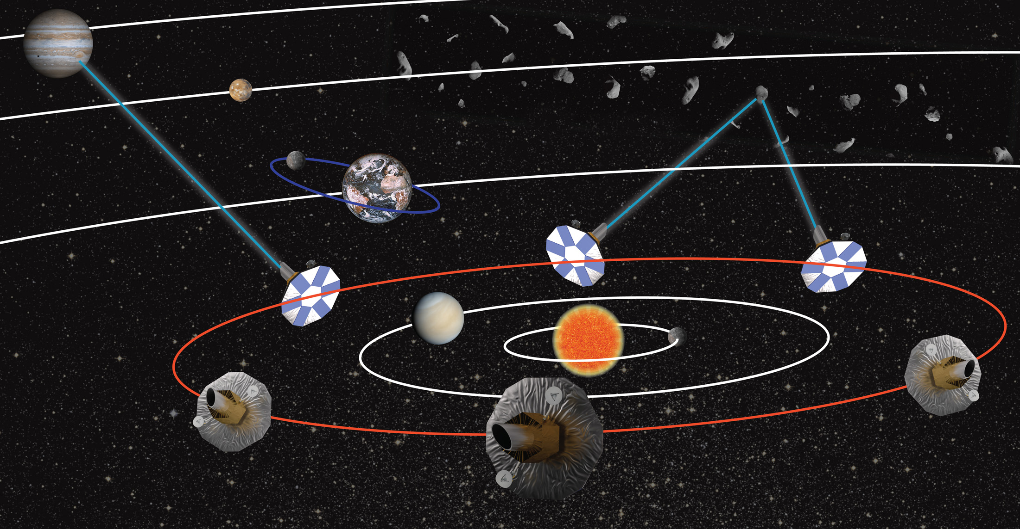
Constellation of Astronomical Telescopes in Heliocentric Orbit for Deep-space Exploration (CATHODE)
CATHODE will encircle the Sun with a fleet of telescopes of modest individual capability to form a single observatory, looking outwards for continuous access to wavelengths blocked by Earth’s atmosphere and continuous access to daylight targets. All objects outside the constellation will be available at all times – no event need go unobserved. Joint observations by two or three elements can furnish instantaneous parallax and stereoscopic views of time-varying events and orbital motion. High-rate I/O over interplanetary distances can enable a relay to support interplanetary human spaceflight.

