Slide 1
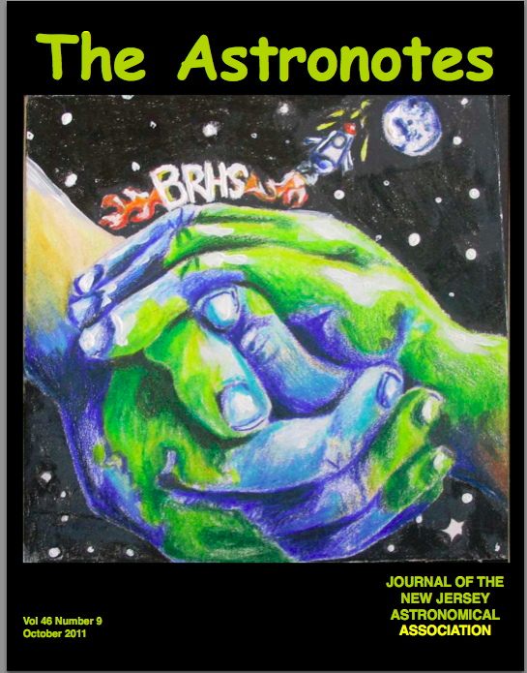
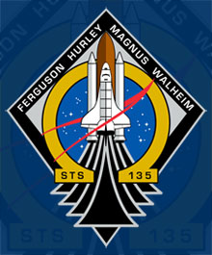
Effects of Microgravity on Osteoblastic Bone Reformation
Principle Investigators: Adam Elwood, Joseph Avenoso, Gage Cane-Wissing
Co-Investigators: Alex Belly, Rotem Herzberg, Tejas Patel
Co-Directors: Dr. Jorge Valdes, Mr. Michael Herbst
Tessa Lewis

Slide 2
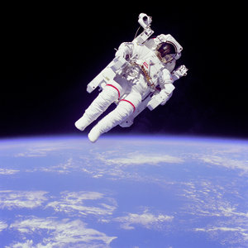
The Motivation
Bone mineral density (BMD) is lost at rates of up to 1.6% per month.
~10X postmenopausal osteoporosis
Recovery needs >2X time spent in micro-gravity
Could inhibit missions to Mars and beyond
McCarthy et al., 2000; LeBlanc et al., 2000; Lang et al., 2004
Notes:
Gage – Motivation comes from the fact that astronauts have trouble with bone loss in space- 10x as fast as postmenopausal osteoporosis

Slide 3
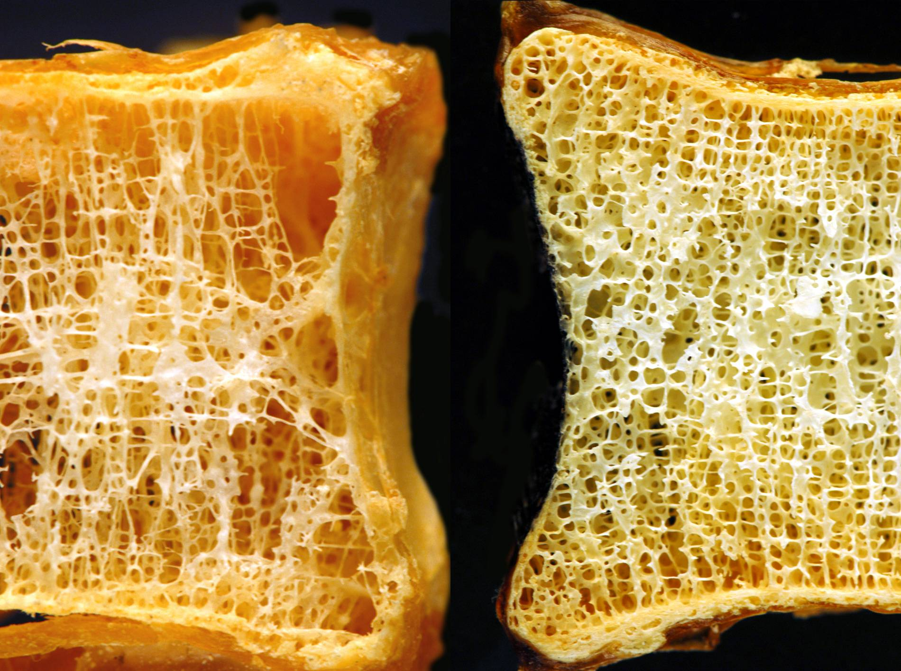
Osteoporosis
Osteoporotic
Normal
Fritton & Schaffler, 2008 “Bone Quality”
Courtesy of Michael J. Klein, M.D.
Notes:
Gage – Imbalance between osteoclast cells and osteoblast cells

Slide 4
Osteoblast Bone Cells – How Broken Bones are Repaired
Notes:
Gage – Osteoclasts clear out bone, osteoblasts create new bone

Slide 5
Experimental Protocol
Essential Question: Can human growth hormone be used to enhance bone growth in space?
Embryonic mouse osteoblast cells
DMEM nutrient broth
Human Growth Hormone
Research supports use of human growth hormone with mouse bone cells
Control Group
Monitored at UMDNJ
Notes:
Joe -

Slide 6
Progression of the Experiment
Cells launched
Growth hormone added a day later
Control group exhibits confluence
Control cells begin to die ten days later
Similar timeline for cells in space
Notes:
Adam –

Slide 7
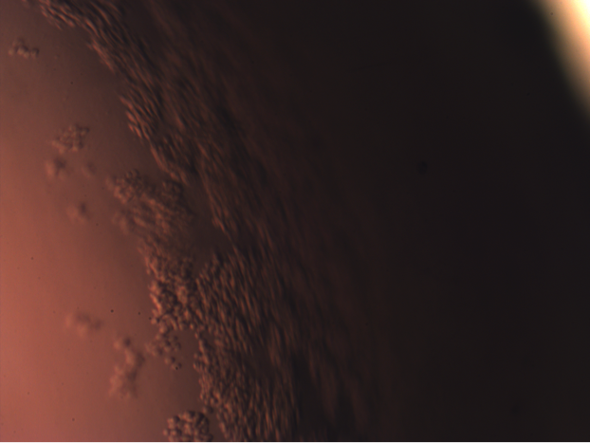
Osteoblast Cells (Control Group) on Launch Date
UMDNJ Department of Orthopaedics

Slide 8
The Experimental Results
Comparison of experimental and control groups yield similar results
Confluence, amount, and differentiation
Resuscitation of cells with oxygen and nutrients
Analysis on survivor cells requires long incubation periods
Notes:
Adam – hike story: in a desert with friends without food/water for 2 weeks; but we had restraints, we knew that the cells needed oxygen and nutrients; some cells could be resuscitated which is surprisingNASA used the best conditions possible, our cells were deprived of oxygen and nutrients due to experimental restraints, however both experiments yielded similar results; osteoblast cells are delicate cells and die easily

Slide 9
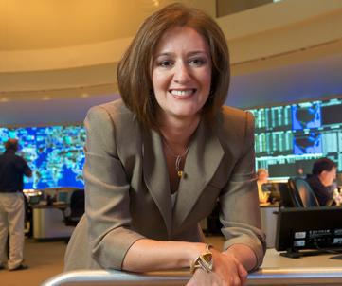
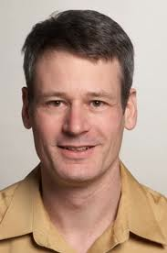
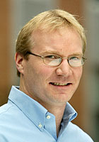
The Sponsors & Collaborators
Dr. Alicia Abella
AT&T Labs
Dr. Chris Fritton
UMDNJ
Professor Mark Zondlo
Princeton University
Notes:
Adam – Then Q&A session w/ slide in background

