Slide 1
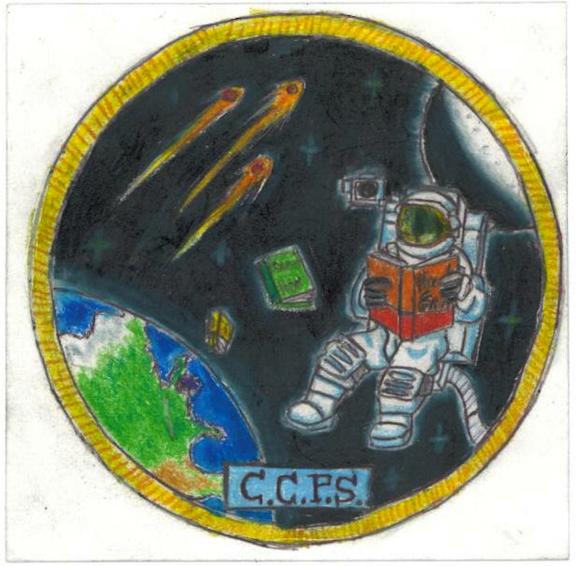
The Physiological Effects of Microgravity and Increased Levels of Radiation on Wild-Type and Genetically Modified Caenorhabditis elegans
Paul Warren
ISS Mission One
Charles County, MD

Slide 2
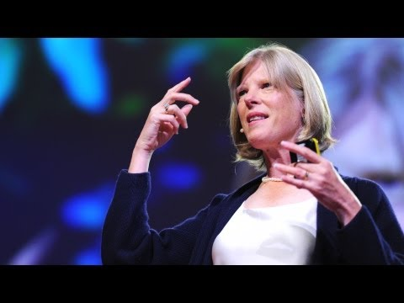
The Inspiration
“Experiments that hint of longer lives”
Insulin Pathway Mutations Longer Lives
Photos: Cynthia Kenyon: Experiments that hint of longer lives | Video on TED.com. (n.d.). TED: Ideas worth spreading. Retrieved June 21, 2012, from http://www.ted.com/talks/lang/en/cynth

Slide 3
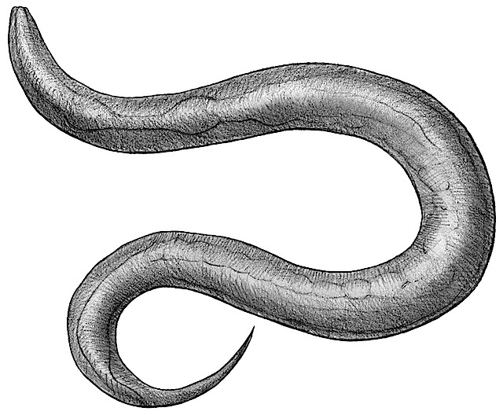
The Organism
Caenorhabditis elegans
Model Organism
Short Life Cycle
Compact Genome
Stereotypical Development
Rapid Propagation
Microscopic Size
Common
Photo: links - Kaganovich Lab. (n.d.).Kaganovich Lab - home. Retrieved June 21, 2012, from http://www.kaganovichlab.com/links.ht

Slide 4
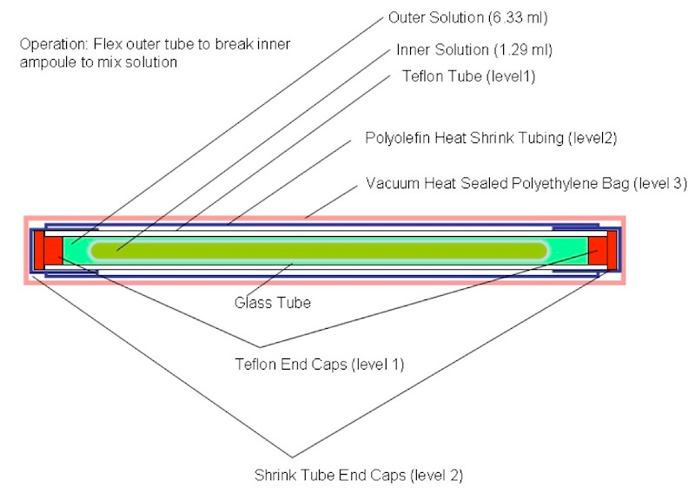
The Design
Fluid Mixing Environment Type 2
Photo: SSEP | SSEP Mission 1 to ISS: Mini-Laboratory Operation. (n.d.). SSEP. Retrieved June 21, 2012, from http://ssep.ncesse.org/current-flight-opportunities/ssep-mission-1-to-the-international-space-station-iss/ssep-mission-1-to-iss-mini-laboratory-operation/

Slide 5
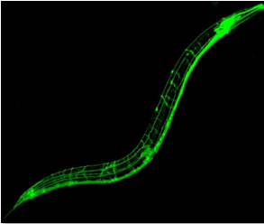
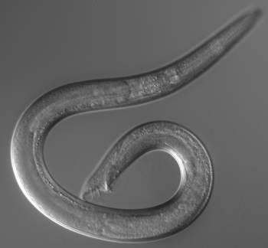
The Strains
Wild-Type GFP
DAF-16 Modified
Strains acquired courtesy of Dr. Nathaniel Szewczyk of the University of Nottingham
Photo: Genetics and Neurobiology of C. elegans. (n.d.). Site en travaux. Retrieved June 21, 2012, from http://www.biologie.ens.fr/bcsgnce/
Photo: Worm Procreation: 50 Ways to Be Your Lover :: University Communications Newsdesk, University of Maryland. (n.d.).University Communications Newsdesk, University of Maryland. Retrieved June 21, 2012, from http://www.newsdesk.umd.edu/scitech/print.cfm?articleID=1242

Slide 6
The Team
National Institutes of Health
University of Nottingham
Dr. Andy Golden
Dr. John Hanover
Dr. Dona Love
Dr. Nathaniel Szewczyk
Dr. Freya Shepherd
Photo: NIH modifies biosketch instructions to permit discussion of productivity factors « OHSU Research News. (n.d.). OHSU Home. Retrieved June 21, 2012, from http://www.ohsu.edu/blogs/researchnews/2011/02/18/nih-modifies-biosketch-instructions-to-permit-discussion-of-productivity-factors/
Photo: University of Nottingham - Wikipedia, the free encyclopedia. (n.d.). Wikipedia, the free encyclopedia. Retrieved June 21, 2012, from http://en.wikipedia.org/wiki/University_of_Nottingham

Slide 7
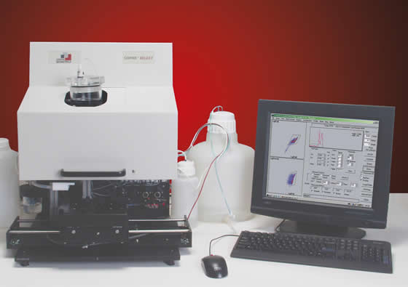
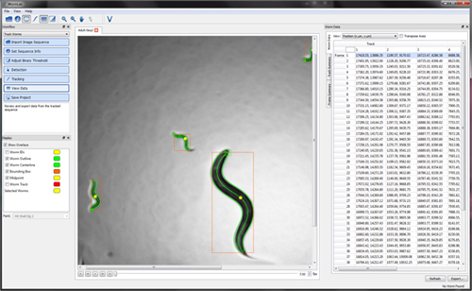
The Analyses
Relative Reproductive Strength (WormSorter)
Autonomous Movement Tracking (WormLab)
Genomics
Proteomics
Lifespan
Brood Size
Photo: Union Biometrica | COPAS Platform Overview. (n.d.). Flow Cytometry for Large Particles | UBI - Union Biometrica. Retrieved June 21, 2012, from http://www.unionbio.com/copas/
Photo: MBF Bioscience : wormlab. (n.d.). MBF Bioscience : Stereology and Neuron Reconstruction. Retrieved June 21, 2012, from http://www.mbfbioscience.com/wormlab

Slide 8
Acknowledgements

