Slide 1
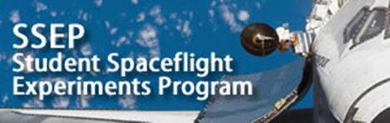


The Effect of Microgravity on the Use of Cactus Mucilage for Water Purification
Mentor:
Dr. Gertrud Konings
By: Jesus Castor
and
Naiki Armendariz
El Paso Community College

Slide 2
Background
Cactus was already used by 19th century Mexican communities to purify water
Dr. Norma Alcantar’s research at the University of South Florida proved that mucilage can remove arsenic and iron from water

Slide 3
Experiment’s Rationale
Chromium was chosen because of its presence on moon’s surface besides iron
Therefore steel production on the moon is being considered
Chromium-VI would be produced as a waste and could contaminate moon water
The mucilage of the Prickly Pear, Opuntia ficus indica, an edible cactus, can be a solution to chromium removal from contaminated water

Slide 4
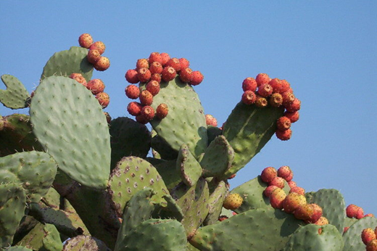
Objective
Test the effect of microgravity on the mucilage’s ability of removing heavy metals, in particular chromium-VI

Slide 5
Composition of Cactus Mucilage
Cactus mucilage is the clear slimy fluid secreted when a stem segment (cladode) is damaged
The main component of the Gelling Extract (GE) mucilage is a pectin
Pectins are found between the cells and in the cell walls of most plants

Slide 6
Purification Property of Mucilage
When extraced, GE pectin is covered by a layer of Ca²⁺ ions.
When chromium-VI reacts with the pectin, Cr⁶⁺ displaces Ca²⁺ ions, giving the pectin an outside layer of Cr⁶⁺ ions.
When chromium-VI binds to pectin, a greater and heavier flock is formed, which sediments to the bottom under Earth’s gravity conditions, leaving the water in the middle free of chromium-VI.

Slide 7
Hypothesis
Microgravity should not affect the chromium binding, since the binding is an ionic reaction. Thus the purification process is expected to work

Slide 8
Experiment Design
FME Main Volume
Chromium-6 trioxide (CrO₃) (1.00 mg/L) dissolved in distilled water (H₂O): Experiment volume filled to capacity, approx. 6.28 ml
Short Ampoule A
O. ficus-indica mucilage extract (10mg/L mucilage in distilled water): filled to capacity, approx. 0.92 ml
Short Ampoule B
100% Ethanol (stabilizing agent): filled to capacity, approx. 0.92 ml

Slide 9
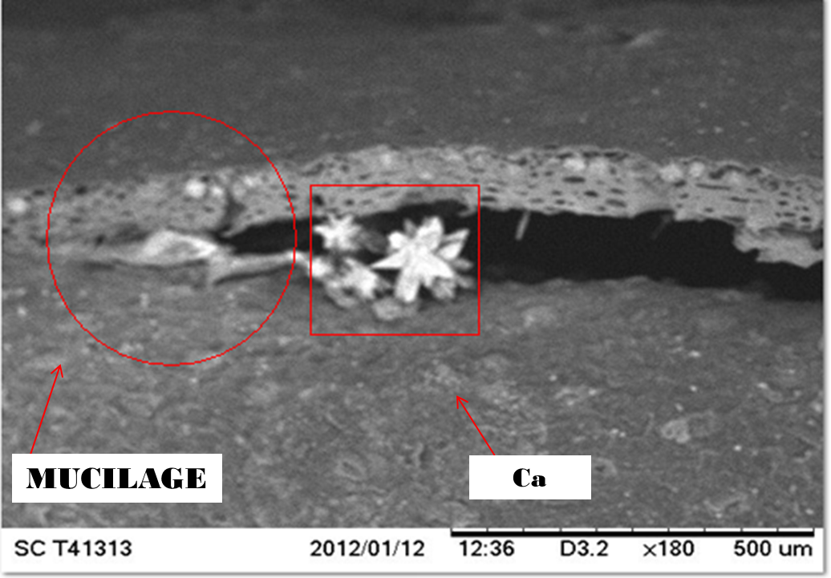
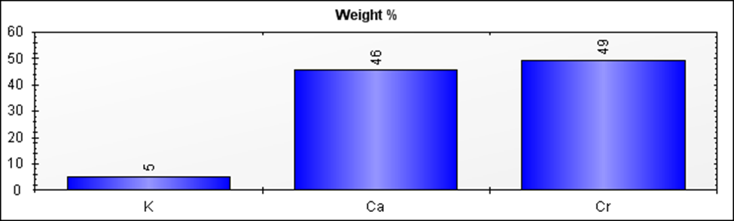
1st Experiment
  Cube of cactus placed in 1.00 mg/L chromium solution for two weeks, then rinsed several times in alcohol
Cactus piece observed under the HITACHI TM-1000 Scanning Electron Microscope (SEM) and measured in X-ray acquisition

Slide 10
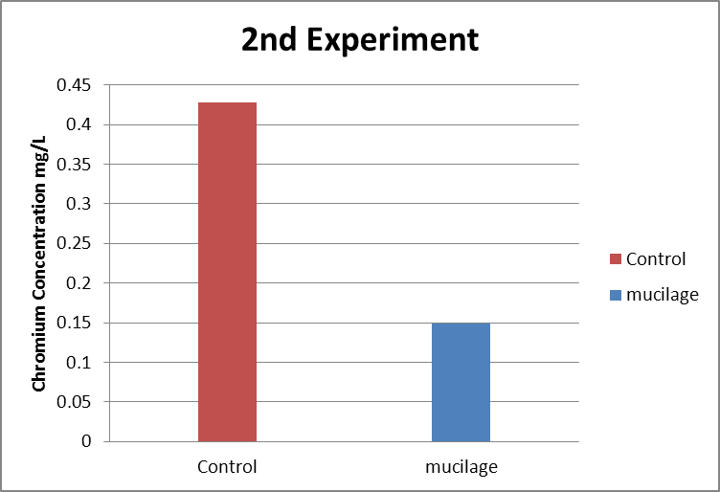
2nd Experiment
2 ml of liquified cactus + 2ml of 1.00 mg/L chromium solution + 2ml of 100 % alcohol
After one day, solution measured in a HACH DR 2800 spectrophotometer
2nd Experiment
Chromium VI concentration
Control | 0.428 mg/L
mucilage | 0.149 mg/L
Difference Percentage | 65.19%

Slide 11
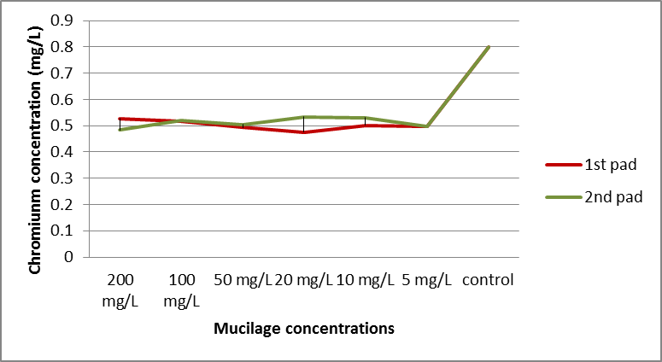
3rd Experiment
Flight experiment trial: 6.3 ml of 1.00 mg/l chromium, 0.92 ml mucilage, and 0.92 ml of 100% alcohol
Wait seven days to add alcohol and read solution in HACH DR 2800 spectrophotometer
Parallel experiments with several concentrations of mucilage

Slide 12
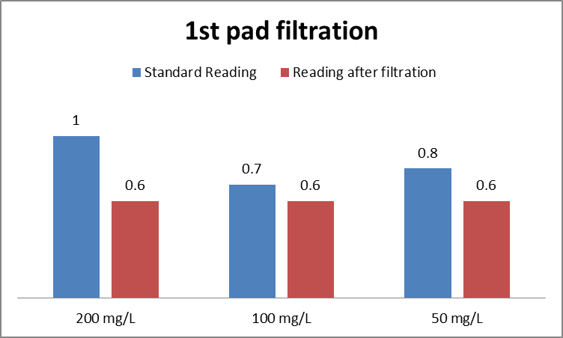
4th Experiment
6.3 ml of 1.0 mg/l of Cr-VI solution + 0.92 ml of mucilage (different concentrations) + 0.92 of 100% ethanol
Solution measured directly from the test tube and after filtration to remove mucilage

Slide 13
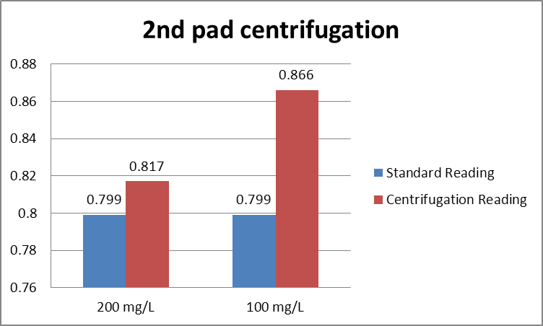
4th Experiment cont.
6.3 ml of 1.0 mg/l of Cr-VI solution + 0.92 ml of mucilage + 0.92 of 100% ethanol
Solution measured directly from the test tube and after centrifugation

Slide 14
Conclusions
From the experiments performed the final design of the flight experiment was determined: 10 mg/l GE mucilage will be used and the mucilage will be filtered out of the solution before measurement
Still waiting to get our experiment back from space

Slide 15
Student Team Members
Co-principal investigators & collaborators
Jesus Castor[1], Naiki Armendariz[1], Dr. Gertrud Konings[1], Dr. Maria Arteaga[1], Dr. Norma A. Alcantar [2], Dr. Alfonso Bencomo[3]
1.-RISE program, El Paso Community College, El Paso, TX 79925, USA
2.-Department of Chemical and Biomedical Engineering, University of South Florida, Tampa, FL 33620, USA
3.-Departamento de Investigación de Genética Humana, Universidad Autónoma de Guadalajara, Guadalajara, Jalisco 44100, MX

Slide 16
Financial Support
Texas Space Grant Consortium, Austin, Texas
NIH MBRS-RISE (Research Initiative for Scientific Enhancement) Grant #5R256M060424
El Paso Community College
A special Thank-You to all our supporters, especially also to Jeff Goldstein and Harri Vanhalla for making this project possible.

