Slide 1
SSEP STS-135 The Growth Rate of Lactobacillus acidophilus in Microgravity
Kayla Nolette
Leighton Noel
Miguel Velez
Victoria Holbert
Olivia Ouellet

Slide 2
MT Project History
Science competition open to 1400 students at Monty Tech
27 different proposals from Monty Tech students went to review panel 1
The Growth Rate of Lactobacillus Acidophilus in Microgravity
HeLa Cell Growth in Microgravity – by Dominika Baczek, Kaylee Nobrega, and Griffin Smith
Acceleration of Porphyridium Reproduction in Microgravity- Benjamin Buckland, Hunter Manley, Robin Murray, and Robert Labier

Slide 3
Mission Patch
This mission patch was designed for Monty Tech to show how proud we are in being chosen for this opportunity, and to work with the Student Spaceflight Experiment Program. The gear represents all the students at Monty Tech that will be watching the space shuttle Atlantis as it takes off for the last time. It surrounds the Earth because with a Monty Tech education you can be successful anywhere on Earth or maybe even in space.

Slide 4
Lactobacillus acidophilus
Proposed Question:
Will the bacteria grow more rapidly on Earth or in microgravity?

Slide 5
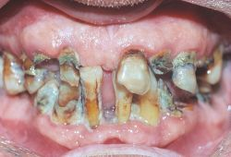
Importance of the question

Slide 6
Hypothesis
The hypothesis was that L. acidophilus would be significantly effected by microgravity conditions and would grow more rapidly.

Slide 7
Variables
Independent – The independent variable tested was the reproduction rate of Lactobacillus acidophilus in normal gravitational conditions
Dependent – The dependent variable tested was the reproduction rate of Lactobacillus acidophilus in microgravity conditions
Constant – Constant variables were volume, spore sample from same vial, nutrient, time, volumes and concentrations

Slide 8
Procedure (continued)
Packing of materials
Spores were packed in cotton using dental probe and filled to capacity
(estimated 6x10e9 spore per ml)
10%m/v milk/tomato juice and 5% m/v yeast suspension filled to capacity approximately 125 microliters

Slide 9
Procedure - materials
Lactobacillus acidophilus bacteria Carolina Biological
10%m/v milk/tomato juice and 5% m/v yeast suspension prepared by Carolina Biological
MDA Type 1 Experiment Slot
Dental Probe
Micropipette
Cotton

Slide 10
Results – Optical density test
Using a Tunable Diode Laser Absorption Spectroscopy
Optical density test – indicated more cells in microgravity sample

Slide 11
Lactate assay procedure
Protocol Summary
Sample Preparation
↓
Standard Curve Preparation
↓
Add Reaction Mix
↓ Measure Optical Density

Slide 12
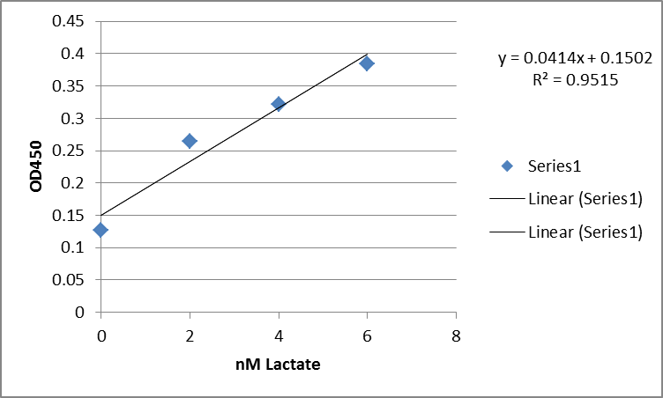
Lactate assay results
Figure 1: Lactate Standard curve

Slide 13
Lactate assay results
Ground truth and microgravity optical density results show significant increase in microgravity
ground
1 | 2 | 3 | avg | lactate (nM)
0.248 | 0.277 | 0.261 | 0.262 | 2.700483
space
1 | 2 | 3 | avg | lactate (nM)
0.296 | 0.271 | 0.296 | 0.287667 | 3.320451

Slide 14
Results – microscope microgravity

Slide 15
Results – microscope ground truth

Slide 16
Conclusion
Hypothesis was supported
There is a significant impact of microgravity on the growth rate of Lactobacillus acidophilus.
Implications - astronauts may be at risk to develop dental caries more rapidly if living in microgravity conditions.

Slide 17
Future study
Repeat this test with a larger sample as well as an inhibitor to stop growth at a specified time.

Slide 18
THANK YOU Sponsors ☺
Community Foundation of North Central Massachusetts
Massachusetts Space Grant Consortium MIT
Workforce Investment Board
Carolina Biological

Slide 19
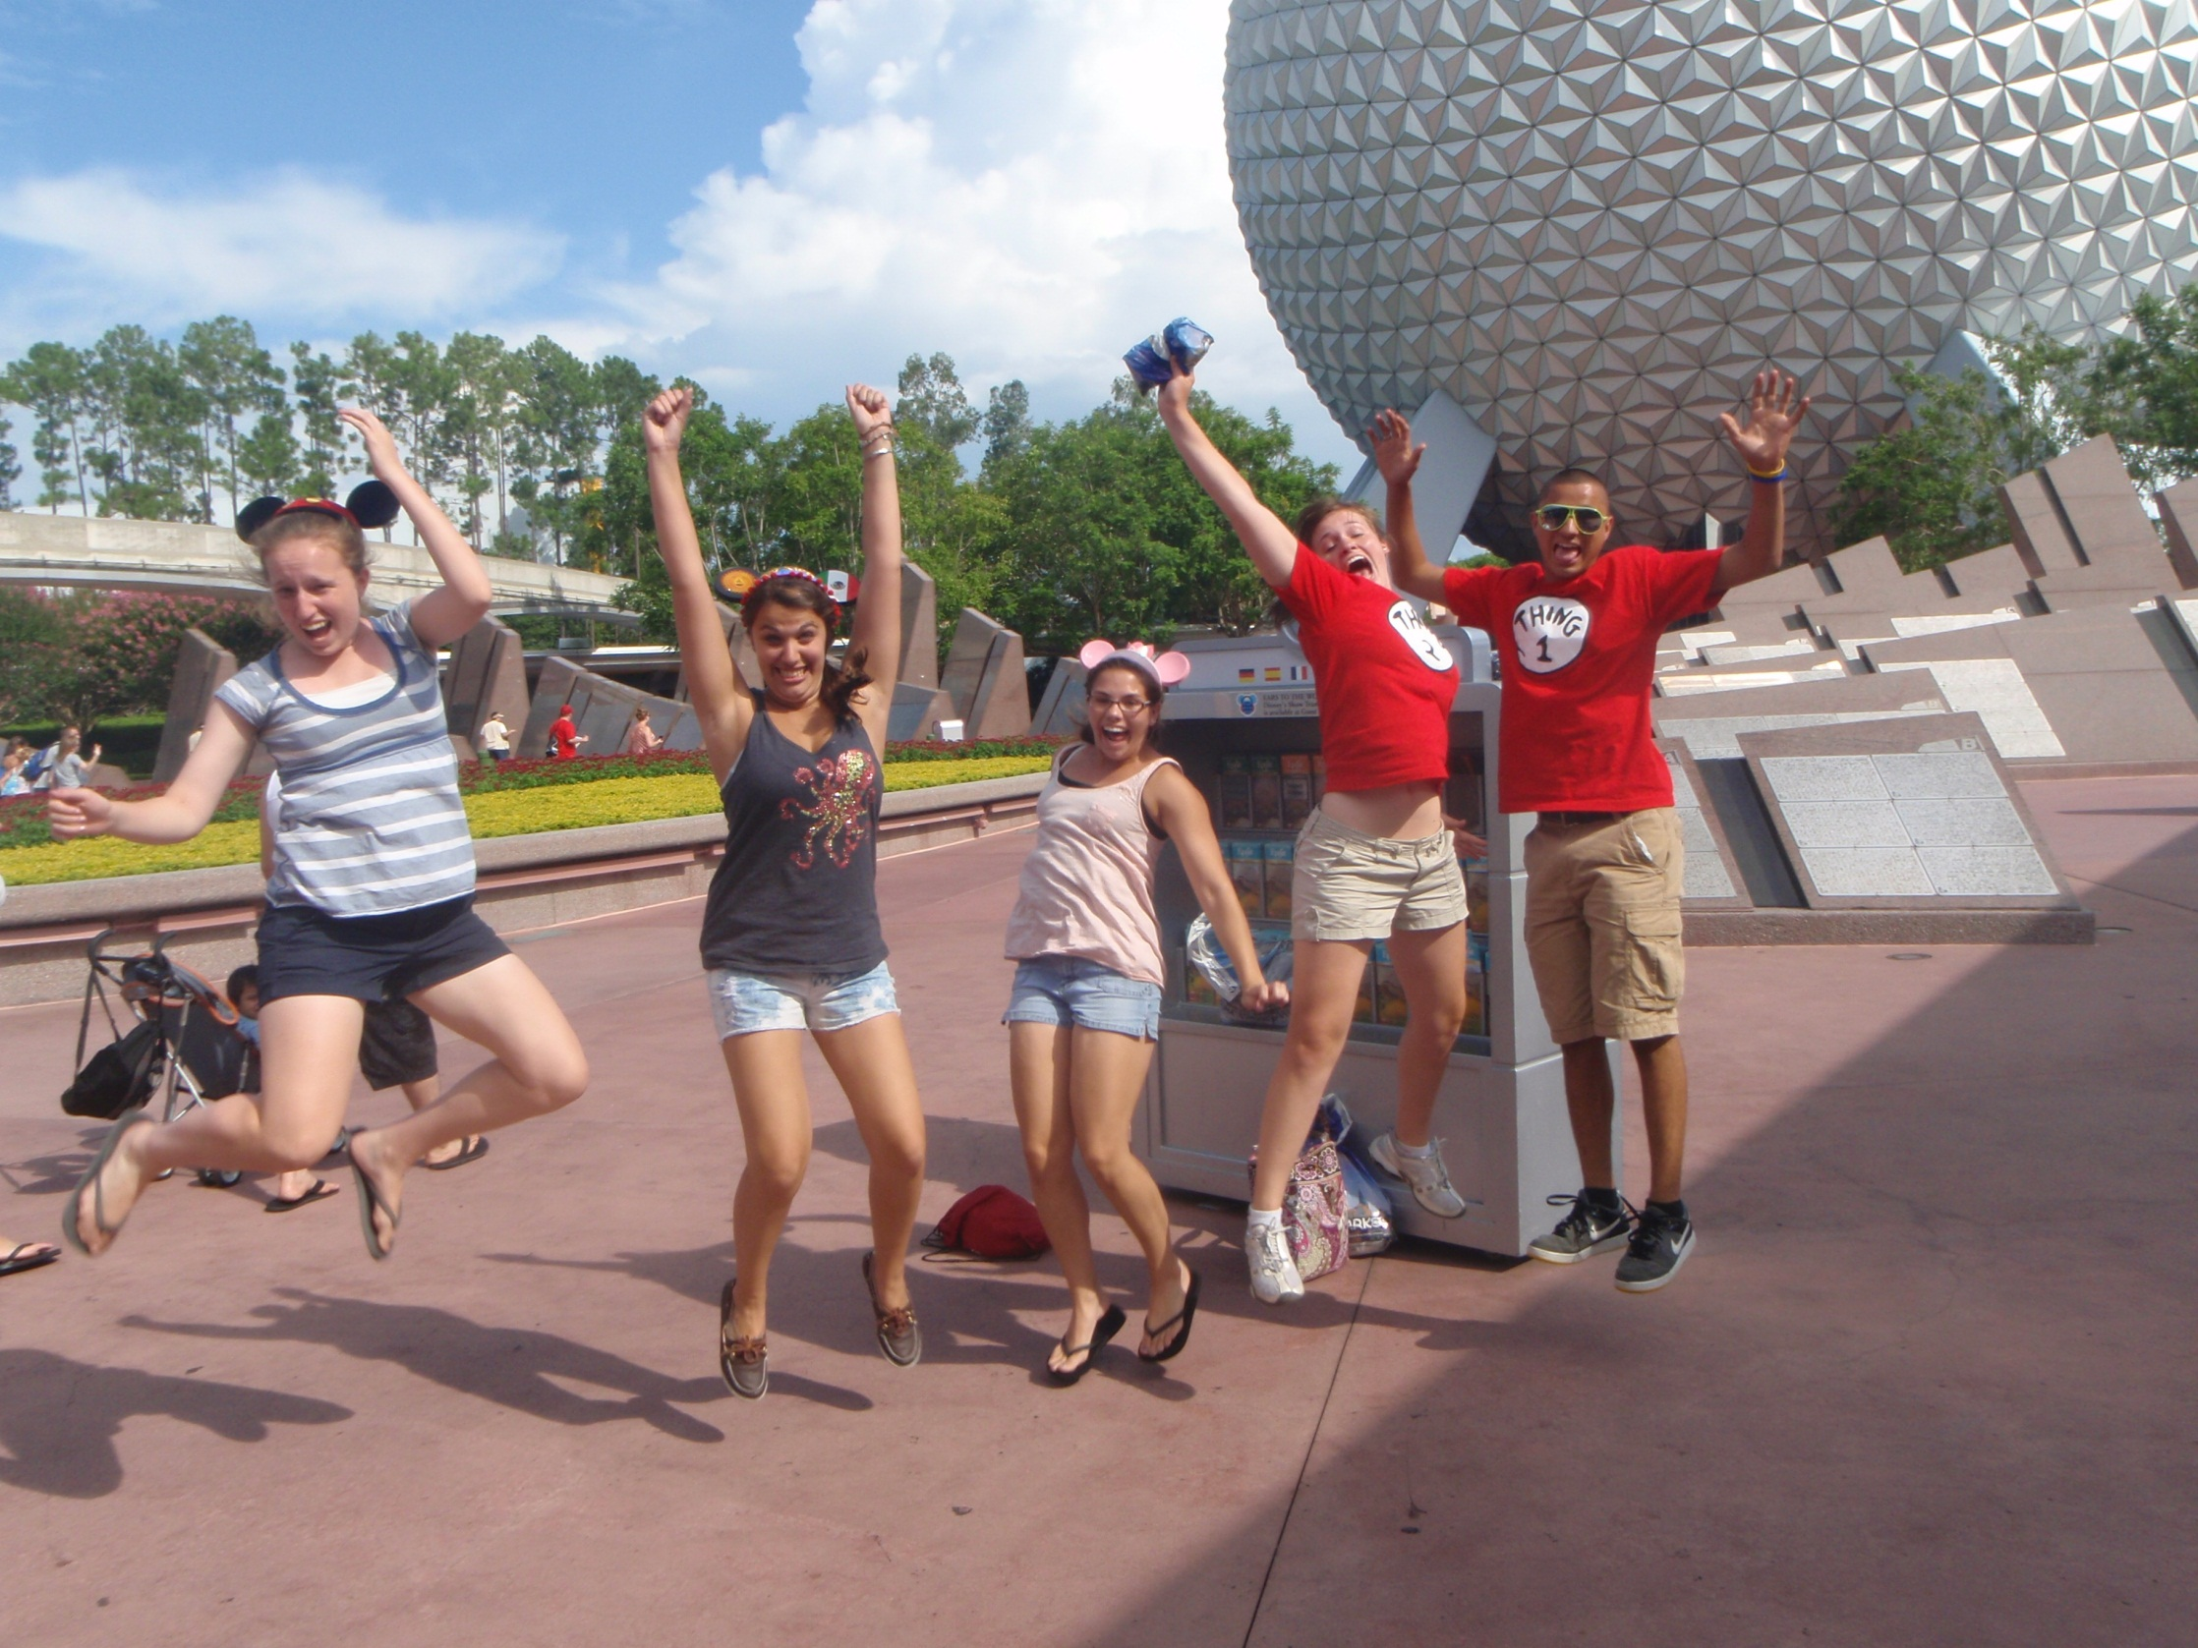
We did it!!!! Any questions?

Slide 20
“ Shoot for the moon. Even if you miss, you’ll land among the stars!” – Les Brown

