Slide 1
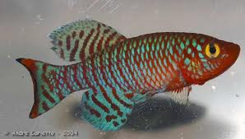
Killifish in Space
A study of the effects of microgravity on bone and muscle mass.
Principal Investigator: Jessica Gunderson
Co-Investigators: Austin Sadler, Justin Sadler, and Brittanie Rigby
Notes:
Jessica: We did our project on the study of Killifish in Space. We are from the OABCIG high school, Austin and Justin, Seniors, Brittanie, a Junior, and myself, Jessica, a sophomore.

Slide 2
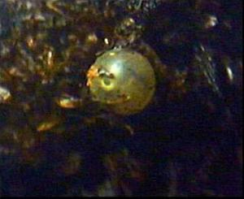
Killifish
Genus Nothobranchius
What are Killifish?
Why did we choose Killifish?
…it was large enough we could tell if bones and muscles had been affected by microgravity.
…because it was small enough to fit inside the test tubes.
Diapause
Three Stages
Dormancy
Diet
Notes:
Austin: Our species of Killifish is called the Genus (Jean-us) (no-though-branch-e-us) <-not sure about branch, or bronc) Killifish are small fresh water fish found around Asia and Europe. We chose Killifish because they… a. Were large enough we could see if the bones and muscles had been affected by microgravity. B. were small enough to fit in the test tube. C. were dormant. Diapause is described as a period of suspended development in an insect, other invertebrate, or mammal embryo, esp. during unfavorable environmental conditions. How does this happen? It can stay dormant through needed times, which these projects were needed to stay dormant until arrival on the ISS… So this factor played a very important role. Due to available space in the FME and oxygen in the water, our Killifish were fed off of fish flakes. A normal Killifish diet consists of brine shrimp.

Slide 3
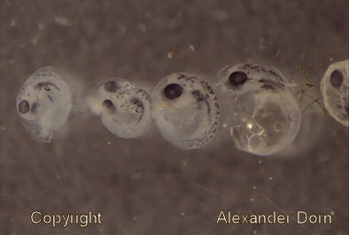
Hypothesis
What did we think will happen?
Negative affect on fish bone and muscle mass
What made us think this?
Gravity vs. Microgravity
Notes:
Jessica: We thought, that since Microgravity’s force is weaker than Gravity’s force, the pressure put on these fish would obviously be weaker. This made us believe that the fish would grow up in a weaker environment, the fish themselves would be weaker. This lead us to the conclusion that the muscle’s and bone’s masses would be less compared to that of on Earth. Another conclusion this lead to, was kidney stones. Being our flight has not yet been returned, we cannot give you results. But we plan to find results by dissection of the organs.

Slide 4
Materials
FME 3 (Fluid Mixing Enclosure type 3)
Experimental and control groups each contain:
Main Volume: 6.28 mL Spring Water
Ampoule A: 3 Killifish eggs in diapause 2
2 Fish Flakes
Ampoule B: empty
Notes:
Brittanie: We, as you can see, used the FME 3. Both the experiment and control projects contain in the main volume… 6.28mL of specifically Spring Water. In Ampoule A: 3 Killifish eggs in diapause stage 3 of 3, with 2 fish flakes. We didn’t put anything in short ampoule B.

Slide 5
Procedure
Break Ampoule A undocking -37 days (June 28, 2012)
We requested that our experiment be kept at room temperature the entire experiment. (Before launching, during transportation to launch, during flight, on ISS, returning to launch site, and after landing.)
When sending materials back to Ida Grove after flight, an enclosed hand warmer must be activated to ensure ambient temperature for Killifish.
Notes:
Justin: We took our materials, and placed them respectively in their locations. After that, we sent them into the SpaceX/Dragon launch site, where it went up on the SpaceX/Dragon on a Tues 22 and docked on the ISS that following Friday, the 25. After 37 days of being on the ISS, the astranauts were to crack the inside ampoule open to mix our materials. After that, they will sit up on the ISS for another 5 more days. Then, they will be sent back to Ida Grove. Our experiment was required to be kept at room temperature, so we are planning to place an enclosed hand warmer with the experiment on the way home.

Slide 6
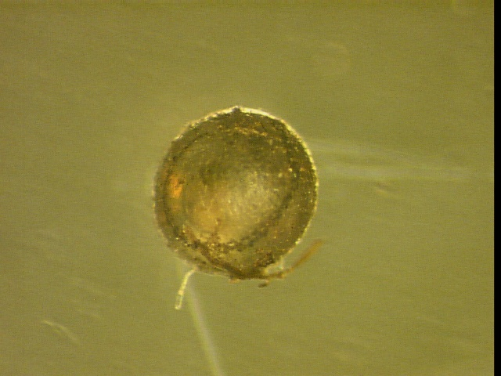
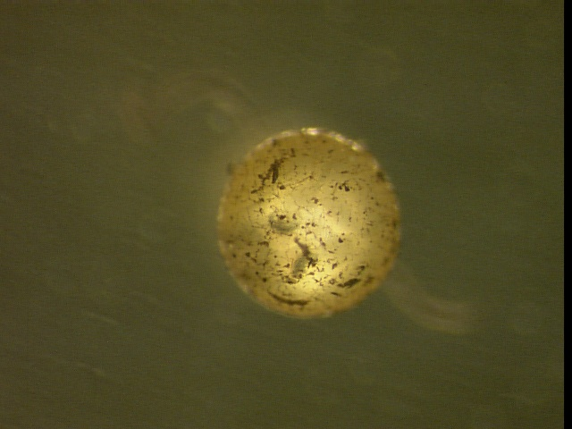
Photos of Controlled Experiment
1
2
3
Notes:
Brittanie: these are simply pictures of what our eggs that were kept down here on Earth look like.

Slide 7
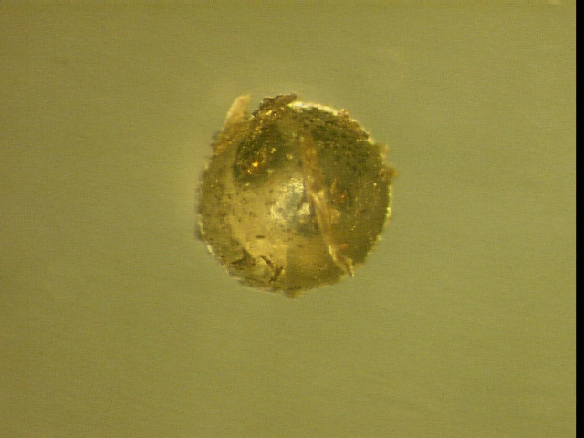
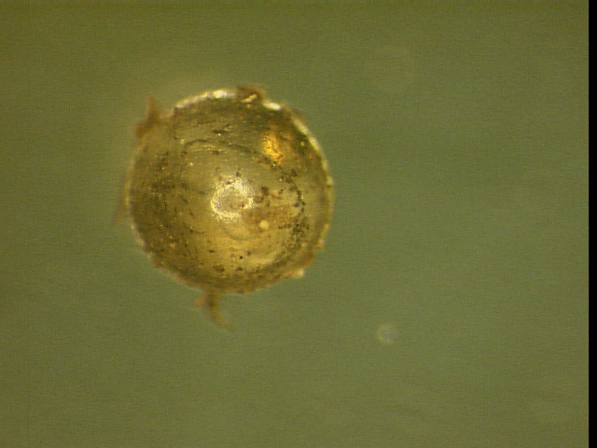
Photos of Experiment
Notes:
Justin: These are pictures of what the experiment eggs sent up to the ISS look like.

Slide 8
Acknowledgements
We would like to thank the following people for all their help with this project:
Mrs. Carol Sadler, teacher facilitator
Mr. Jim Christiansen, NWAEA science consultant
Dr. Eugene Hull, Diapause Foundation
Dr. Melinda Coogan, Biology Professor at BVU
Jeff Goldstein, SSEP program director
Rita Frahm, Ida County Economic Development
Many local financial sponsors
Notes:
Austin: We’d Like to give thanks to these people for making this experiment possible.

