Slide 1
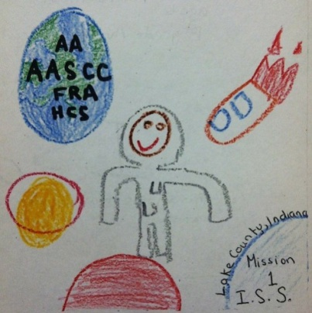
Effect of Microgravity on the Reproduction of Curli-Producing E. coli 0157:H7 Strain 43895OR
Presented by
Amalia Arceo-Hosken and Jenna Rifai
Avicenna Academy Science Community Collaboration
Lake County, Indiana

Slide 2
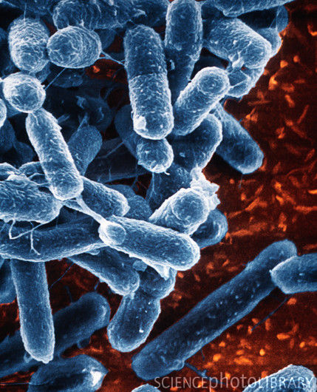
E.coli 0157: H7
Single-celled organism known as a bacteria
Gram negative and rod-shaped
Pathogenic (disease causing)
It’s a cause of foodborne illness
Fecal-oral contamination
Eating contaminated meat or crops
Swimming in contaminated waters
Bloody diarrhea and if untreated can lead to kidney failure
Photo courtesy of sciencephoto.com

Slide 3
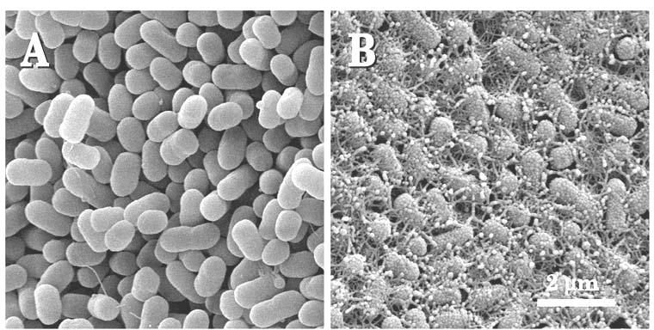
E. coli 0157:H7 strain 43895OR
Mutant strain which was discovered by the USDA after a preserved sample, originally obtained from the Centers for Disease Control (CDC), of E. coli 0157:H7 was thawed and prepared for analysis
Mutant exhibits curli, which are external features that contribute to the pathogenicity of the bacteria by helping them produce biofilm
Mutation is not always exhibited and can be manifested in one generation but then not again in another.
Photo courtesy of USDA (Left: E. coli that does not produce curli and Right: curli-producing strain 43895OR)

Slide 4
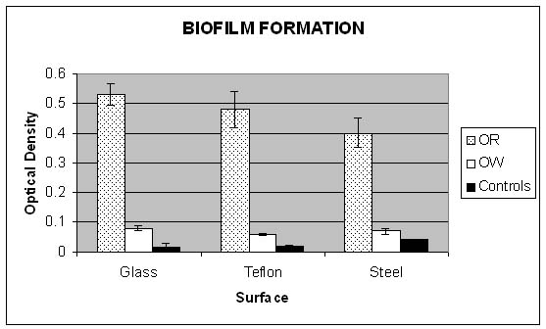
43895OR and Biofilm
Biofilm are the result of cells sticking to a surface and then to each other.
Biofilm have been shown to increase a species’ pathogenicity .
In 2006 USDA studied biofilm formation on glass, Teflon and steel and compared 43895OR’s biofilm growth capabilities with a non-curli forming strain of E. coli
OR: curli-producing 43895OR
OW: strain that does not produce curli
Implications: Curli contribute to biofilm formation and ultimately, pathogenicity
Photo courtesy of USDA

Slide 5
Our Experiment
What effect does microgravity have on the reproduction of E. coli 0157:H7 and on the external structures known as curli?
As space travel continues and with private companies looking to play a role in space, it is important to understand what effect microgravity will have on pathogencity.

Slide 6
Details
Type 3 FME (3 experiment slots)
Main volume: 6 ml of Tryptic soy broth
Short Ampoule A: 0.9 ml of approximately 1 million CFU of 43895OR
Short Ampoule B: 0.92 ml gluteraldehyde (2.5% concentration) as a fixative
T0=Crack Short Ampoule A and shake (activates experiment)
T+6 days= Crack Short Ampoule B and shake (deactivates experiment)

Slide 7
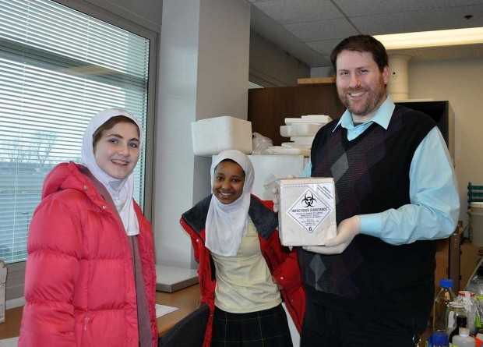
Logistics
Due to the bacteria’s pathogenicity, we were not able to handle the samples ourselves. So, we worked with Dr. Harold Olivey at Indiana University Northwest

Slide 8
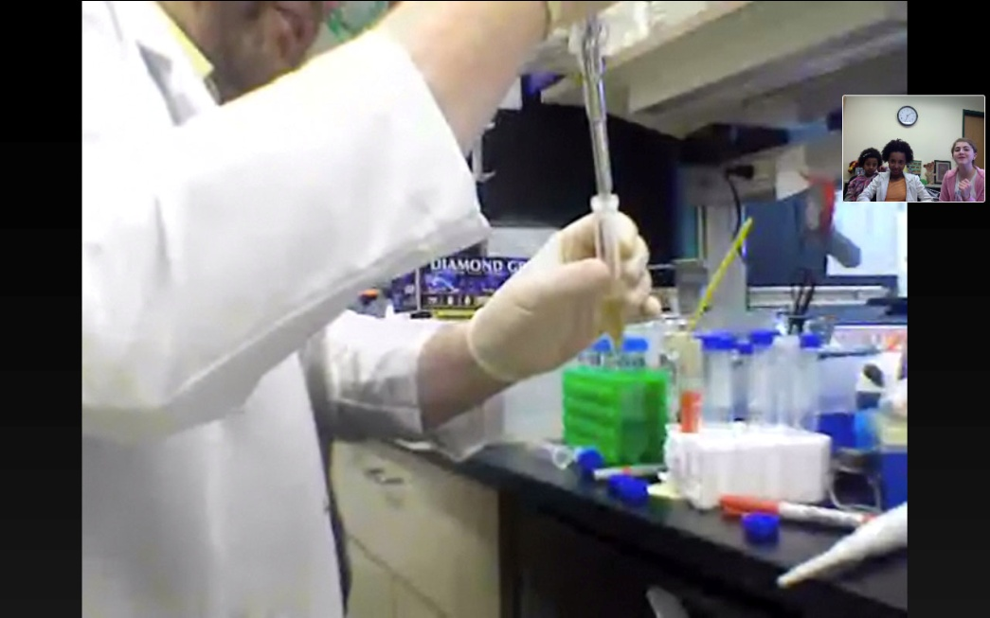
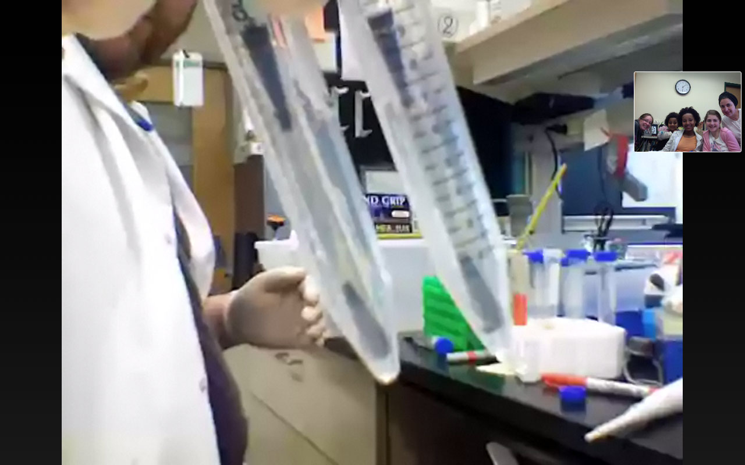
We used SKYPE to join Dr. Olivey in the lab and we walked him through the steps of our experiment.

Slide 9
Real Science
On June 1st we were told that there was a miscommunication and our experiment was deactivated early. We’re awaiting a reflight opportunity this coming fall and we’ll be analyzing our ground truth and flight samples from this current (spring/summer) trip and the reflight.
We will be using a scanning electron microscope (SEM) to analyze the outside of the bacteria to determine if curli are still present and what effect, if any, microgravity had on the structures.

Slide 10
Team & Acknowledgements
Team:
Amanda Arceo (community director)
Nicole Gustafson (teacher)
Amalia Arceo-Hosken (PI)
Collaborators:
Jenna Rifai, Ameer Rifai, and Rehan Uribe
Thank you to:
Indiana Space Grant Consortium
NCESSE & NanoRacks
USDA
Dr. Harold Olivey and Indiana University Northwest

