Slide 1
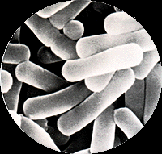
The Effect of Microgravity on the Growth
and pH of Lactobacillus acidophilus
Presidio High School
Teacher Facilitator: Melody Crowder
Principal Investigator: Illiana Fernandez
Co-Principal Investigator- Alvaro Ali Romero
Collaborator- Rafael Sanchez
Notes:
Collaborator

Slide 2
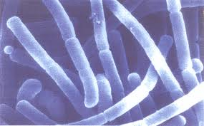
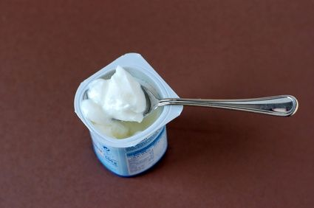
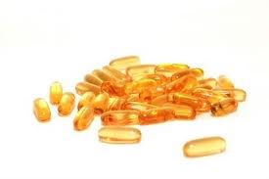
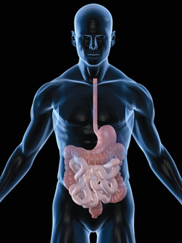
Lactobacillus acidophilus
Grows in 5.0-7.0 pH
Reproduces rapidly
Naturally found in the human intestines
Notes:
Descriptions of Lactobacillus Acidophilus

Slide 3
Objective
Hypothesis
Test the effects of microgravity on the growth rate and pH of Lactobacillus acidophilus bacteria.
Determine if astronauts should be given supplemental probiotics
The growth rate will slow down and the pH will increase.
Purpose
Notes:
Experiment

Slide 4
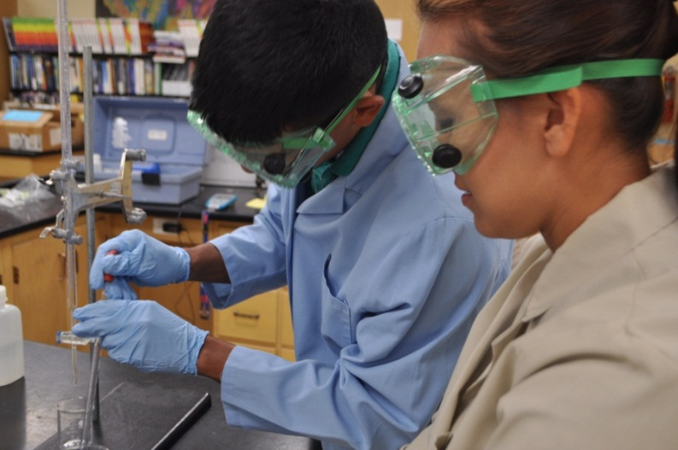
Procedure
Main Volume: Distilled Water
Ampoule A: powdered
lactobacillus acidophilus
and powdered milk.
Ampoule B: Formalin
The L. acidophilus will be rehydrated in the same time frame in microgravity as our ground truth experiment.
Notes:
Experimental Procedure

Slide 5
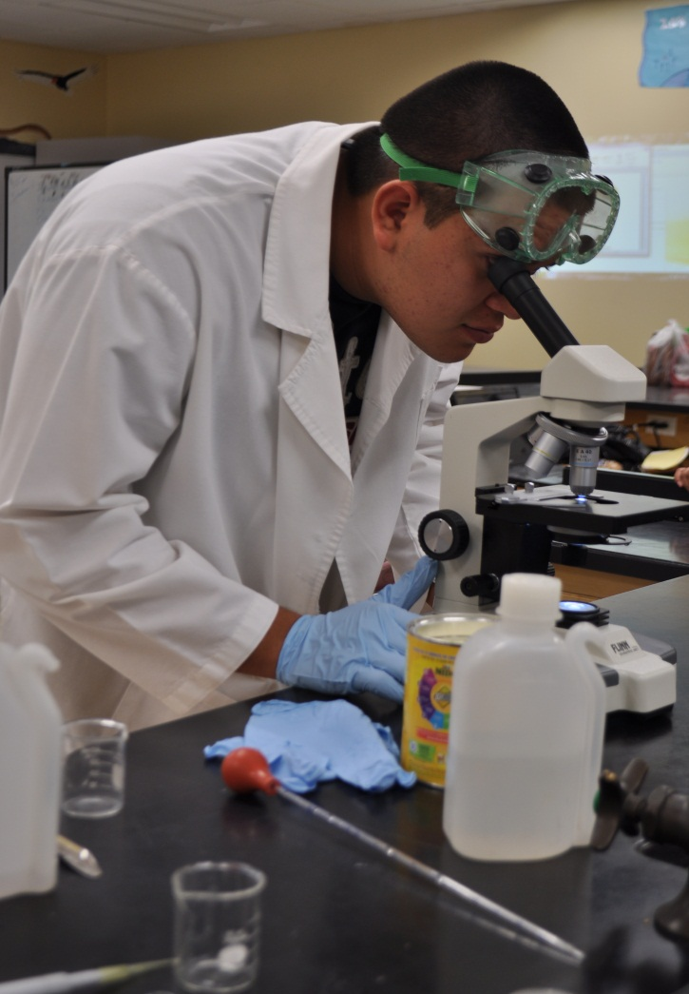
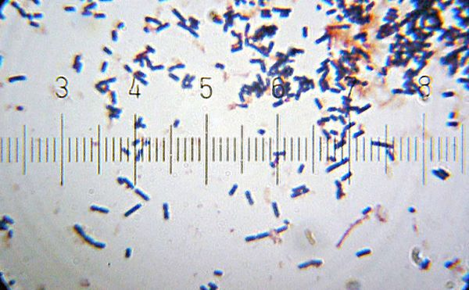
Procedure
Bacteria will be counted and compared to the ground truth experiment.

Slide 6
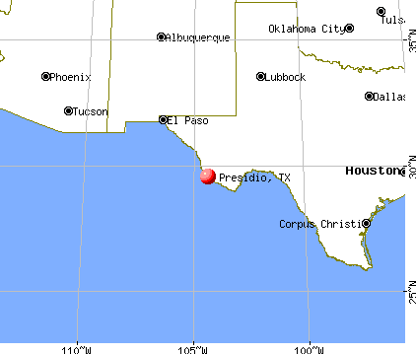
Limitations
Remote location of Presidio ISD
Size of FME can not store enough nutrients for 90 days
MEXICO
Notes:
Limitations

Slide 7
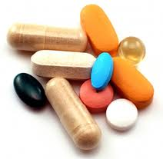
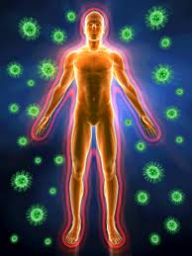
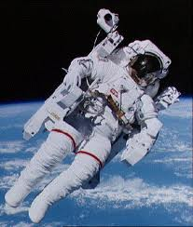
Real World Applications
Give supplemental probiotics to astronauts
Aid in production of Vitamin K
Improve digestion and overall health
Supports a healthy immune system
Notes:
Limitations

