Slide 1
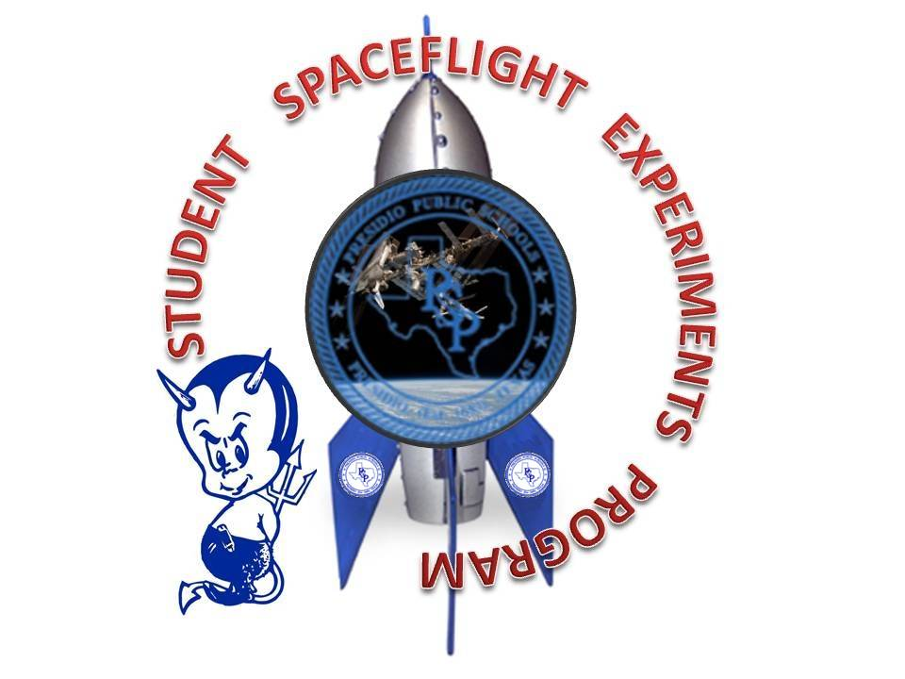
Lucy Rede Franco Middle School
Presidio isd
Presidio tx 79845
Lucy Rede Franco Middle School
Presidio isd
Presidio tx 79845

Slide 2
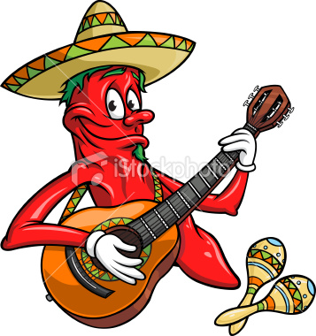
Chemical Analysis of the Effect of Gravity on Capsicum Chinense ‘Habanero’
Lisa Marie Pena
Principal Investigator
Juan Nieto and Vanessa Rohanna
Co-Investigators
Alma Baeza and Maxwell Ferguson Collaborators
Ernesto Monte
Teacher Facilitator

Slide 3
HYPOTHESES
Habanero chili exposed to microgravity will decrease in carotenoid content, thus decreasing piquancy.
Amount of ascorbic acid will decrease, thus increasing pH value of the chili.

Slide 4
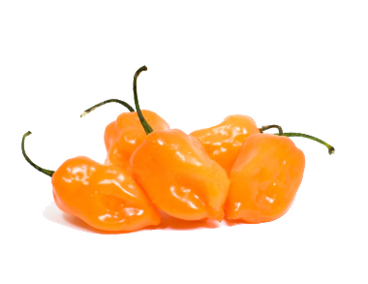
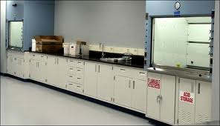
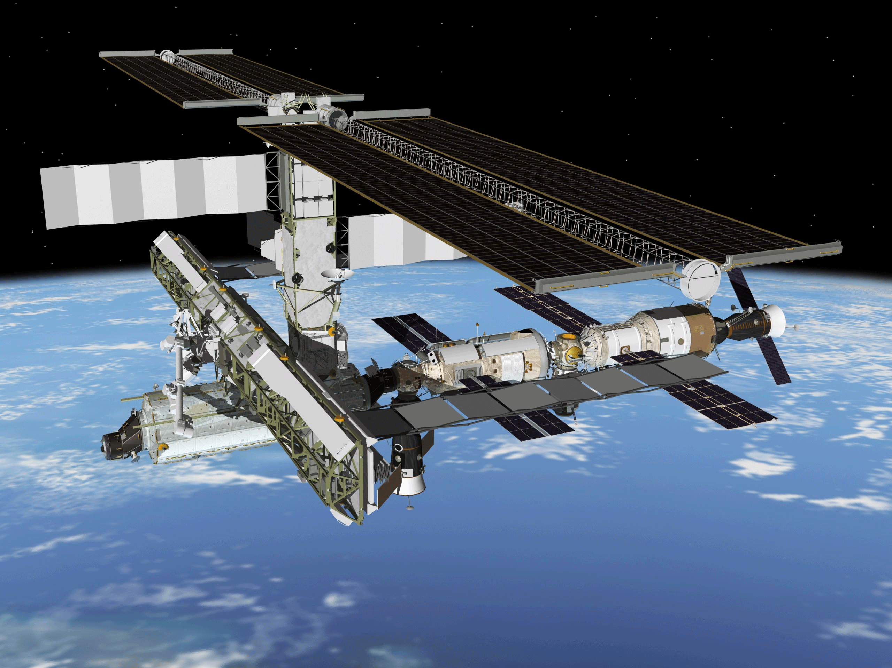
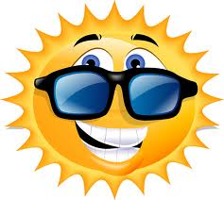
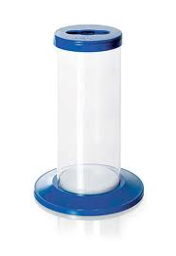
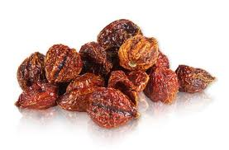
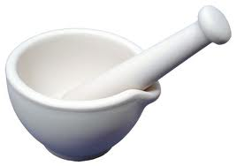
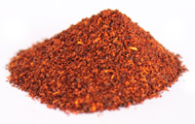
EXPERIMENT DESIGN GROUND PREPARATION OF EXPERIMENTAL SET UP
I’m heading to space to disprove the rumor about my hotness.
MANIPULATED VARIABLE:
CONDITIONS OF GRAVITY
RESPONDING VARIABLE:
PH VALUE
ASCORBIC ACID
PIQUANCY
CAROTENOID

Slide 5
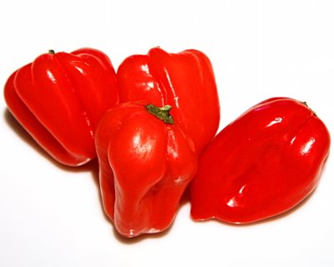
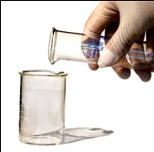
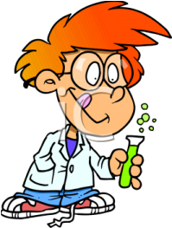
EXPERIMENT DESIGN INSTRUCTIONS ON BIOCHEMICAL ANALYSES
ASCORBIC ACID CONTENT
CAROTENOIDS DETERMINATION
HABANERO’S PIQUANCY
Acetone
(10 ml)
Oxalic Acid
(5 ml)
Diatomaceous Earth
Filter
homogenize
Extract
oil
centrifuge
Petroleum Either
distilled water
filter
Amount of sugar solution (ml)
Extract
acetone
pH
Ascorbic
Acid
Spectrometer (450 nm)
Absorbance

Slide 6
DATA AND OBSERVATIONS
 | Sample 1 | Sample 2 | Sample 3 | Sample 1 | Sample 2 | Sample 3
Habanero Chili exposed to Microgravity
Habanero Chile on Earth’s standard gravity
pH value
SORRY! THERE’S NO DATA AVAILABLE FOR THIS.
5.05
5.05
5.05
Ascorbic Acid content
THEY DID NOT ALLOW ME TO GO…TOO HOT!!! (LOL!!!)
Carotenoid content
Amount of sugar solution added to dilute piquancy (ml)
500
500
500

Slide 7
SIGNIFICANCE OF THE STUDY
This could provide insights on providing astronauts more flavorful meals.
Exposure to microgravity could also have an effect on how capsacidoids bind with pain receptors.
This could lead to future studies on the effect of chili in inhibiting the growth of bacteria.
This experiment could lead to further studies on developing drugs from chemical compounds found in chili due to its effect on our brain.

