Slide 1
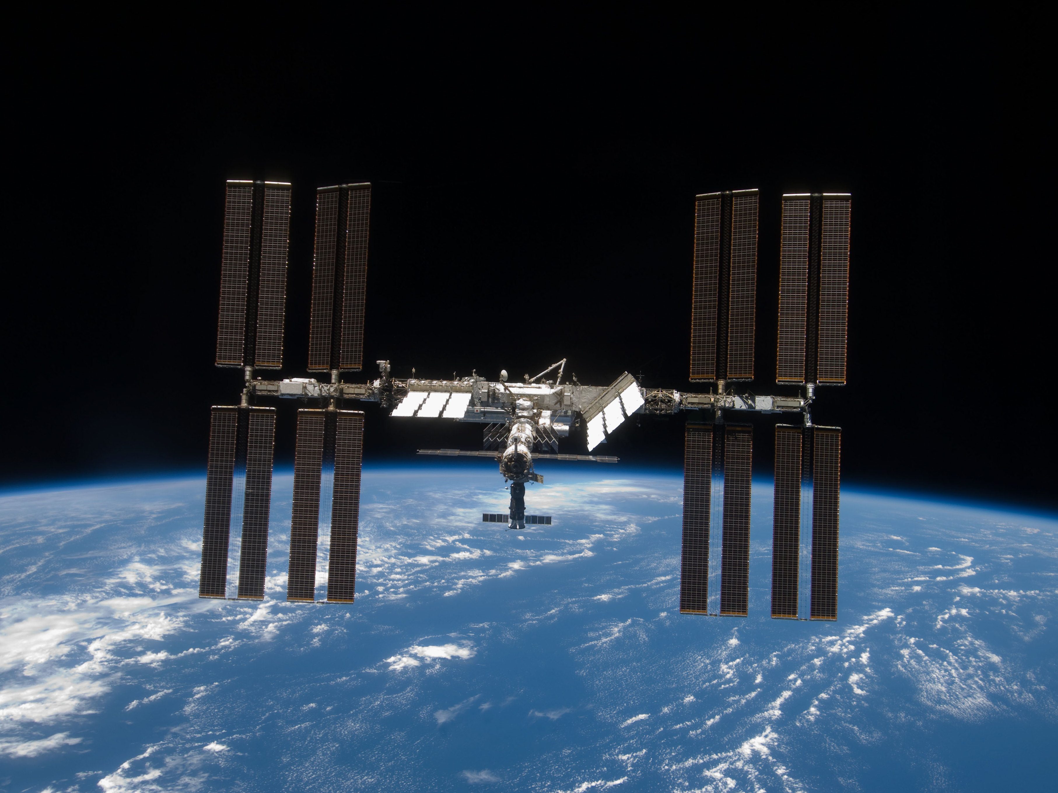
Navigating SSEP Experiments
from Selection to Flight
Dr . Harri Vanhala
National Center for Earth and Space Science Education
SSEP National Conference 2012
July 2, 2012

Slide 2
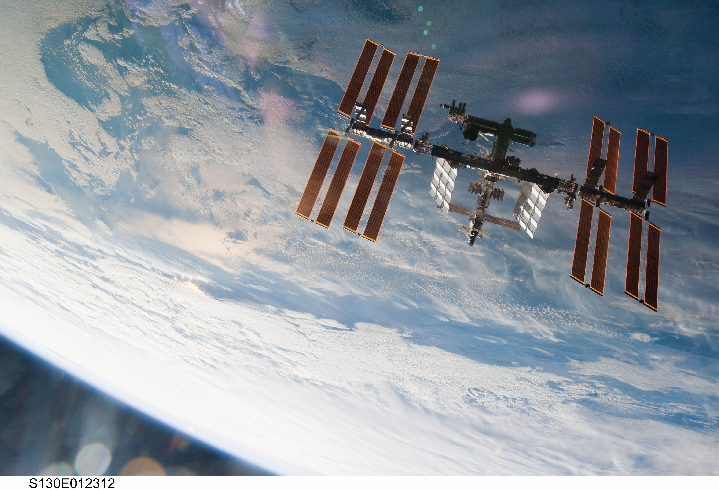
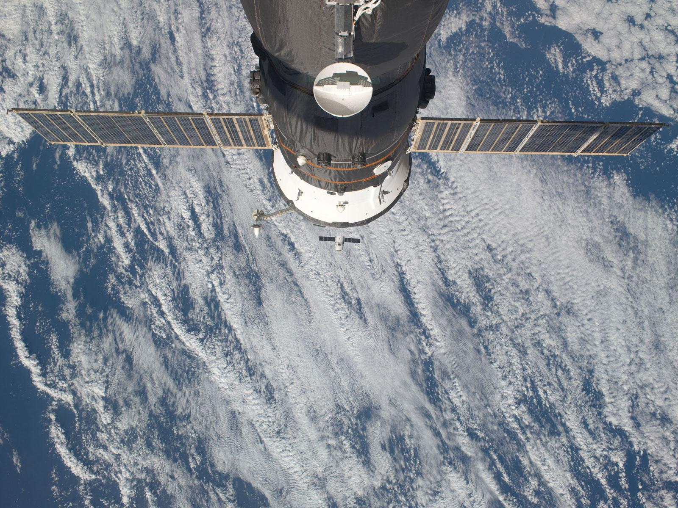
From Proposal to Flight: Overview
Phases of experiment preparation:
Proposal review and tentative experiment selection
Confirming experiment selection
NASA flight safety review
Scheduling activities with payload aboard the International Space Station (ISS)
Payload integration and pre-launch activities
Launch and arrival at ISS

Slide 3
Proposal Review
SSEP communities hold Step 1 review of student proposals in their communities.
Each community will send up to three finalist proposals to NCESSE for Step 2 review.
Step 2 review panel includes scientists, engineers, and science educators from academia, federal agencies, commercial entities, and national science education non-profit organizations.
Step 2 review panel meets in Washington, DC, to tentatively select one experiment to fly from each SSEP community.

Slide 4
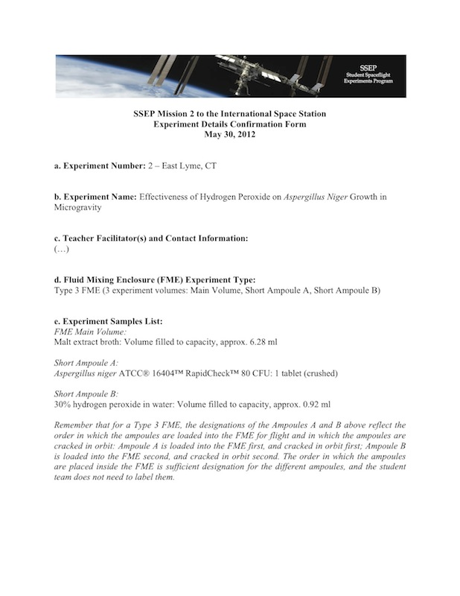
Confirming Experiment Selection
Once an experiment is tentatively selected, then what? Experiment team:
Must answer any outstanding questions posed by the reviewers
Have to finalize the list of experiment samples with precise concentrations
Need to confirm special handling requests and timeline for experiment handling aboard ISS
After all these points have been addressed, the tentative experiment selection can be confirmed.
CONGRATULATIONS!

Slide 5
Required Specificity of Experiment Samples
To be selected for flight, teams must list their experiment samples at the required level of specificity. For example, if a team wants to fly “Lactobacillus acidophilus and milk powder” in Short Ampoule A, sample descriptions need to be precise:
Short Ampoule A:
Mixture of powdered, freeze-dried Lactobacillus acidophilus (5x10e9 CFU/ml) and powdered milk at ratio 1:3 (25% powdered Lactobacillus acidophilus; 75% powdered milk): Volume filled to capacity, approx. 0.92 ml
This specificity is required to pass NASA flight safety review.

Slide 6
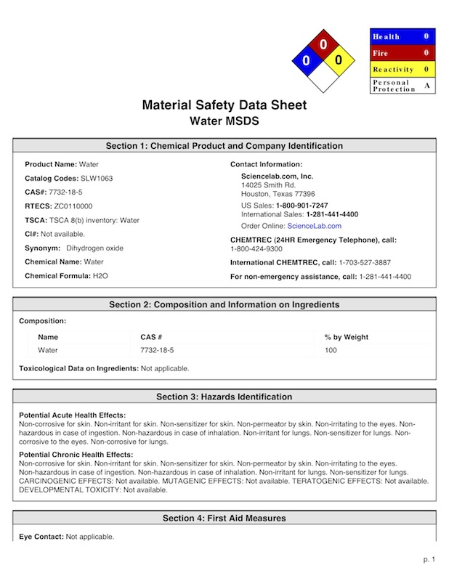
NASA Flight Safety Review
Before flight, all selected experiments must pass a flight safety review conducted by NASA Toxicology.
The purpose of the review is to ensure that the samples inside the experiment device pose no risk to the astronauts.
For the review, the teams must provide:
Final samples list with concentrations provided at the required specificity
Material Safety Data Sheets
Test results for human samples
NanoRacks provides the required data to NASA 90 days before launch.
To date, all SSEP samples lists have passed the NASA flight safety review.

Slide 7
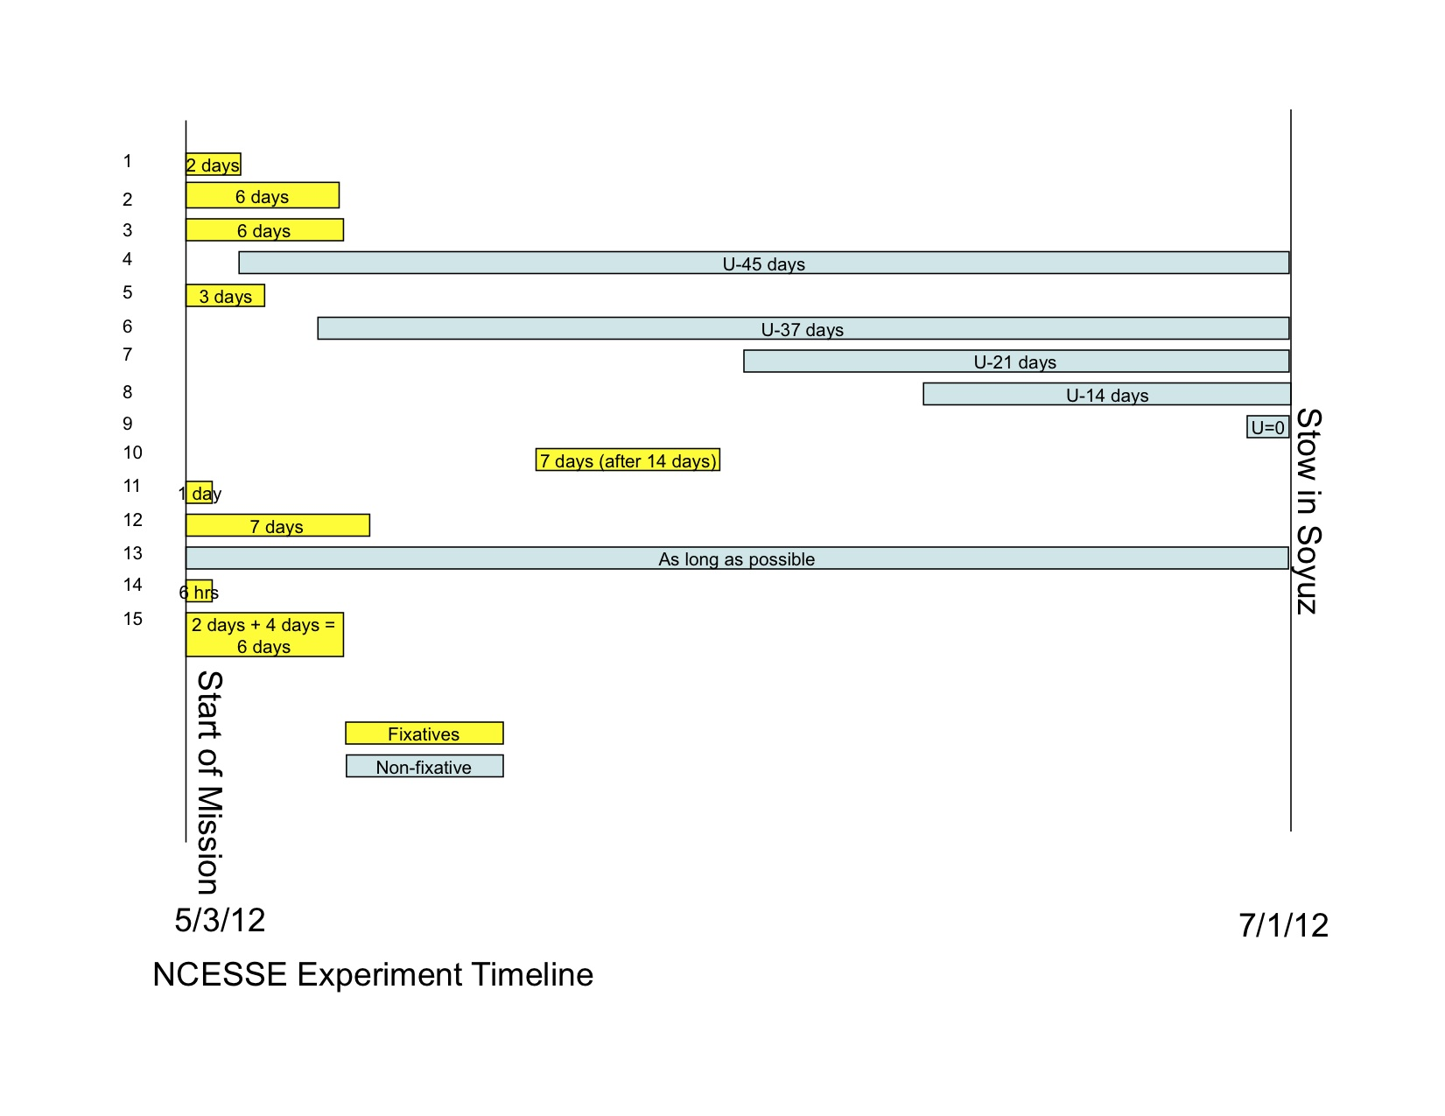
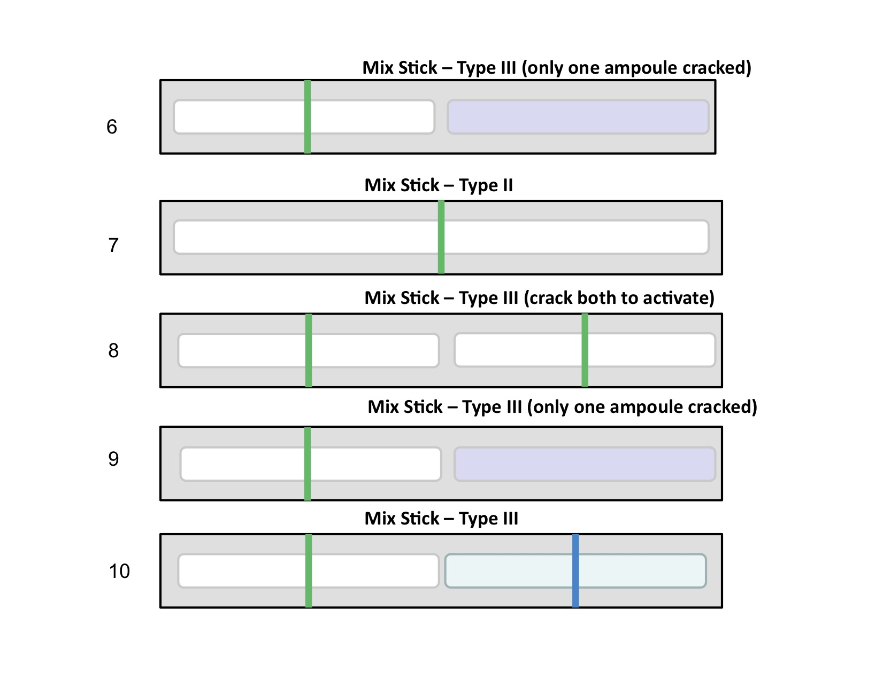
Timeline of Activities aboard the ISS
NanoRacks works with ISS crew scheduling team to place the activity with the SSEP payload into the astronauts’ work schedule. As part of this process:
Timeline for the entire payload is created that shows which experiments are manipulated at what point during the flight
The mini-laboratories (FMEs aka MixSticks) are assigned a descriptive schematic according to their type and when the ampoules are to be cracked
It is highly useful for the timeline to be as accurate as possible at this point.

Slide 8
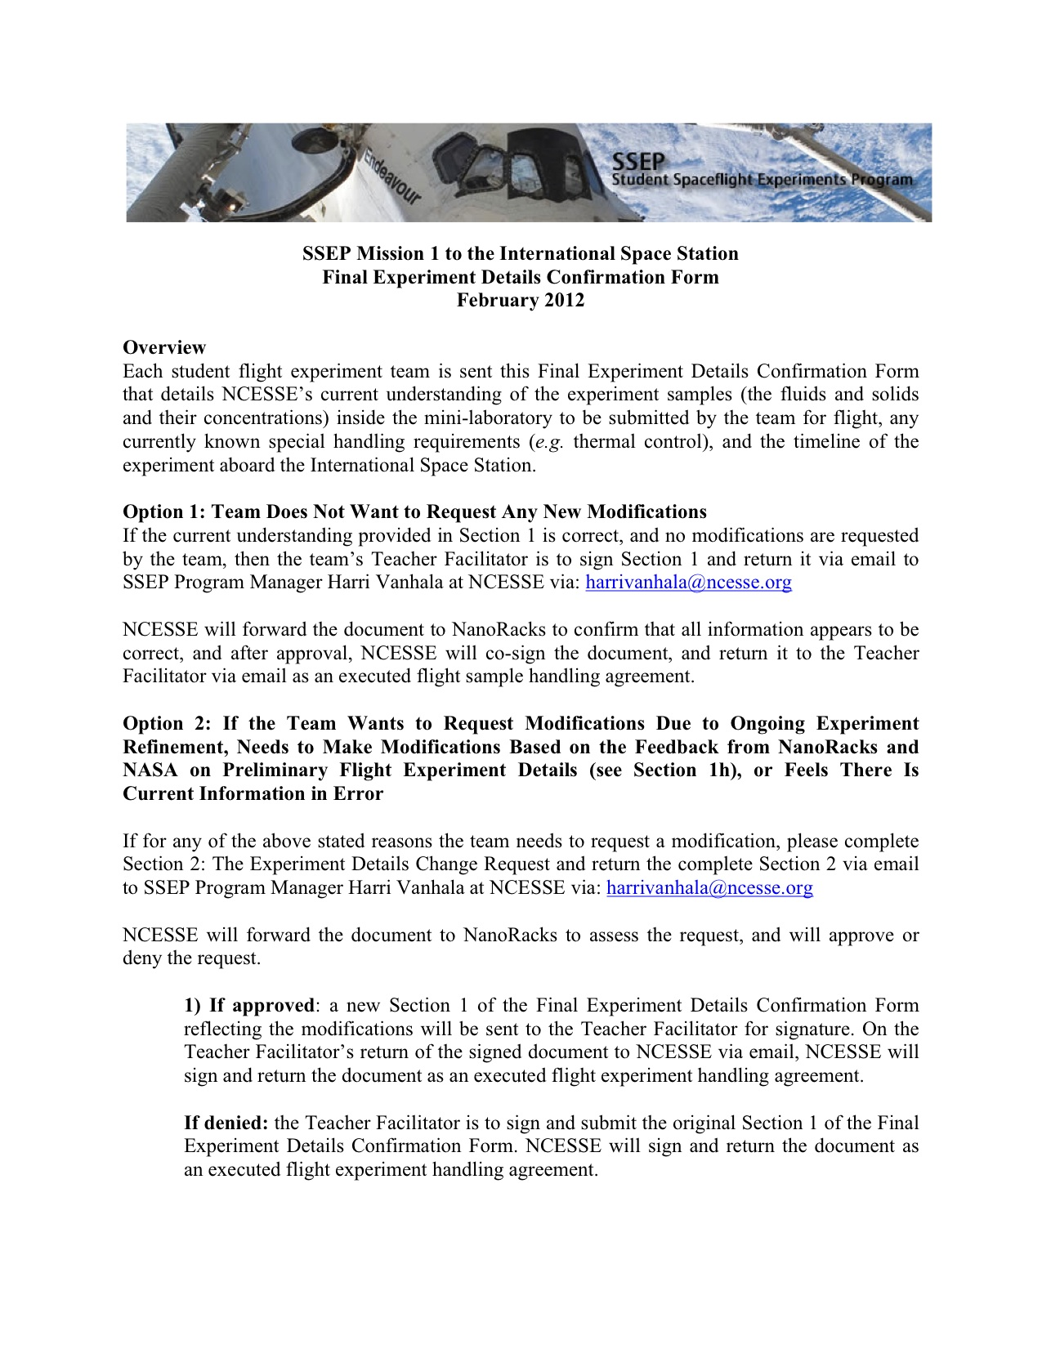
Preparing Experiments for Flight
After experiment details have been submitted to NASA safety review, the teams can continue to test and refine their experiment design as follows:
No new samples can be introduced.
The concentrations or amounts of any samples can not be increased; however, they can be reduced.
Special handling requirements can be revised.
Experiment timeline aboard ISS can be modified (within constraints)
NCESSE works with experiment teams and NanoRacks to confirm final details before mini-labs are sent for flight.

Slide 9
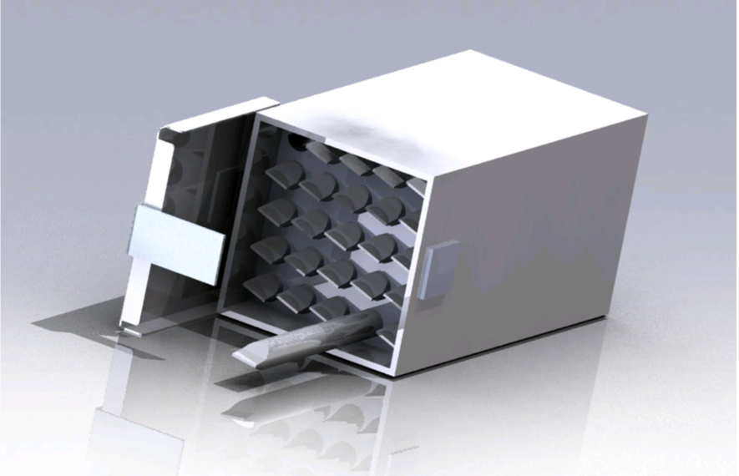
Payload Integration
When final experiment details are confirmed, teams will load the experiment samples into the mini-laboratories and ship the flight-ready devices to NanoRacks (typically four weeks before launch.)
Once received, the mini-laboratories are stored according to the special handling requests made by the team.
During payload processing, NanoRacks will seal the mini-labs for flight:
Drill a pin through the teflon end cap
Heat-seal level 2 and 3 containment bags
The mini-labs are placed in the SSEP payload box, which is placed inside a transport container (typically refrigerated.)

Slide 10
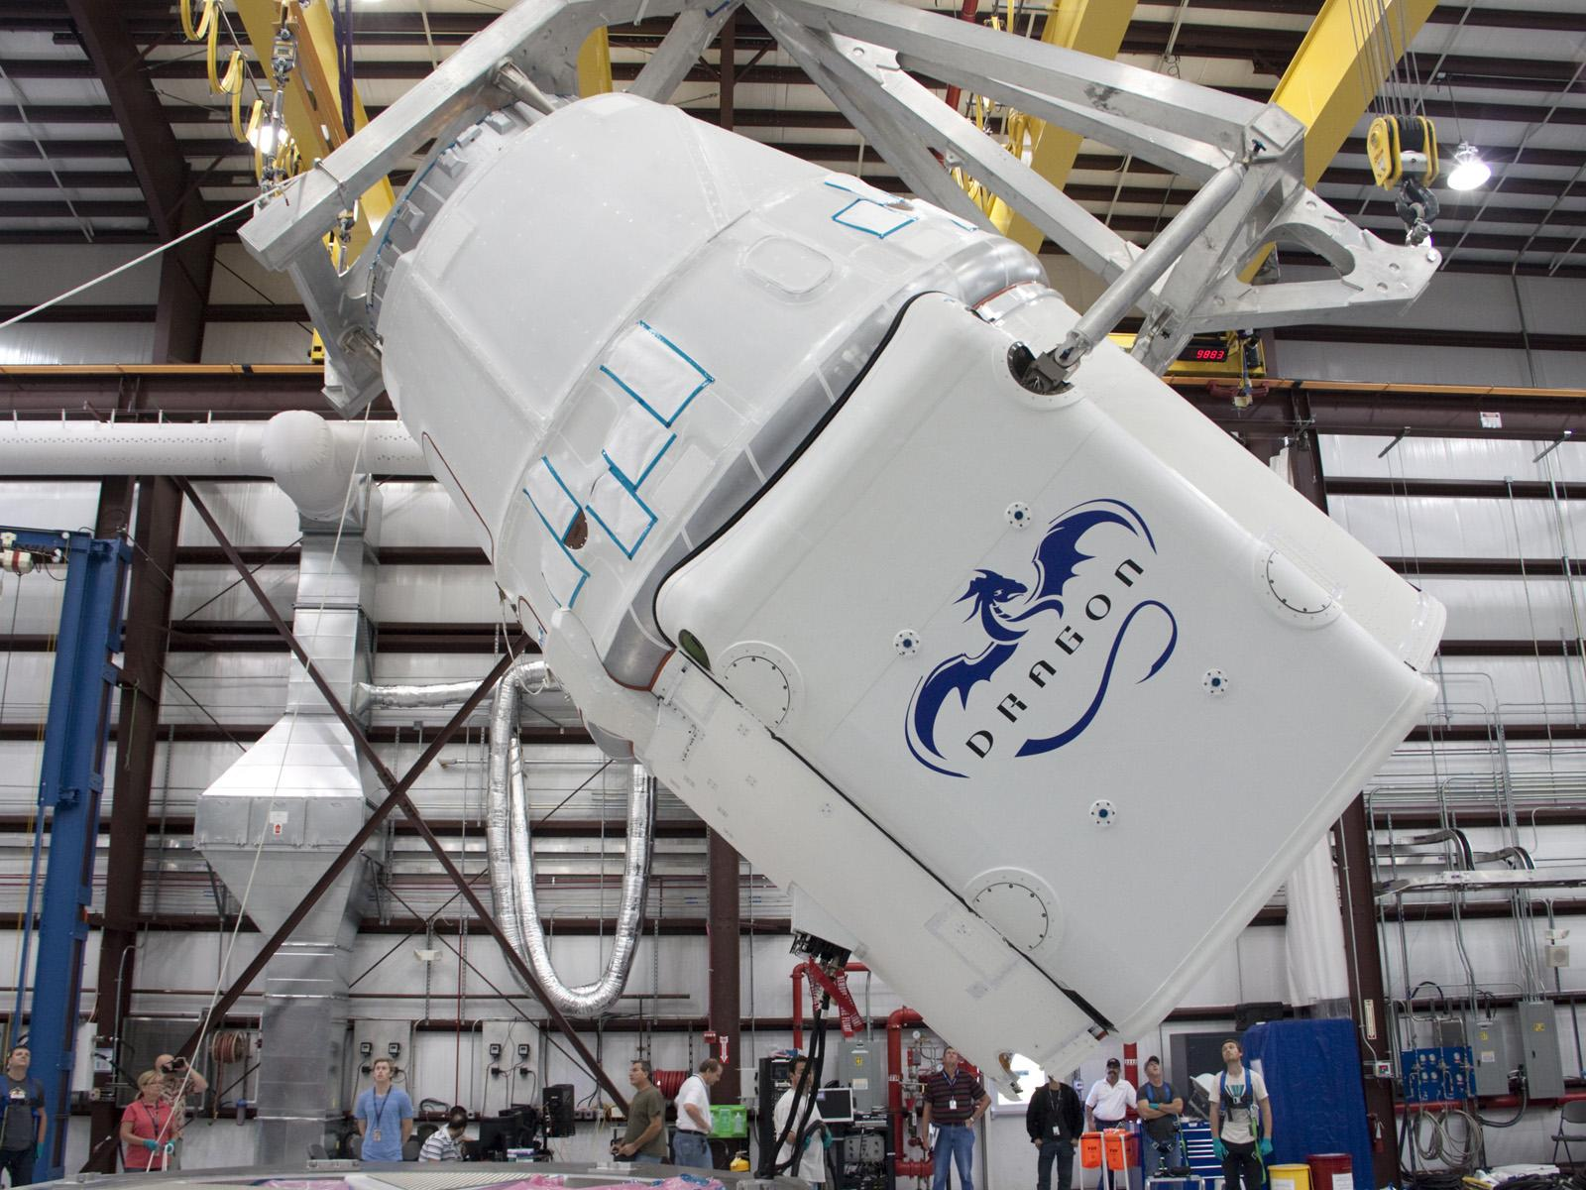
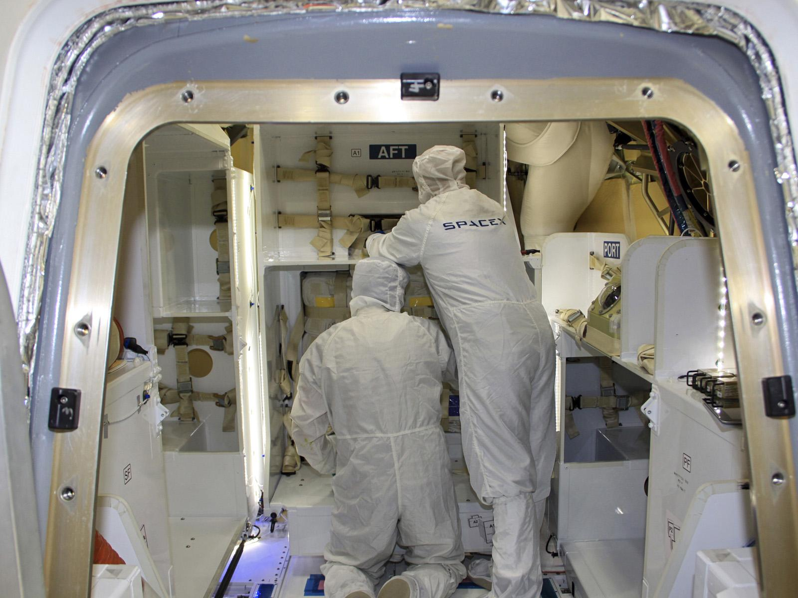
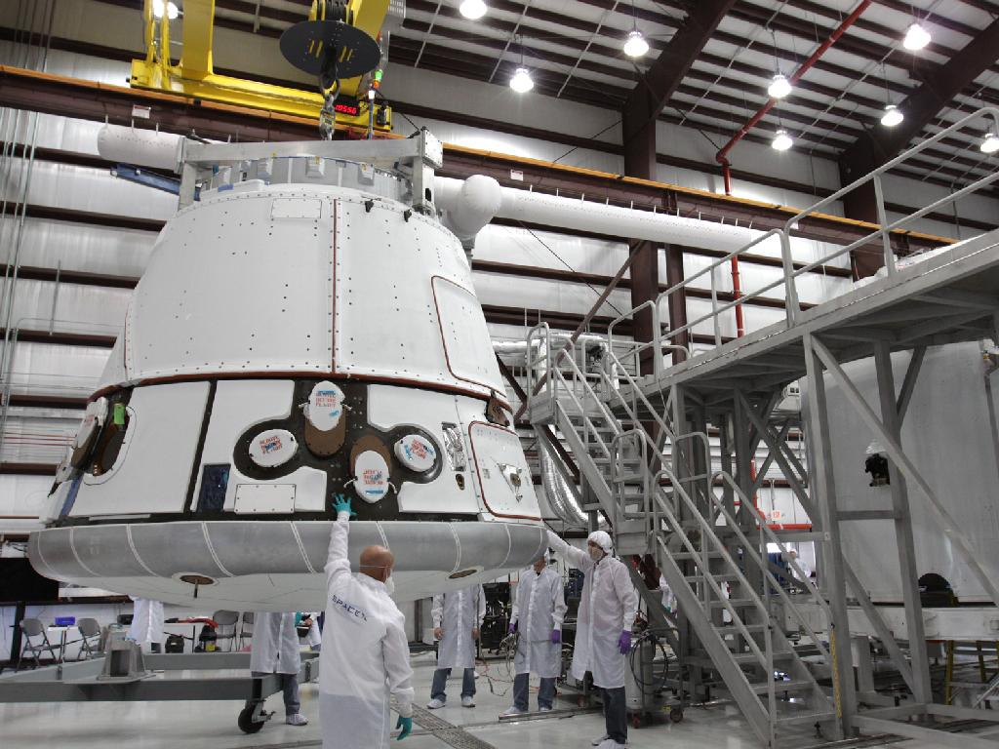
Pre-Launch Activities
For transportation to the ISS, the SSEP payload is placed inside an appropriate ferry vehicle (for SSEP Mission 1 to ISS, SpaceX Dragon) to wait for launch. Depending on the ferry vehicle to be used, this may be 1.5 – 4 weeks before launch.

Slide 11
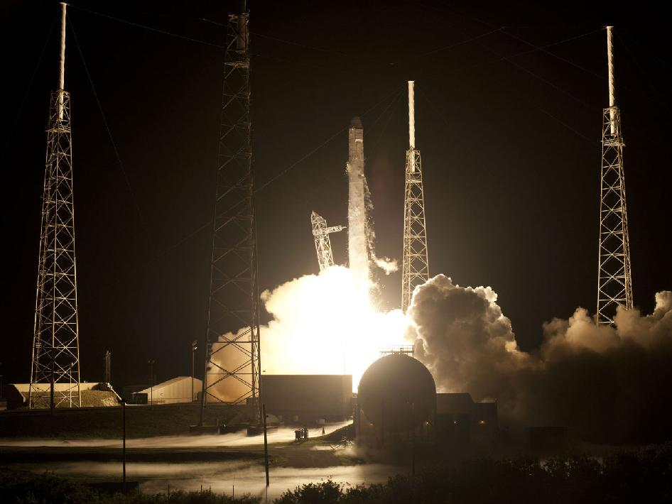
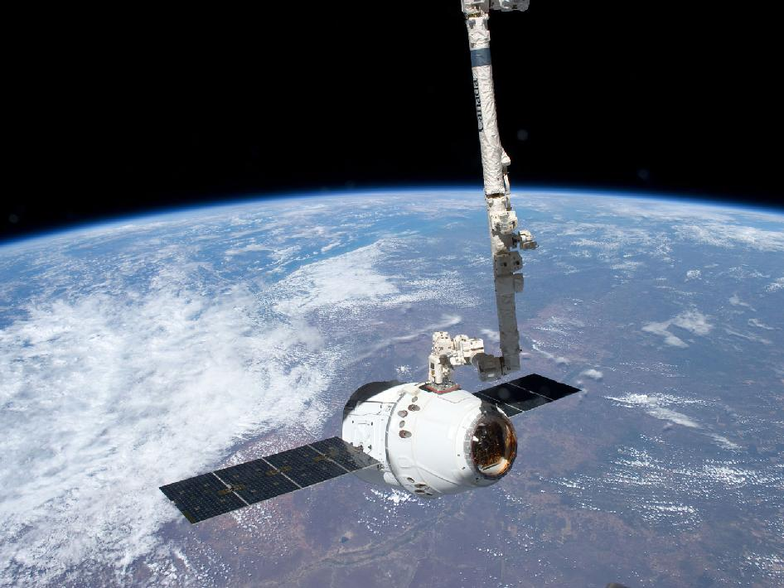
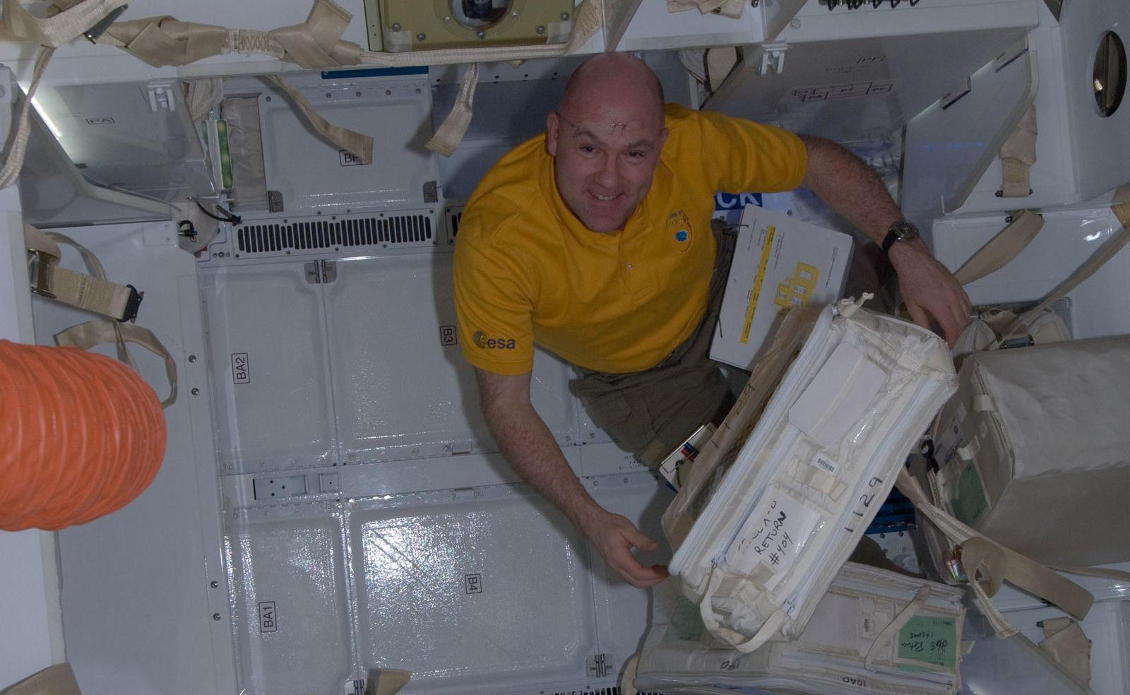
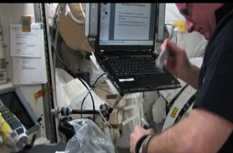
Launch and Arrival at ISS
Good luck to all SSEP experiment teams!

