Slide 1
Effect of Microgravity on the Antibacterial Resistance of P. aeruginosa
Community 1 - San Marino, CA
Principal Investigator: Martin Liu
Co-Investigators: Kristie Liu, Ryan Puri, William Tam
Teacher Facilitator: Joseph Carmona
Community Program Director: Wyeth Collo

Slide 2
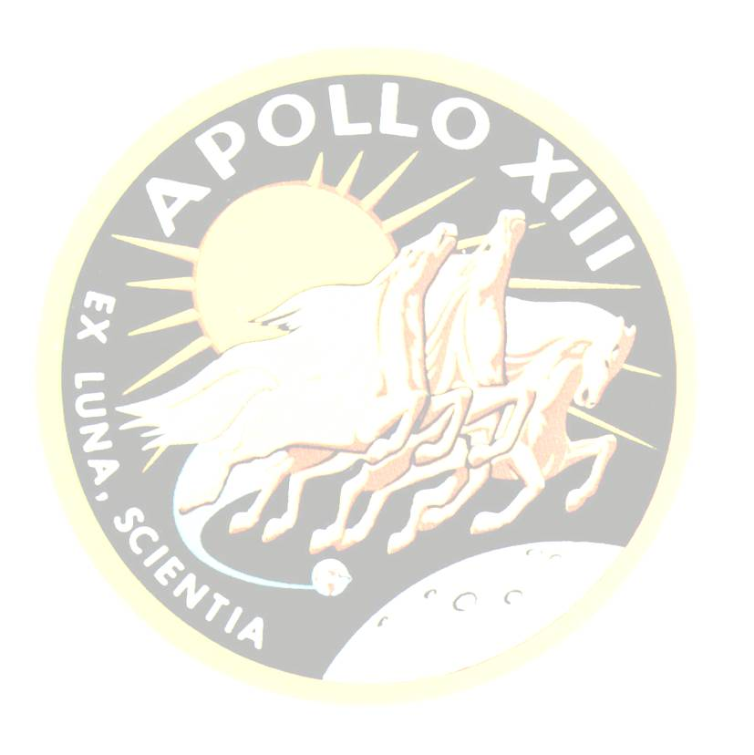
History
- In 1970, astronaut Fred Haise was infected by Pseudomonas aeruginosa aboard the Apollo 13 mission
- Bacteria found in the water supply of the Apollo 13 module
- Previous research has shown that short-term exposure to microgravity decreases antibacterial resistance while long-term exposure increases resistance

Slide 3
Pseudomonas aeruginosa
- Facultative anaerobe
- Innate resistance to a variety of antibiotics and can easily develop new resistance
- Free-living bacterium often found in soil
- Very few nutritional requirements, occasionally found growing in distilled water
- Affects those with compromised immune systems or exposed tissue

Slide 4
Abstract
By growing two bacterial cultures of Pseudomonas aeruginosa, the students of San Marino High School team 1 investigate the effects of anti-gravity on the antibacterial resistance of bacteria. With help from Oaks Crest Institute in Pasadena, CA, the students strongly believe that microgravity will play a difference in the resistance to common antibiotics.

Slide 5
Experiment Samples
Type 3 FME
- FME Main Volume: 5.50 ml of Broth Medium
- Short Ampoule A: 1 mg freeze-dried Pseudomonas aeruginosa (ATCC® 10145)
- Short Ampoule B: 0.512 ml of 0.5 mg/ml L-Valine in distilled water
A
B

Slide 6
Procedure
- Two cultures, one in space and one on Earth, will be grown simultaneously for 48 hours
- P. aeruginosa stays dormant until Ampoule A is released and the bacteria is reactivated by Broth Medium
- After sufficient growth time, Ampoule B is broken and L-Valine inhibits the growth of the bacteria

Slide 7
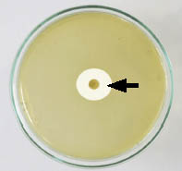
Data Analysis
- 0.512 ml of 0.5 mg/ml L-isoleucine is added to both cultures revives bacteria
- Both samples incubated for a short period to allow cultures to recover
- Various antibiotics, including but not only ampicillin, streptomycin, and
tobramycin, will be used to test
the resistance of P. aeruginosa by
examining the zones of
inhibition

Slide 8
Acknowledgments
- San Marino PTSA
- Oak Crest Institute of Science
- SSEP, NCESSE, and NanoRacks

Slide 9
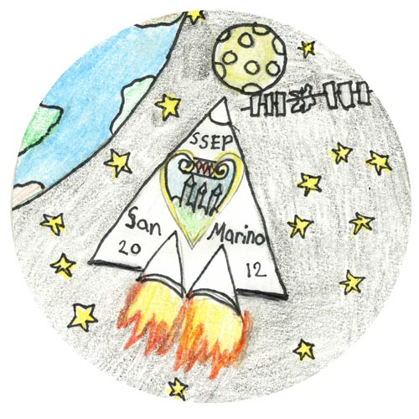
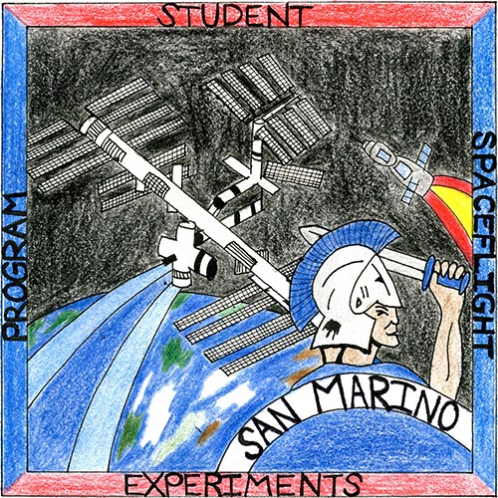
Patch Winners
Emma Catherine Collo
Valentine Elementary School
4th grade
Hope Welder
San Marino High School
11th grade

