Slide 1
Discovery : Champion of the Space Shuttle Era
Jennifer Levasseur
Museum Specialist
Smithsonian
National Air and
Space Museum

Slide 2
Discovery Comes to Washington

Slide 3
And to the Smithsonian National Air and Space Museum

Slide 4
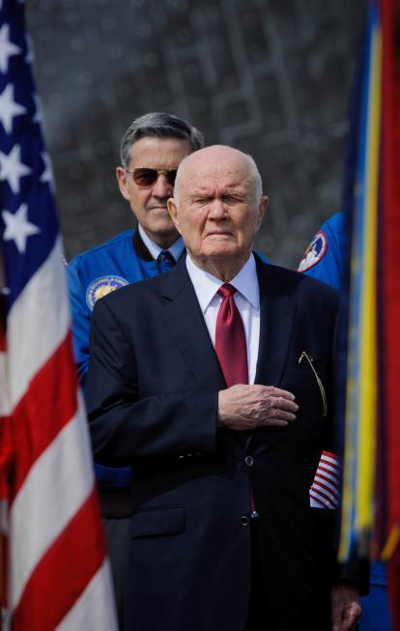
Celebration – April 2012

Slide 5
Shuttle Exchange

Slide 6
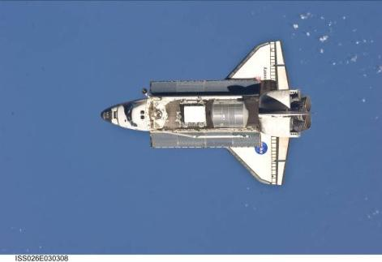
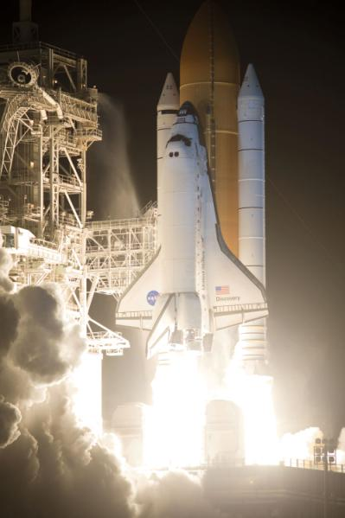
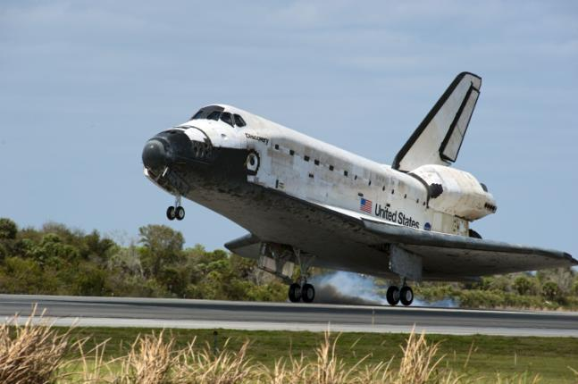
WhyDiscovery ?

Slide 7
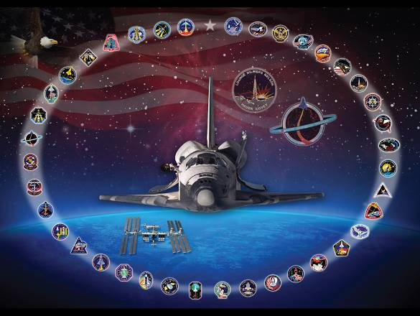
Discovery
39 missions
commercial
defense dept.
scientific
planetary
Hubble
Mir
ISS
365 days in space
1.5 million miles
184 individuals
251 crewmates

Slide 8
Discovery : Champion of the Shuttle Fleet
1984 First mission
1988 Return-to-Flight vehicle after Challenger tragedy
1990 Delivered Hubble Space Telescope into orbit
1997 Hubble servicing mission
1998 Final shuttle mission to Russian space station Mir
1999 Hubble servicing mission
2000 Flew 100th shuttle mission
2005 Return-to-Flight vehicle after Columbia tragedy
2011 39th and final mission
1999–2011 Delivered trusses, Harmony node, Kibo laboratory, Robonaut 2, permanent logistics module, and tons of supplies to International Space Station
1984 First commercial payload specialist to fly on shuttle
1985 First U.S. government official in space
1989 First African American spacecraft commander: Col. Frederick D. Gregory
1993 First Hispanic woman in space: Dr. Ellen Ochoa
1995 First woman spacecraft pilot: Lt. Col. Eileen M. Collins
1995 First African American spacewalker: Dr. Bernard Harris
1995 First shuttle mission to Russian space station Mir
1998 Only shuttle flight of a Mercury astronaut Senator John H. Glenn
1999 First docking with International Space Station
2005, 2007 Only orbiter flown by both women commanders
Col. Eileen M. Collins and Col. Pamela A. Melroy

Slide 9
Discovery on Display

