Slide 1
Human Spaceflight and American History
Roger D. Launius
National Air and Space Museum
Smithsonian Institution
Washington, D.C.
June 26, 2012
Notes:
Introductory Slide.
This presentation is the result of research over time compiling polls from various sources showing the public’s perception of NASA. While one may question the validity of polls, they tend to show several trends that offer verisimilitude.

Slide 2
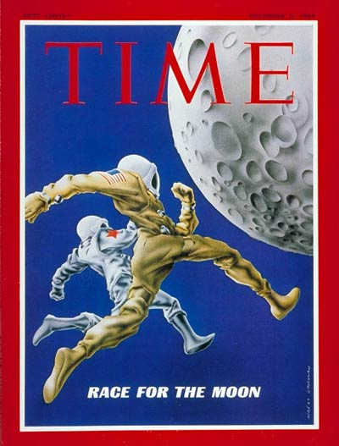
Human Spaceflight’s Dominant Frames
Cold War Competition
  U.S./USSR national security
  Dominant in period between 1950s and 1980s
  Combat by non-lethal means
  Pride and prestige powerful drivers
Cultural Conceptions
  Historical perceptions of exploration
  National narratives (frontier, progress, exceptionalism, etc.)
Economics and Commerce
  Dominated by movement of electrons (comsats, remote sensing, etc.)
  Ground-based components central to commercial viability (GPS and ground-based uses worth billions)

Slide 3
Public Support for Apollo
Americans did not send astronauts to the Moon with Project Apollo between 1969 and 1972 because everyone supported it.
Notes:
Should the Government Fund Human Trips to the Moon
Favor Oppose Source
Jun-61 42 46 1
Feb-65 39 52 1
Oct-65 45 42 2
Jul-67 34 54 2
Apr-70 39 56 2
Jul-79 44 51 3,4
Jul-94 47 47 5
Jul-95 47 51 6
Jun-99 46 50 5
Jul-03 52 45 6
Dec-03 53 44 1
Jan-04 48 48 7
Jul-04 47 50 2
Sources: 1 Gallup
2 Harris
3 CBS/NYT
4 NBC/AP
5 CNN/USAT
6 Zogby
7 AP by Ipsos-Public Affairs
Note: Questions asked differed slightly in wording.

Slide 4
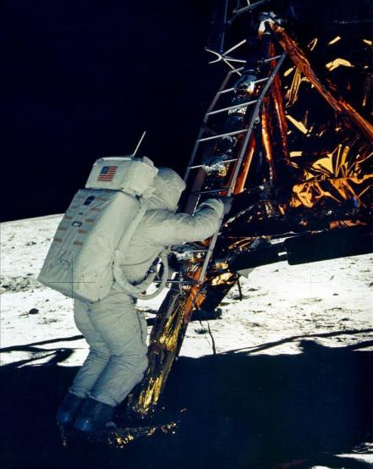
The Culmination of Apollo
$25.4 billion cost.
Apollo 11 landing, July 20, 1969.
Six successful landings altogether.
Three circumlunar flights (Apollos 8, 10, 13).
Technological advance was pathbreaking.
Scientific return was astounding.
Notes:
There are several important legacies (or conclusions) about Project Apollo that need to be remembered. First, and probably most important, the Apollo program was successful in accomplishing the political goals for which it had been created. Kennedy had been dealing with a Cold War crisis in 1961 brought on by several separate factors--the Soviet orbiting of Yuri Gagarin and the disastrous Bay of Pigs invasion only two of them--that Apollo was designed to combat. At the time of the Apollo 11 landing Mission Control in Houston flashed the words of President Kennedy announcing the Apollo commitment on its big screen. Those phrases were followed with these: "TASK ACCOMPLISHED, July 1969." No greater understatement could probably have been made. Any assessment of Apollo that does not recognize the accomplishment of landing an American on the Moon and safely returning before the end of the 1960s is incomplete and inaccurate, for that was the primary goal of the undertaking.

Slide 5
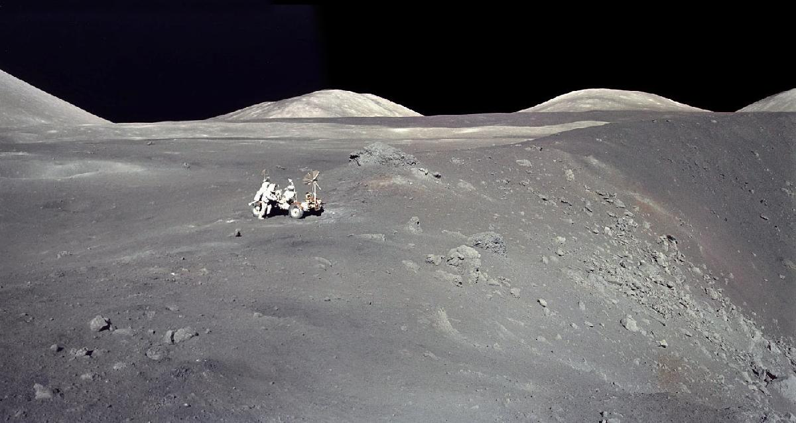
Apollo 17 Panorama
This image of Harrison Schmitt makes clear one reason Apollo was never followed with additional Moon landing programs. Humanity found nothing there of value that they wished to exploit, as had happen repeatedly in previous terrestrial explorations.
5

Slide 6
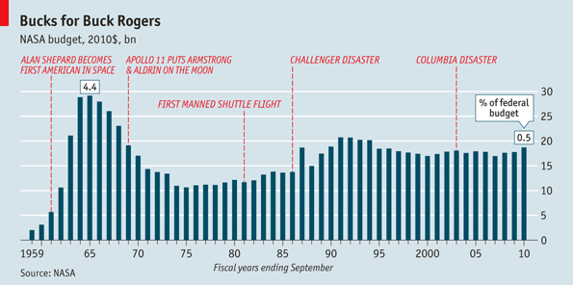
NASA Budget over Time

Slide 7
Some Good News
While Americans may not know that much about NASA’s efforts in space, they generally have a positive opinion of it. Over 70 percent say they have a favorable impression, compared to less than 20% who hold an unfavorable impression. Polls conducted by Yankelovich.
Notes:
Source: Yankelovich
Question: To Agree: "I approve of America's current civilian space program."
question changed from approve to "What is your overall impression of the space program?“
While Americans may not know that much about the space program, they have a largely favorably opinion of it--over 70% say they have a favorable impression, compared to less than 20% who hold an unfavorable impression.

Slide 8
Making the Moon a Second Home
Space Task Group Report, 1969.
  Post-Apollo program that included:
    Space Shuttle.
    Space Station.
    Moon base.
    Human expedition to Mars.
  Nixon approved only Space Shuttle, January 1972.
Space Exploration Initiative, July 1989.
  Moon base.
  Human expedition to Mars.
  Ended by 1991 because of $400B price tag.
Vision for Space Exploration, January 2004.
Notes:
When Richard Nixon took office, he appointed a Space Task Group to study post-Apollo plans and make recommendations. Chartered on 13 February 1969 under the chairmanship of Vice President Spiro T. Agnew, this group met throughout the spring and summer to plot a course for the space program. The politics of this effort was intense. NASA lobbied hard with the Group and especially its chair for a far-reaching post-Apollo space program that included development of a space station, a reusable Space Shuttle, a Moon base, and a human expedition to Mars. The NASA position was well reflected in the group's report on 15 September 1969, but Nixon did not act on the Group's recommendations. Instead, he was silent on the future of the U.S. space program for nearly a year. Finally, Nixon issued a 7 March 1970 statement that clearly announced his approach toward dealing with NASA and space exploration, "we must also recognize that many critical problems here on this planet make high priority demands on our attention and our resources."

Slide 9
A Mission to Mars?
The challenge of human missions beyond the Moon.
Do you want t o see humans on Mars
Notes:
Sources: 1 Gallup
2 CBS/New York Times 3 Harris
4 Rockwell/Yankelovich
Note: Questions asked differed slightly in wording.
Question: Would you favor or oppose U.S. government spending to send Americans to Mars?*

Slide 10

Reconsidering Spaceflight Rationales
Currently, no firm strategic imperative for human space exploration and development
As primary rationales, human destiny, national prestige, technology spin-offs, science, and inspiration of youth appear insufficient
Expansive views of economic development and survival might become primary rationales of future

