Slide 1
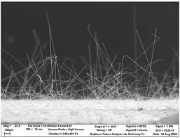
The Affect of tin whisker growth on a lead-free solder test bed
By Gabriel Voigt And Joe Garvey

Slide 2
Experiment rationale
Tin whiskers are a modern problem that can destroy any device with lead-free solder. They have destroyed planes and satellites, costing millions of lost dollars.
Tin whiskers are thin crystalline structures that come from metal that is covered with tin, tin solder, or metal that is plated with tin. Tin whiskers are less likely to form on solder with lead in the alloy mixture, but lead is a health hazard.
Our team would like to send up a lead-free solder testbed and compare it to one that was left here on Earth.
A printed circuit board also would be sent and would be compared with an identical circuit board on Earth.
Notes:
Tin whiskers are a modern problem that can destroy any device with lead-free solder. Tin
whiskers are thin crystalline structures that come from metal that is covered with tin, tin solder,
or metal that is plated with tin. These tin whiskers can cause a short circuit of a device by
creating a new current. They have destroyed planes and satellites, costing millions of lost dollars.
Today there is a modern belief that zero gravity and microgravity cause tin whiskers to be
reated faster. Though a lot of people think this, several people at NASA believe that
microgravity and zero gravity do not make a difference in how fast tin whiskers are created. We
believe that tin whiskers develop because of compression and stress instead of microgravity.
The testbed would be made of a brass substrate electrically plated
with tin. In addition, a printed circuit board would be sent, too, and would be compared with an
identical circuit board on Earth. The testbed would increase the chances of tin whiskers
occurring, and the printed circuit board would be an authentic representation of circuitry present
on satellites and other in-orbit machinery. With this data, we should be able to determine if
microgravity affects the development of tin whiskers.

Slide 3
Materials
1. Type 1 FME (quantity of 2)
2. 12 cm x 0.5 cm tin-soldered printed circuit board (quantity of 2)
3. Circuit board printing machinery
4. Polyethylene foam packing cylinders for securing testbed in tube (Quantity of 4
cylinders; 0.5 cm in diameter, 1.27 cm in depth)
5. 99% pure tin bath
6. 12 cm x 0.5 cm Brass substrate (lead-free)
7. 50 volts of electric current
8. Plating machinery
9. Scanning electron microscope
10. Standard microscope

Slide 4
Experimental preparation
Two FME’s would be prepared according to these specifications. One FME would stay on Earth, and the other would go to the ISS.

Slide 5
Data analysis
Data from both FME’s would be analyzed and compared.
The testbed would be examined with a scanning electron microscope to look for tin whisker formation.
We could continue to analyze the solder test bed and circuit board for many years. Tin whiskers can continue to form for years.
Notes:
In space we will keep in touch with the astronauts on the space station, and we will ask
them if they notice any changes to our electroplated testbed or our printed circuit board. The
astronauts will not record any data on the Type 1 FME. All of the data will be recorded and
analyzed back on Earth and will be compared to the data recorded and analyzed from the control
experiment that stayed back on Earth. We will analyze the data with a scanning electron
microscope and on a normal lab microscope to maximize the amount of data recorded when the
test tube comes back from space. As soon as the test tube comes back, we could continue to
study and analyze any tin whisker formations yearly as a class project. This is a neat aspect of
our project. Our experiment can continue throughout our high school careers at PSA.

Slide 6
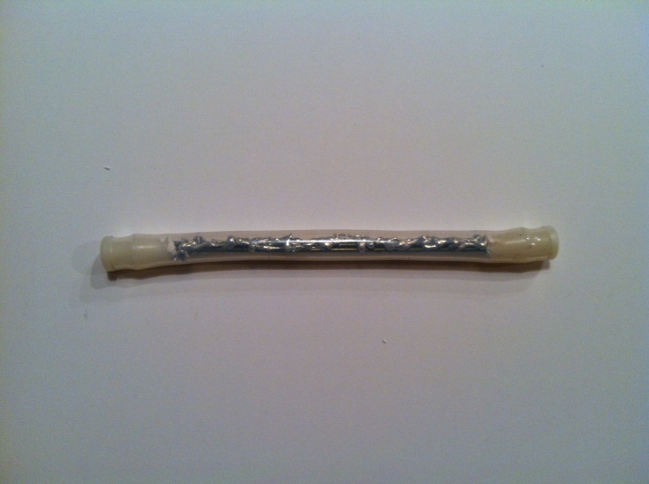
GROUND TRUTH EXPERIMENT
Since our experiment was not selected for spaceflight, our experiment could no longer conform to the research proposal due to lack of resources.
A metal solder testbed was created within the Type 1 FME. Lead-free solder covered the metal substrate.
The printed circuit board was eliminated due to financial constraints.
The Type 1 FME is in a secure location at room temperature. Substrate can be analyzed by a student microscope to look for tin whisker formation.
Notes:
Ground Elements and Analysis
The control experiment on Earth will be set up exactly the same as the test tube going to
space to ensure the accuracy of the experiment. This will give us the best results because there
are no altering variables besides the independent variable of microgravity. The test tube will be
stored in a secured environment that will not be under any stress or exposed to anything that will
jeopardize the effectiveness of the experiment. Thus, we can ensure that our data is valid. When
the test tube comes back from space, we will record and analyze data with a lab microscope and
a scanning electron microscope, comparing it to our control. Once again, we would continue
studies for years to come.

Slide 7
Acknowledgments
Thank you to the Partners and Sponsors who made this experiment possible:
Partners
Space and Naval Warfare Systems Command (SPAWAR)
Center for the Advancement of Science in Space (CASIS)
National Center for Earth and Space Science Education
College of Charleston
Medical University of South Carolina (MUSC)
National Oceanic and Atmospheric Administration (NOAA)
Sponsors
ISHPI
CASIS
Palmetto Scholars Academy Board Members
Palmetto Scholars Academy Families

