Slide 1
How Does Microgravity Effect the Mold Growth on Food?
By: Amanda Chavez & Brianna Azuara
Notes:
Present Ourselves. Hello I am Brianna Chavez and this is my partner Amanda Chavez. We are from Cesar Chavez Elementary in Pharr, TX. Amanda: We are both happy to represent our school and South Texas with this microgravity experiment.

Slide 2
What is Mold?
Mold is a furry growth of minute fungal hyphae that typically grows on moist conditions and environments.
It is part of the fungi family kingdom.
Notes:
Brianna: First, we need to define what mold is a furry growth of small fungal hyphae that typically grow in moist conditions and environments. The fungi kingdom includes such things as the delicious edible mushrooms, the makers of the "miracle drug" penicillin and the yeast that makes our bread rise. Biologically, all fungi have defined cell walls, lack chlorophyll and reproduce by means of spores. Amanda: Approximately 100,000 species of fungi have been described and it is estimated that there are at least that many waiting to be discovered.

Slide 3
Conditions for growth
Mold Spores
Mold Food
Appropriate Temperatures
Considerable Moisture
Notes:
Amanda: There are 4 critical requirements for mold growth – available mold spores, available mold food, appropriate temperatures and considerable moisture. The removal of any one of these items will prohibit mold growth

Slide 4
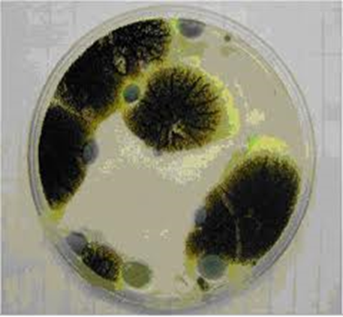
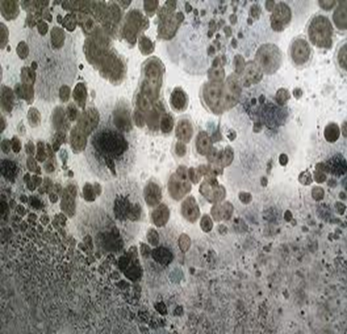
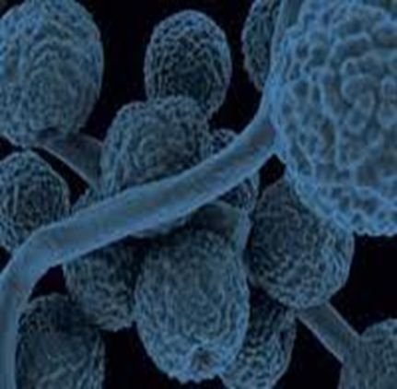
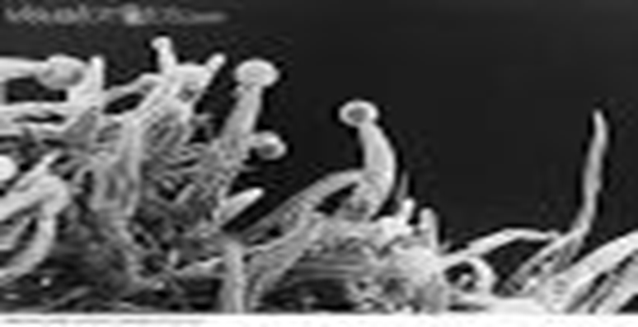
Mold
Notes:
Amanda: And if the conditions are right, molds grow like in these photos.

Slide 5
Earthbound Testing
Gerber Graduates for Toddlers lil’ Biscuits (2grams)
Aquafina distilled water
Nanorack test tubes
Clamp
Triple Beam Balance
Dropper
Notes:
Brianna: We chose Gerber Graduate Toddler Lil’ Biscuits for testing. To conduct our test we used biscuits, water, test tubes, a clamp, a triple beam balance, and a dropper.

Slide 6
Materials
Earth Experiment
Variable: Amount of water
2 g Biscuit + 2 milliliters of water = optimum mold growth.
Notes:
Amanda: Our first experiment was to determine the amount of water that is needed for ideal mold growth, not too fast or not too slow. We used the same about of biscuit in 6 different test tubes and added various amounts of water to each one. Our results could change based upon the time of the experiment return. The one that grew the most mold in a set timeframe was the one with equal amounts of biscuit and water (2 milliliters).

Slide 7
Testing in Earth’s Gravity
Procedures
1
First, put the Gerber Graduates for Toddlers lil’
Biscuits (2 grams) inside the Nanorack test tube,
Volume 2.
Then, pour the 1, 2, and 3 milliliters of
Aquafina distilled water into the three
separate test tubes.
2
Finally, we will slowly open the
clamp letting the distilled water drop, giving
the Gerber Graduates for Toddlers lil’
Biscuits moisture to start growing mold.
3
Notes:
Brianna: We set up our experiment using nanorack test tubes. We placed 2 grams of the biscuit inside the test tube. We poured 2 milliliters of water into volume 1. We slowly opened the clamp so the water would drop onto the biscuit. We observed daily for ____(how many days) and recorded results each day.

Slide 8
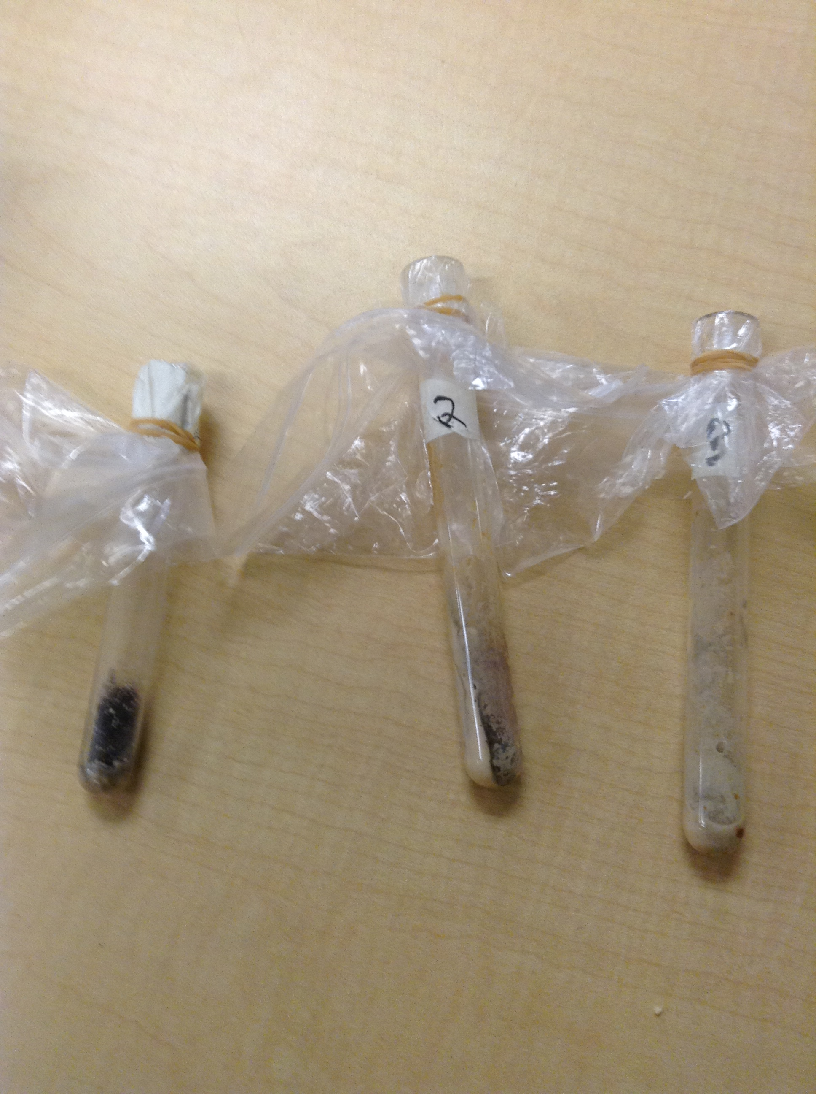
Earth Gravity Project
Conclusion
We learned that that the ideal mold growth happens when there is an equal amount of biscuit and water.
Notes:
Amanda: The ideal mold growth of our experiment here on Earth was a 1:1 ratio. Equal parts of each material.

Slide 9
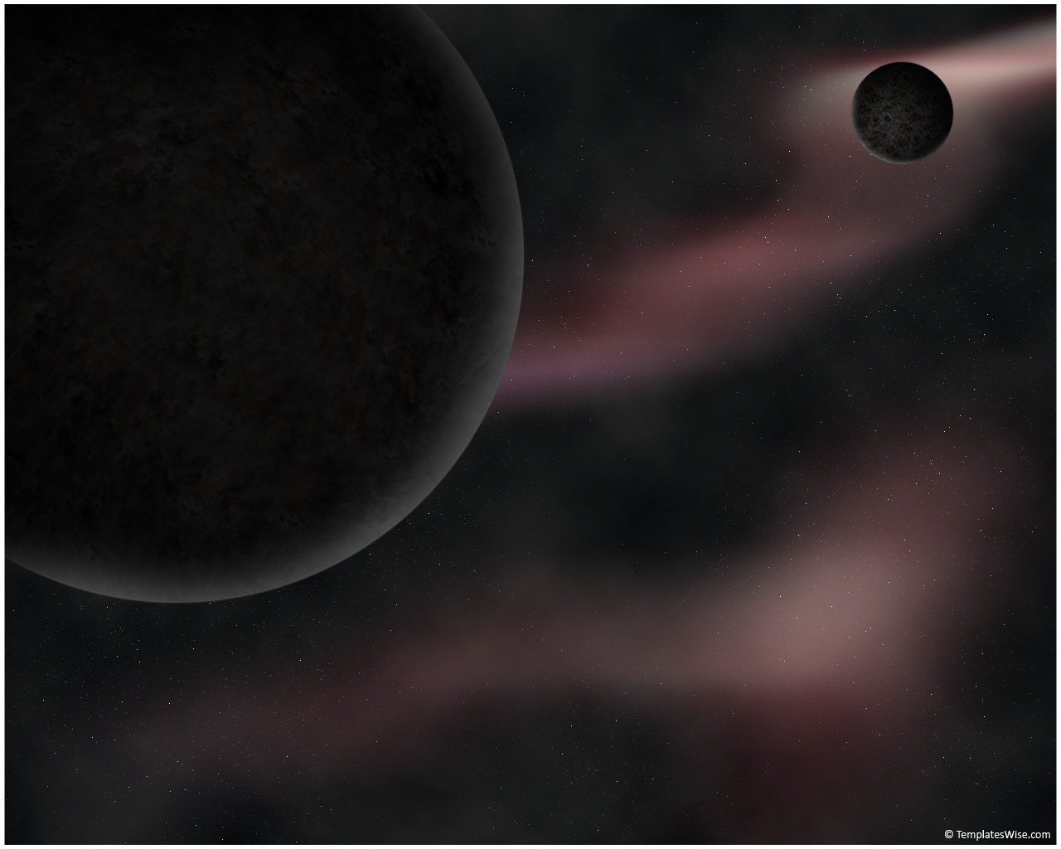
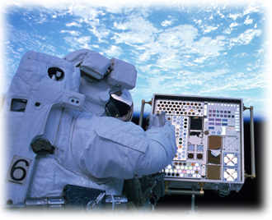
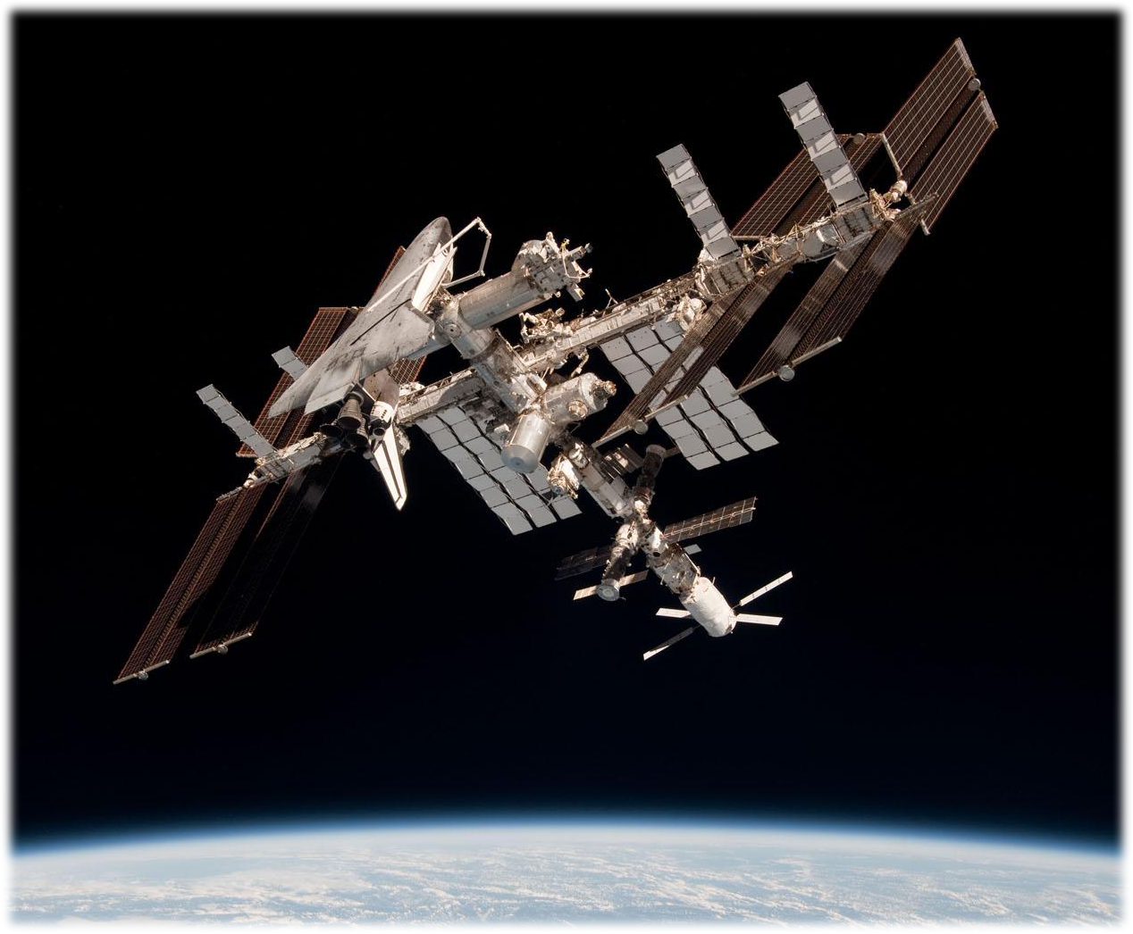
Mold in Microgravity
Notes:
Brianna: So now our question is, “How will mold grow in microgravity?”

Slide 10
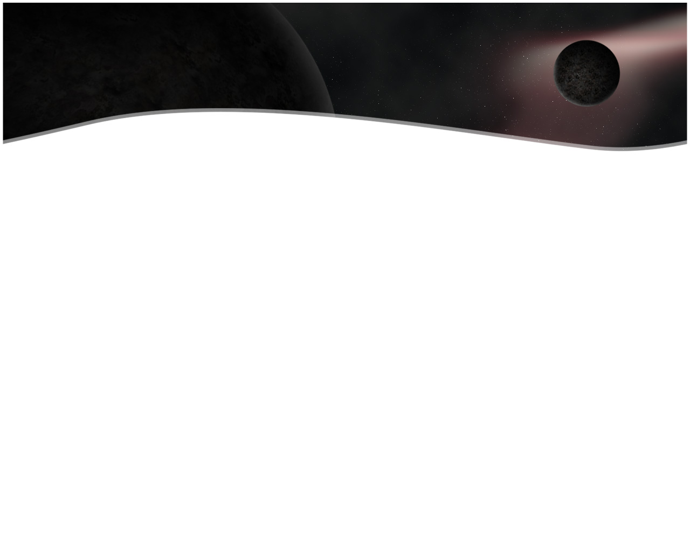
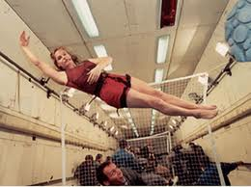
Microgravity
Microgravity, also known as zero gravity.
The condition of microgravity comes about whenever an object is in free fall.
When an object is in microgravity it appears to float.
Astronauts on the station experience weightlessness due to microgravity.
Notes:
Amanda: First, we need to understand what microgravity is. Some people call is zero gravity. It is really a condition in which there is very little net gravitational force, such as a free-falling object, an orbit, or interstellar space. It is a condition, especially in orbit where the force of gravity is so weak that weightlessness results. Objects seem like they are lighter in microgravity because the force of gravity is not pulling down on the object like here on earth.

Slide 11
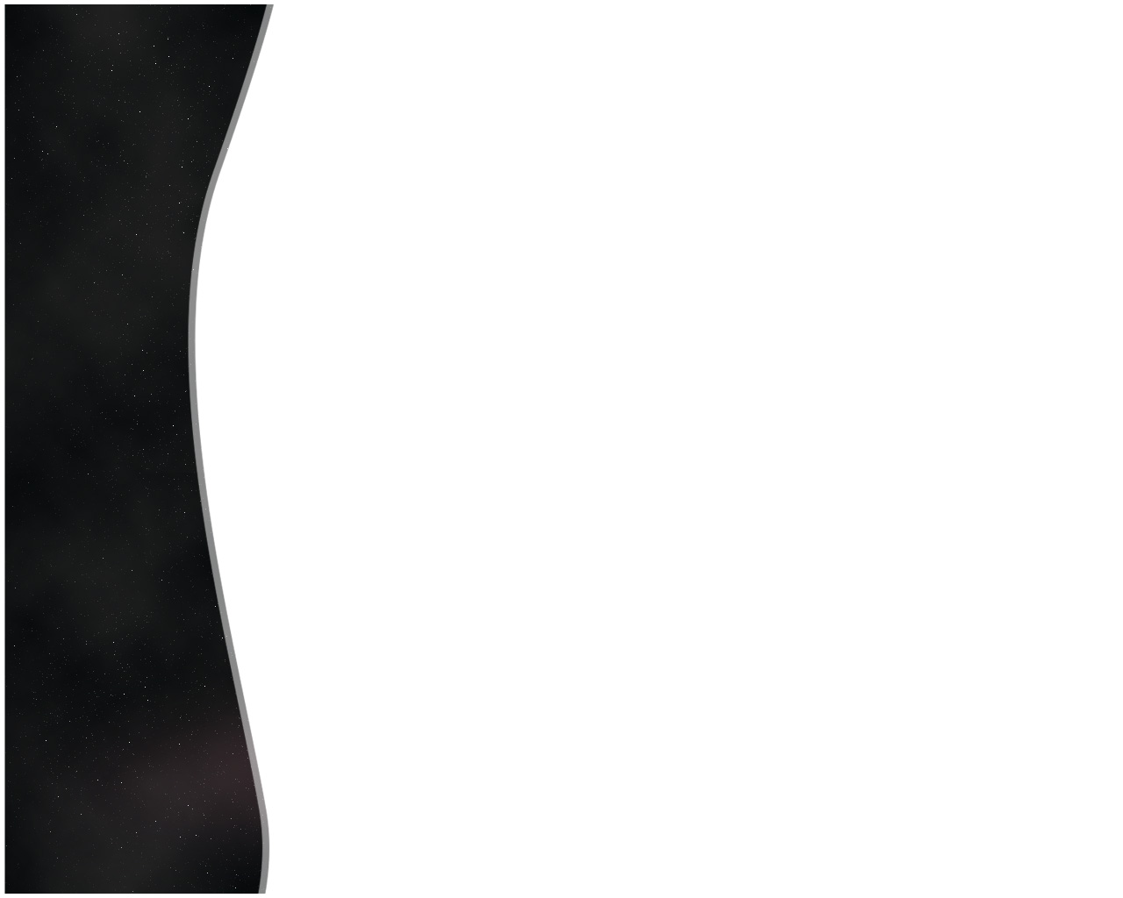
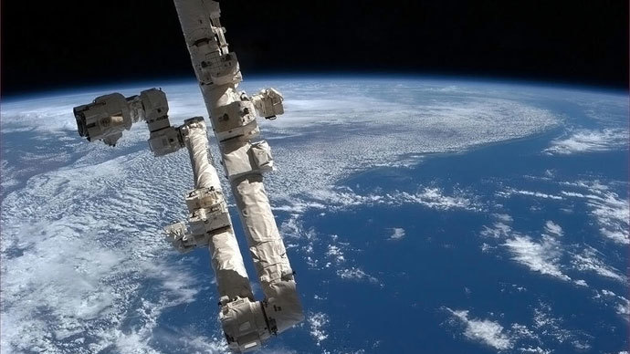
Hypothesis
Our hypothesis is that mold will grow faster in microgravity than on Earth because the mold spores are adapted to gravity. In microgravity, they will have no pressure to contain the growth of the mold.
We expect the mold to grow 2x more in microgravity.
Notes:
Brianna: We believe that the mold will grow two times faster in microgravity than on Earth because there is more heat and radiation.

Slide 12
Materials
Gerber Graduates for Toddlers lil’ Biscuits (2 grams)
Aquafina distilled water (2ml)
Nanorack test tubes
Clamp
Triple Beam Balance
Dropper
Notes:
Amanda: We will use the same materials to set up our experiment for spaceflight. 2 grams of biscuit, 2 milliliters of water, and the nanorack test tube.

Slide 13
Procedures
First, put the Gerber Graduates for Toddlers lil’
Biscuits(2 grams) inside the Nanorack test tube,
Volume 2, which will be separated by a clamp.
1
Then, pour the 2 milliliters of
Aquafina distilled water into volume 1.
2
Finally, on A+2 (2 days after the arrival) the
astronauts will slowly open the
clamp letting the distilled water contact
the Gerber Graduates for Toddlers
lil’ Biscuits to start growing
mold.
3
Notes:
Brianna: We will place 2 grams of biscuit inside the nanorack test tube Volume 2 which will be separated by a clamp. We will then pour 2 millileters of water into volume 1. Two days after arrival the astronauts will slowly open the clamp so the water will come in contact with the biscuits.

Slide 14
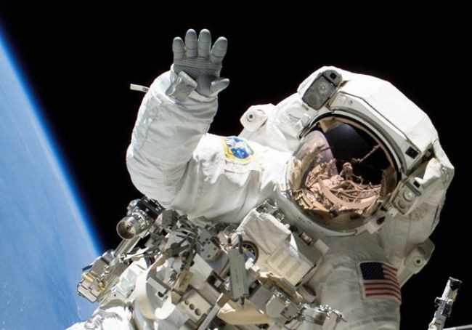
Conclusion
Pending the return of the experiment, we expect to find that mold will grow faster in microgravity than on Earth because the mold spores are adapted to gravity.
Notes:
Amanda: Pending the results from Space X we are expecting to learn that microgravity does effect the growth of mold.

Slide 15






Everything was possible thanks to our supporters:
Notes:
Brianna: We want our supporters for this wonderful opportunity: Cesar Chavez Elementary and our teacher Mrs. Celena Miller, the Rio Grande Valley Science Association, Texas Space Grant, the City of Pharr, Magic Valley, Space X, and CASIS. Thank you.

