Slide 1
Effect of Microgravity on fermentation
Principal Investigator: Max Holden Collaborator: Paige D’Andrea
Teacher Facilitator: Eric Esby and Nancy McIntyre
With the help and support of Medtronic

Slide 2
How it happened?
We were given our groups and told to pick a topic
Having grown up with a father who collects wine, I immediately thought of the fermentation process
I thought of how to apply the process in two different ways to microgravity and how to test the variable
Once I had it down I wrote it out and we tested the question: “Does microgravity effect the speed of ethyl fermentation?”

Slide 3
Experiment Design
Two Identical Type 3 FME tubes
Main tube contains Grape Juice
1 smaller tube contains yeast
1 smaller tube contains neutral buffered Formalin
The tube with yeast is broken first and shaken
After it has sat for two days the second tube containing formalin is broken and shaken
Both tubes are tested for dissolved Carbon Dioxide, and compared to test which has fermented more

Slide 4
How Adjustments were Made?
After we had our idea we had to test the amounts and size
The top to the main tube would often pop off in early test runs, due to CO2 build up
However, once we got the levels down to where it would not pop off, we needed to establish a timeframe for the experiment
It could not be too long or the CO2 levels could even out
After a few more test runs we had all our variables on point

Slide 5
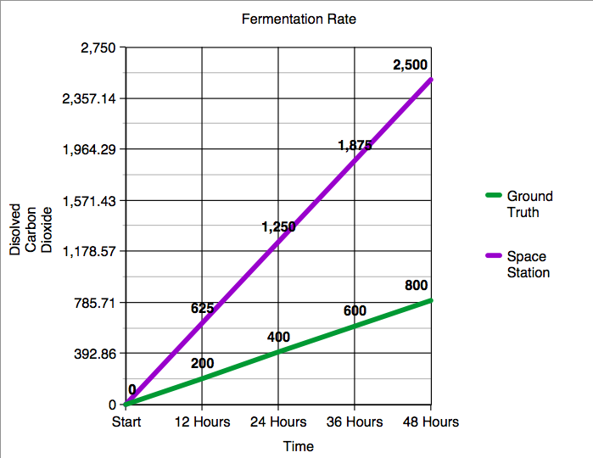
Data Collected
As you can see from the data above, the ISS tube fermented a little over three times faster
These readings are testing the PPM of dissolved Carbon Dioxide (given off in fermentation)

Slide 6
What does this mean?
Fermentation is a process that more than just food goes through
There are medicines that require fermentation along with other things
Testing one type of fermentation opens doors for testing many other types of fermentation
Due to the fermentation process being sped up drastically, it could mean larger yield for a variety of medicines and foods

Slide 7
Thank You
Mr. Esby, Mrs. McIntyre, and Mrs. McConnell
The Holden Family
The D’Andrea Family
MedTronic
Chaminade College Preparatory
SSEP
The Smithsonian Museum

