Slide 1
fibroblast Division in Microgravity
Jennifer Jiang, Jasmine Kuo, Kara Lukas
San Marino High School
San Marino, California

Slide 2
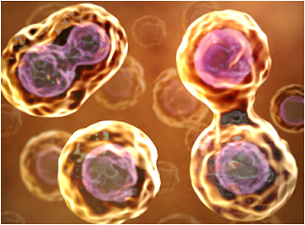
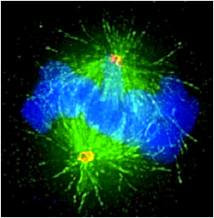
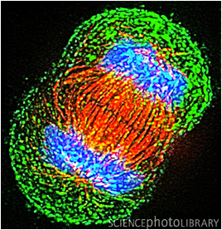
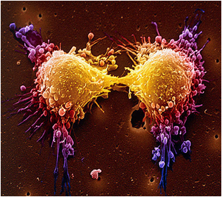
Background
Cell division is an integral component of life.
All organisms must go through the cell cycle in order to grow, develop, and reproduce.
Past experiments in simulated microgravity have shown that lack of gravity causes cells to divide at a slower rate.

Slide 3
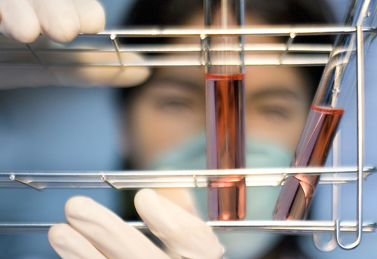
Purpose
To discover the effect of microgravity on cell division
To compare the rates of cell division in the absence and presence of gravity

Slide 4
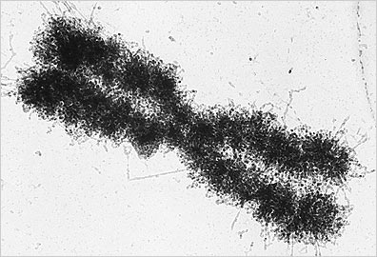
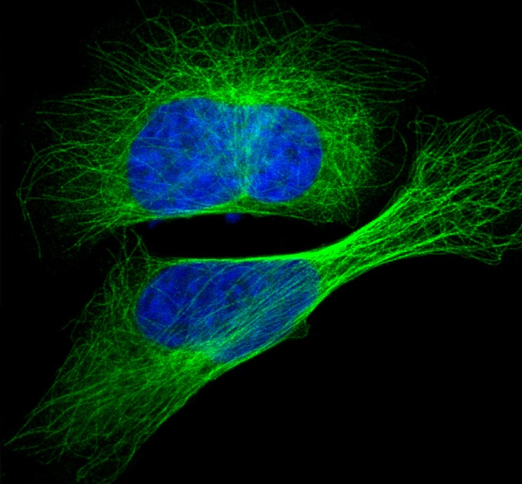
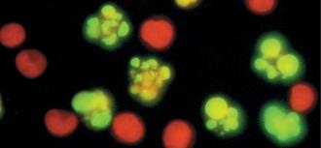
hypothesis
If cells are exposed to microgravity during their life cycles, then there will be a reduction in cell division because of
disorganization of microtubules
change in actin filaments
chromatin less dense
increased apoptosis

Slide 5
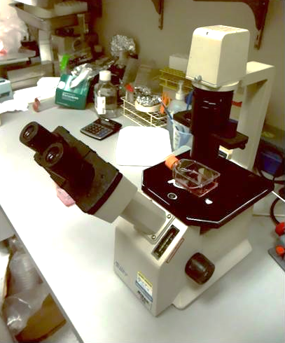
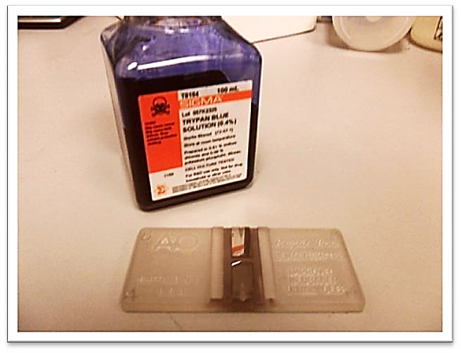
Materials
Type 3 FME
Mouse embryonic fibroblasts
Eagle’s Minimum Essential Medium (EMEM)
Fetal Bovine Serum (FBS)
Formaldehyde
Light Microscope
Hemocytometer
Trypan Blue

Slide 6
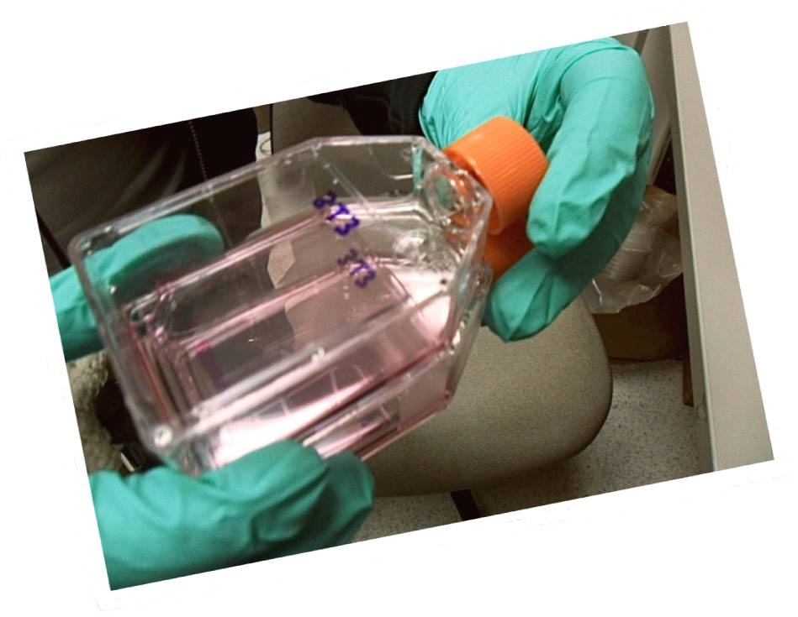
Assembly procedures
Place experiment samples into the appropriate compartment of the FME.
Main Volume
5.6 mL of EMEM
0.56mL of 100% FBS
Short Ampoule A
0.92 ml fibroblast cells
Short Ampoule B
0.92 ml formaldehyde

Slide 7
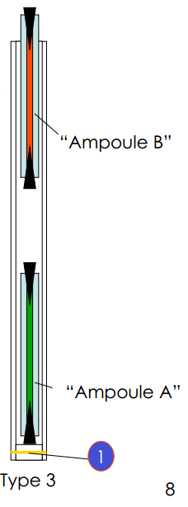
experiment
Initiation: crack Ampoule A
Termination: crack Ampoule B
Experiment lasted 9 days

Slide 8
Data
Number of fibroblasts

Slide 9
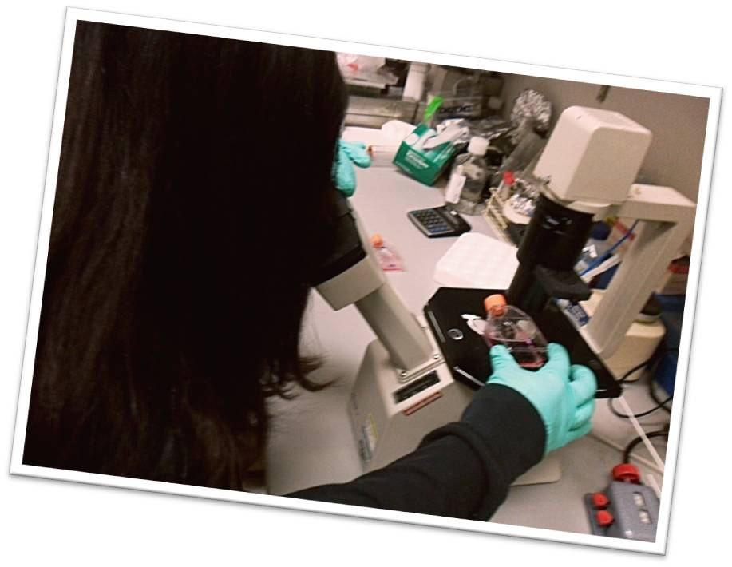
Analysis/Conclusion
Growth is more favorable for cells in 37°C CO2 incubator.
Cell growth is greater when the original cell count is increased from 500 to 750.
More conclusions will be drawn after flight experiment returns.

Slide 10
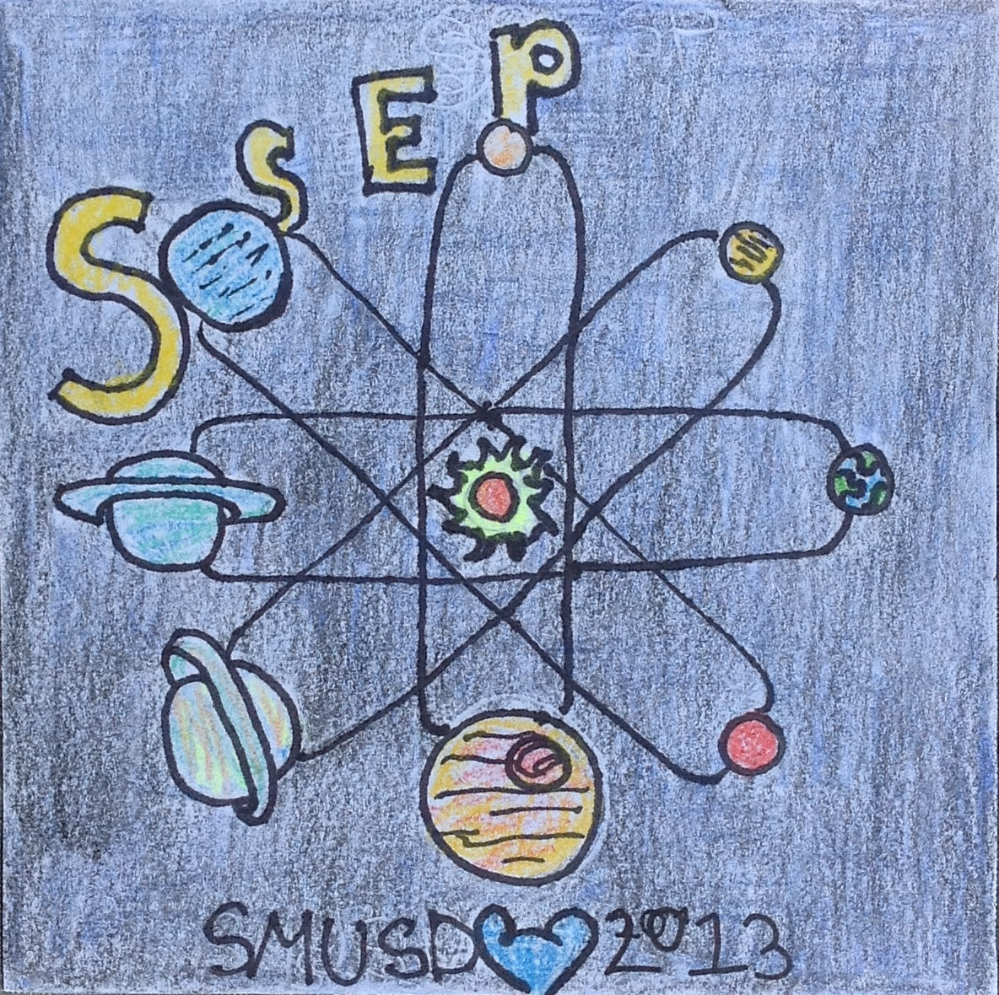
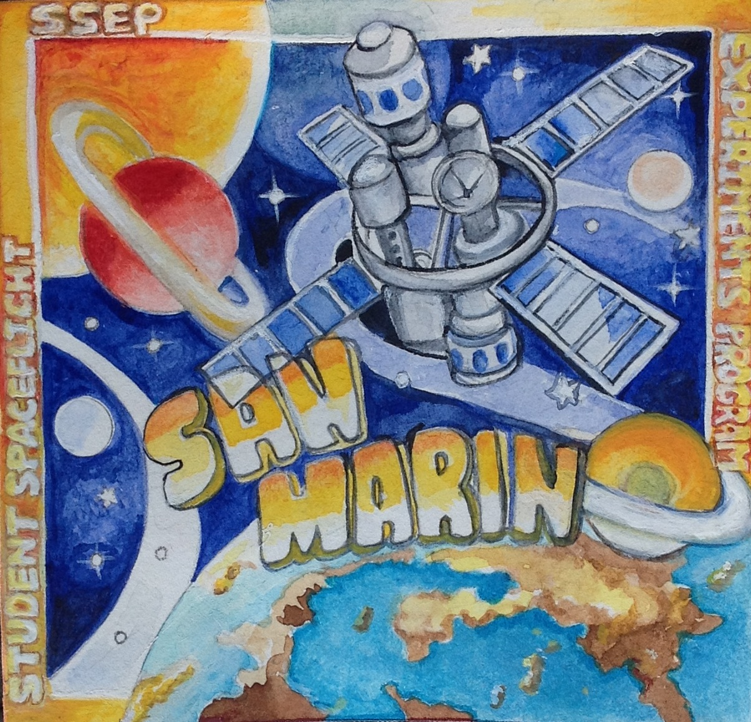
Acknowledgements
Mr. Wyeth Collo of San Marino High School
Dr. Susan Kane and Ms. Erin Denny of City of Hope Cancer Center
Center for the Advancement of Science in Space
San Marino Unified School District PTSA
Stephen and Mary Birch Foundation
Smithsonian Air and Space Museum
NanoRacks
Student Spaceflight Experiments Program

