Slide 1
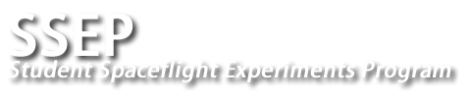
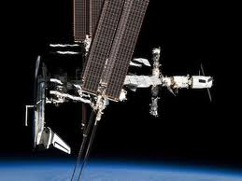
Effect of Arthrobacter on Polyethylene Decomposition Rate in Microgravity
Russell Holbert
Junior, Montachusett RVTHS
Victoria Holbert
Freshman, Norwich University
Brittany Velez
Junior, Montachusett RVTHS
Miguel Velez III
Freshman, New England University

Slide 2
Our big question is…
"Would plastic eating microbes decompose polymers at a quicker rate in microgravity?"
Based on a few things we know…
The majority of microorganisms thrive in space.
There are bacteria capable of degrading plastics
Microorganisms should be able to degrade plastics at a faster rate in microgravity.

Slide 3
How could this knowledge be beneficial?
How could this knowledge be used to benefit both scientific and everyday communities?
On a simpler scale…
By detecting if the biodegradation of plastics, such as polyethylene, is more efficient in microgravity, the implementation of this knowledge may be applied with space technology to help manage what packaging or disposable materials are used by those aboard the International Space Station.
On a large scale…
By detecting if the biodegradation of plastics, such as polyethylene, is more efficient in microgravity, the implementation of this knowledge may be applied with space technology to facilitate a solution to our planet’s pollution problem.

Slide 4
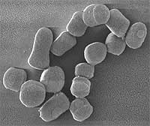
Now how do we test THAT?
Here we began our research for the materials and preparations necessary for answering our question.
Our Type 3 FME
FME Main Volume
Nerdles – cut into halves
Short Ampoule A
Diatomaceous Earth
Short Ampoule B
Arthrobacter sp. Freeze-dried: 1.4x10e8 CFU/ml; ampoule is filled to capacity, 0.92 ml | ATCC: Global Bioresearch Center. #12834
Timeline for Experiment Aboard the International Space Station
FIRST – The Bacteria
Thanks to Dr. Mincer at Woods Hole Oceanographic Institute, we decided on testing the colonization of Arthrobacter
T = 0: The SSEP payload is transferred to the ISS
T + 23 days: Break Short Ampoule A to mix its contents with the Main Volume
T + 23 days: Break Short Ampoule B and shake the FME for 5 seconds to help mix its contents with the rest of the FME
Our Mediums
Diatomaceous Earth-
naturally occurring, soft, siliceous sedimentary rock
Nerdles-
Appreproduction microplastic
pellet about the size of a pea.

Slide 5
It took two attempts, but we were finally able to analyze our results!
Electron Microscopy
Thanks to Dr. Mincer and his team at Woods Hole Oceanographic Institute, we were able to use an electron microscope to analyze the colonization of Arthrobacter.

Slide 6
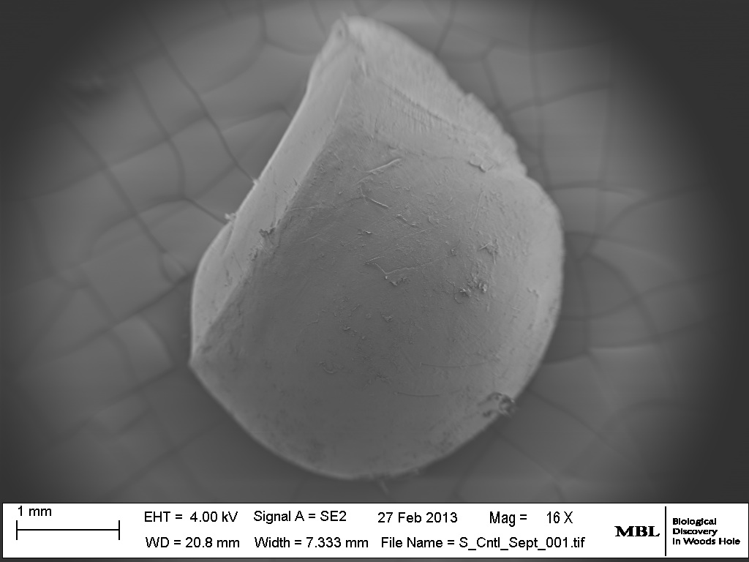
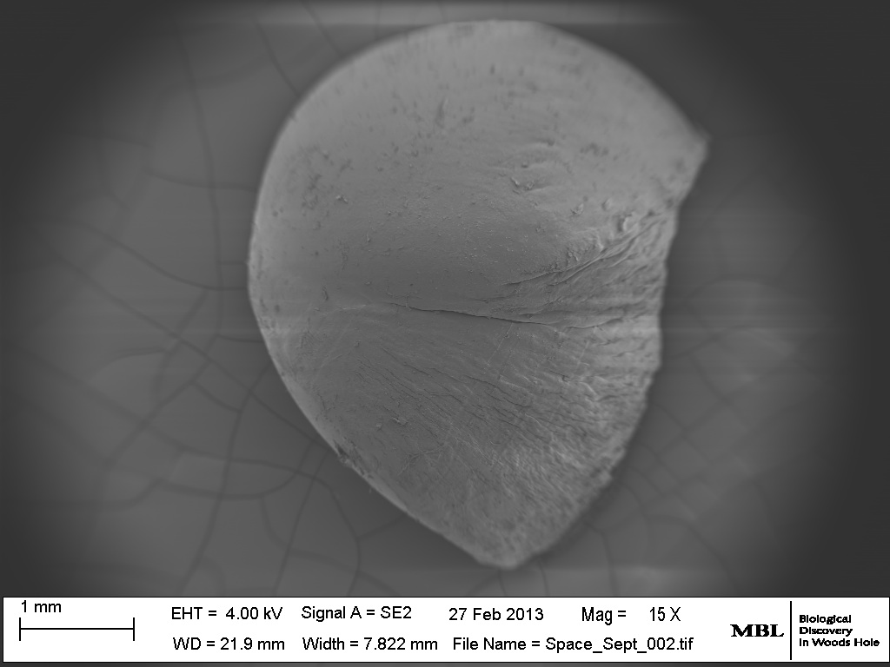
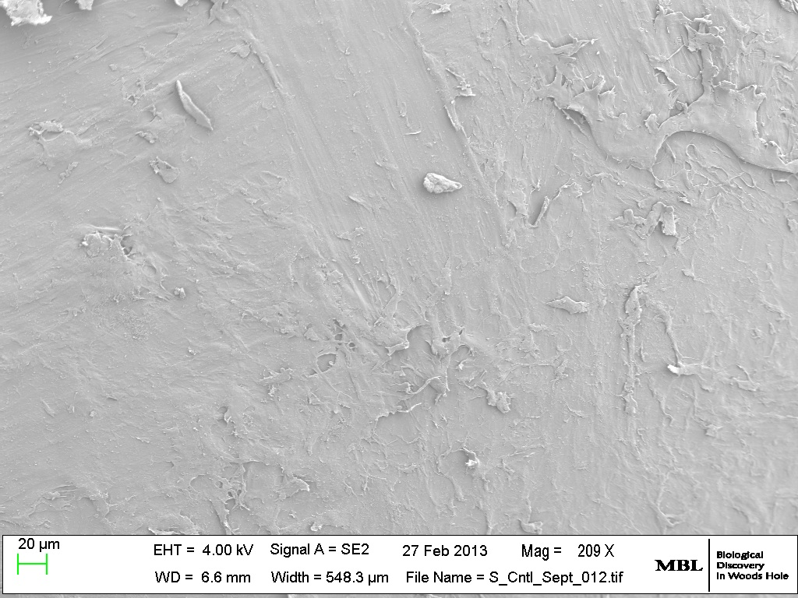
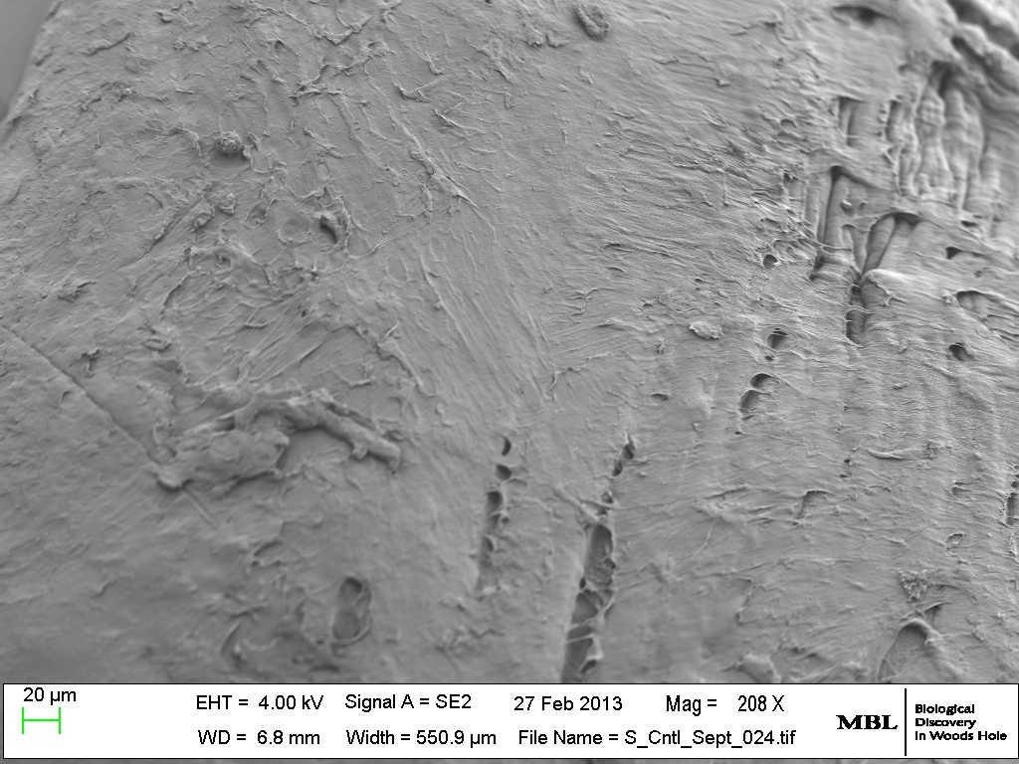
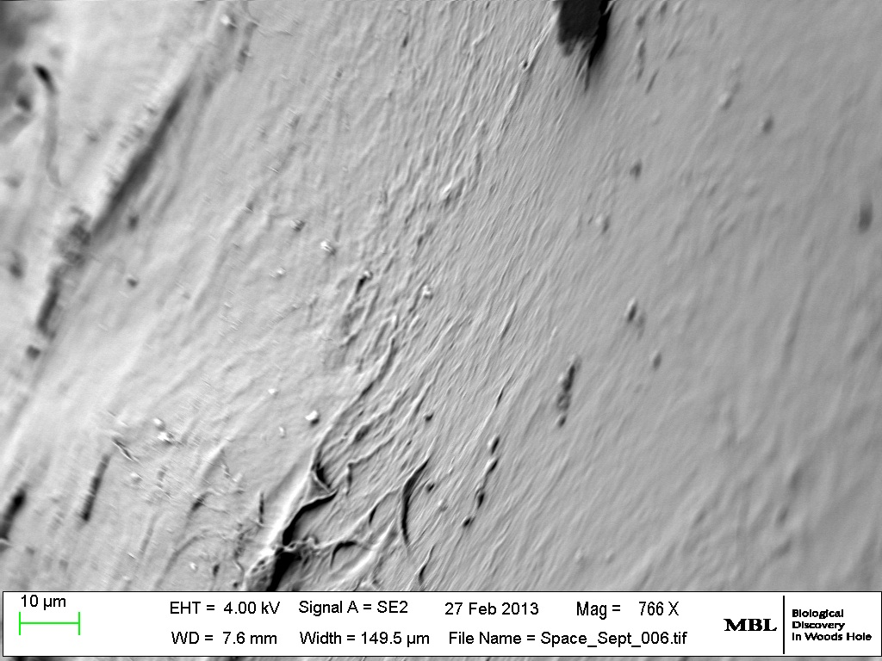
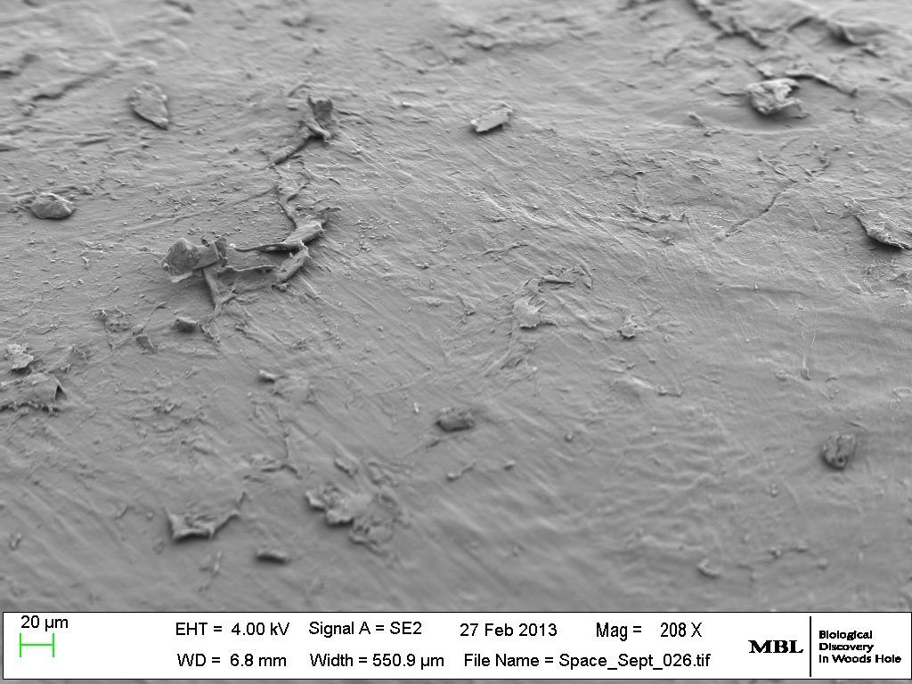
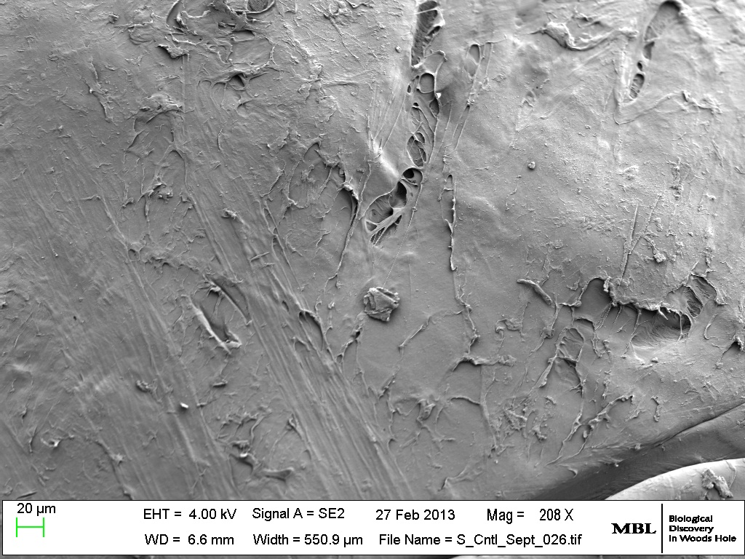
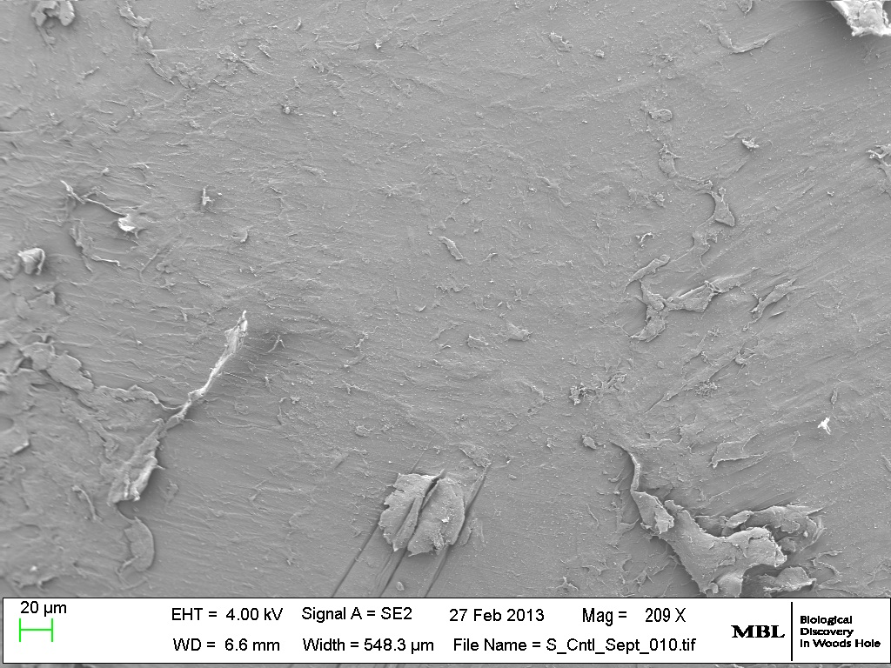
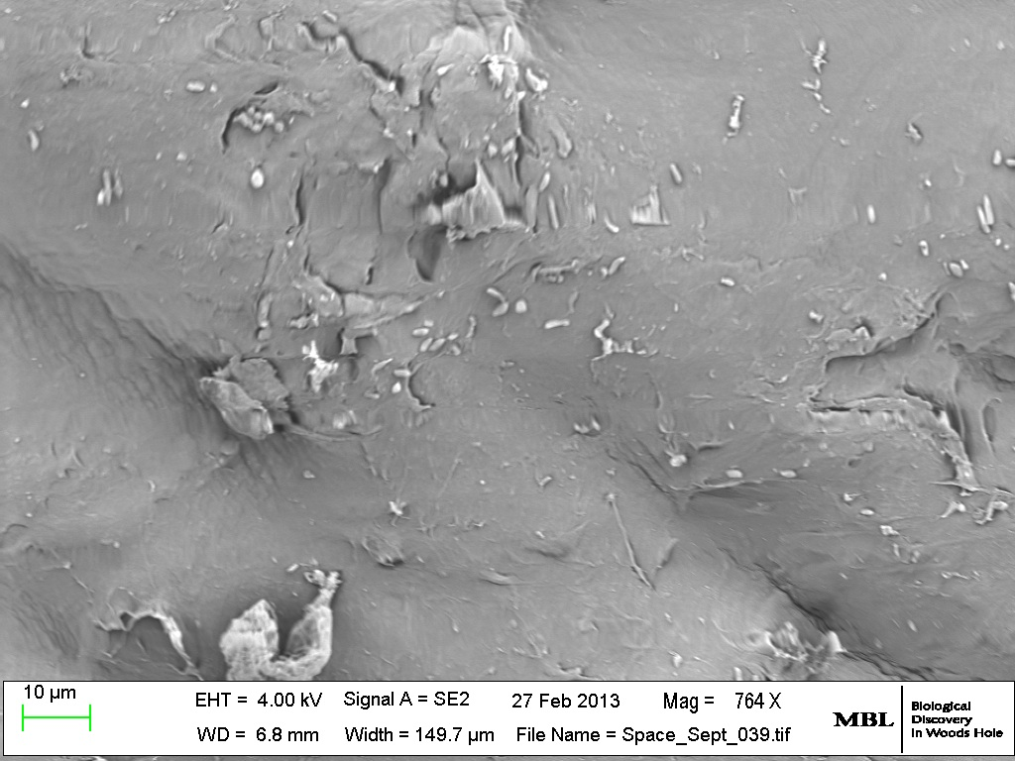
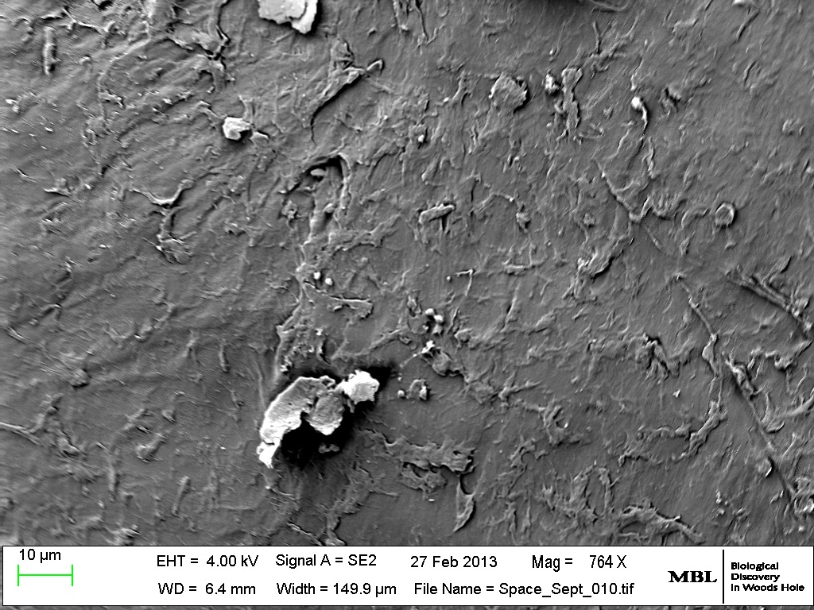
Control
Space

Slide 7
DAPI Stained
We were also able to measure the volume of bacteria, proving that there was an equal amount of growth in both mediums, but more colonized growth in the Space sample.

Slide 8
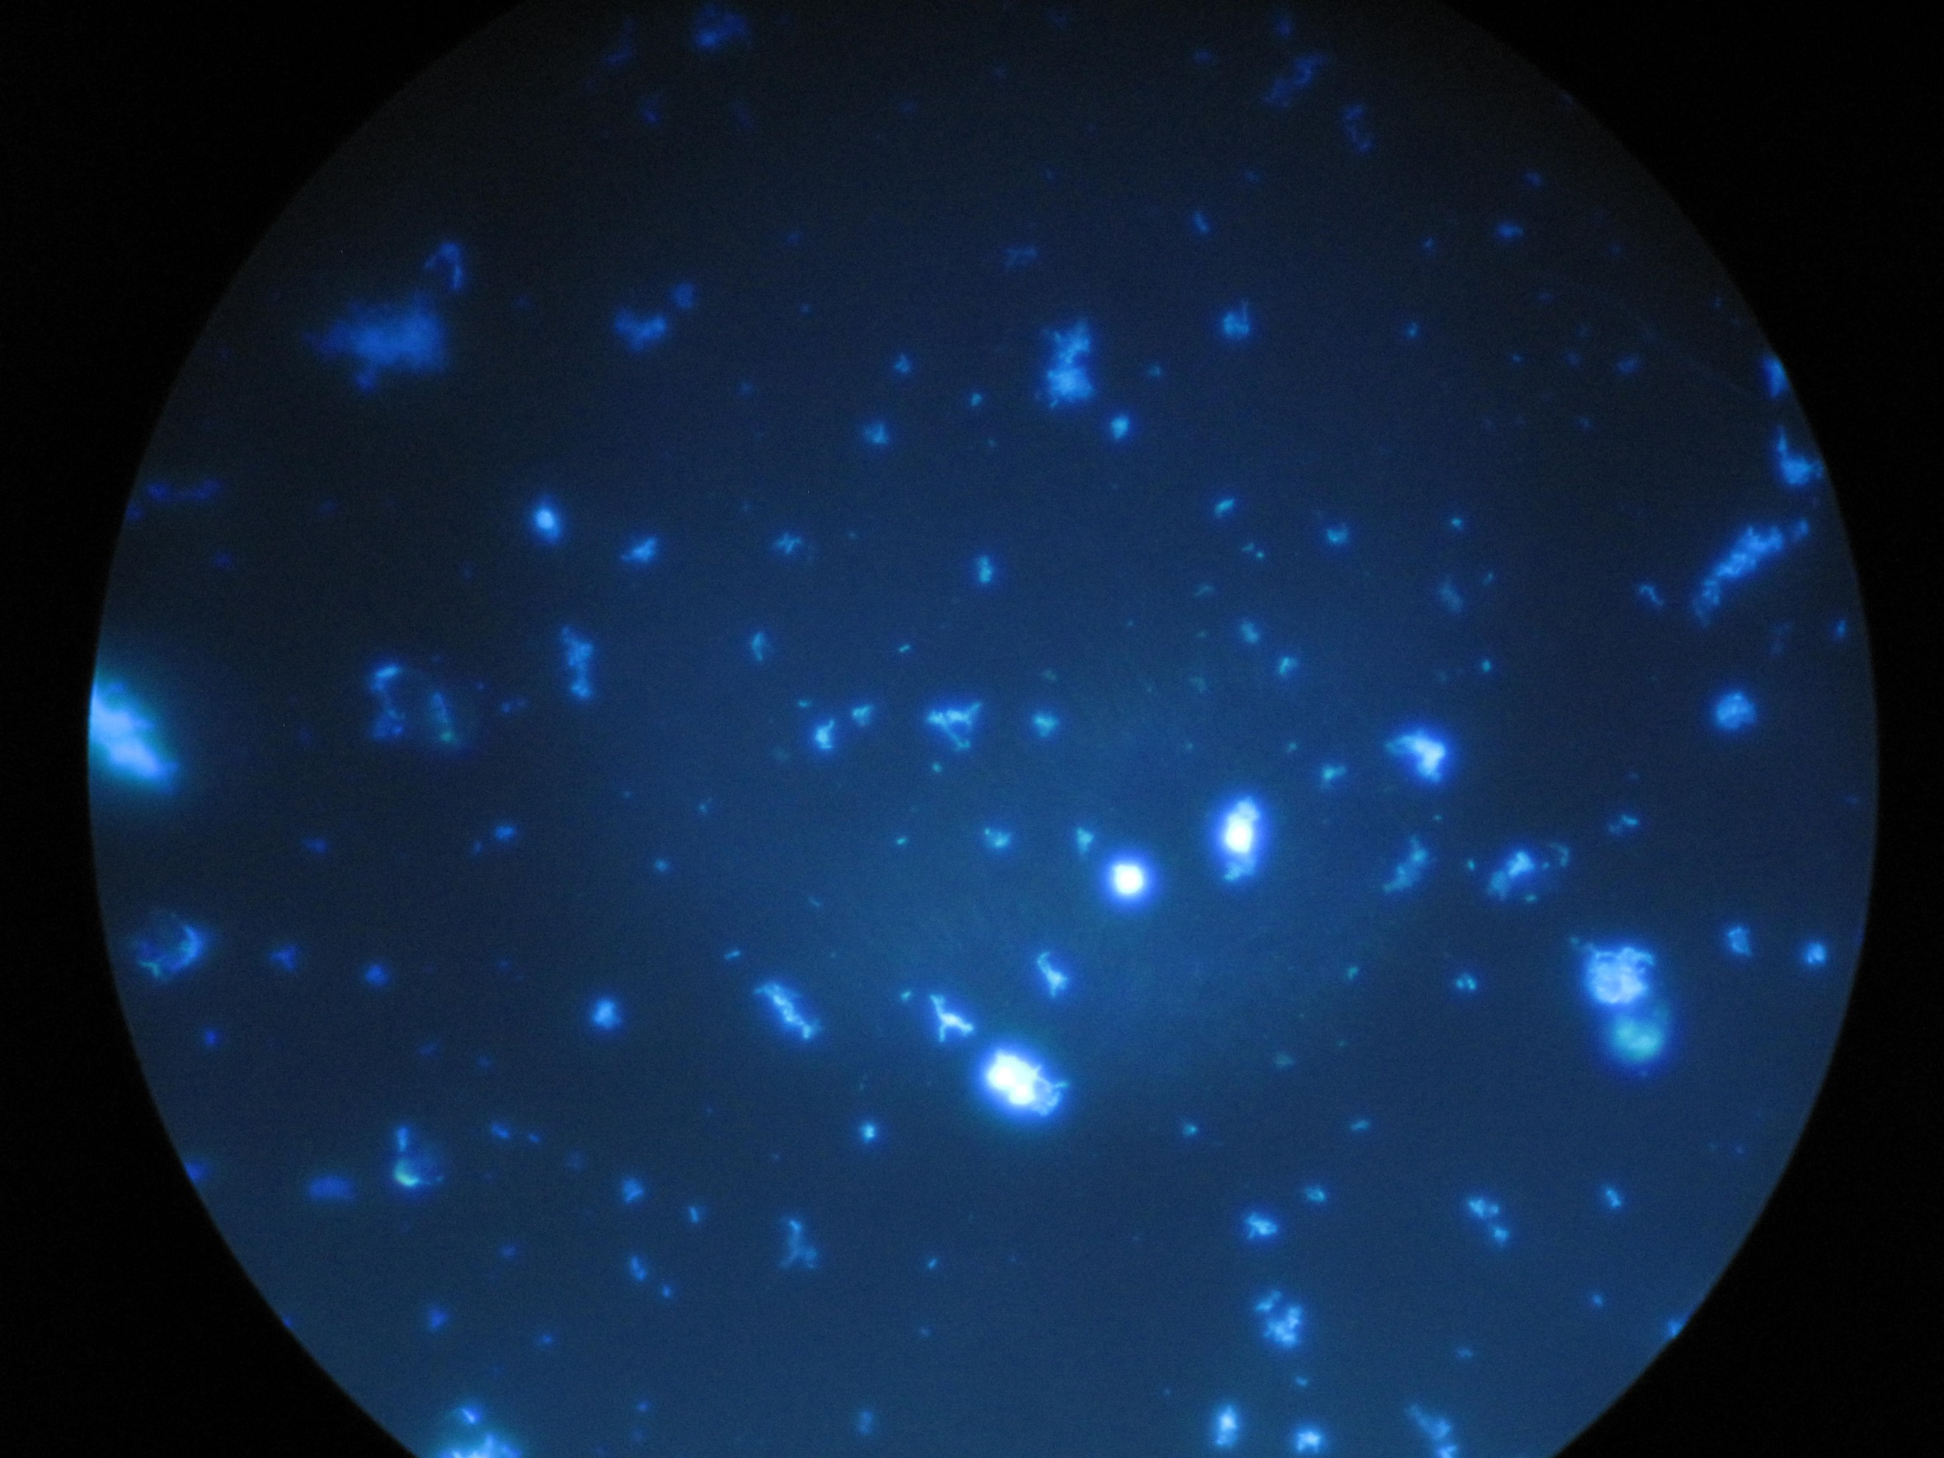
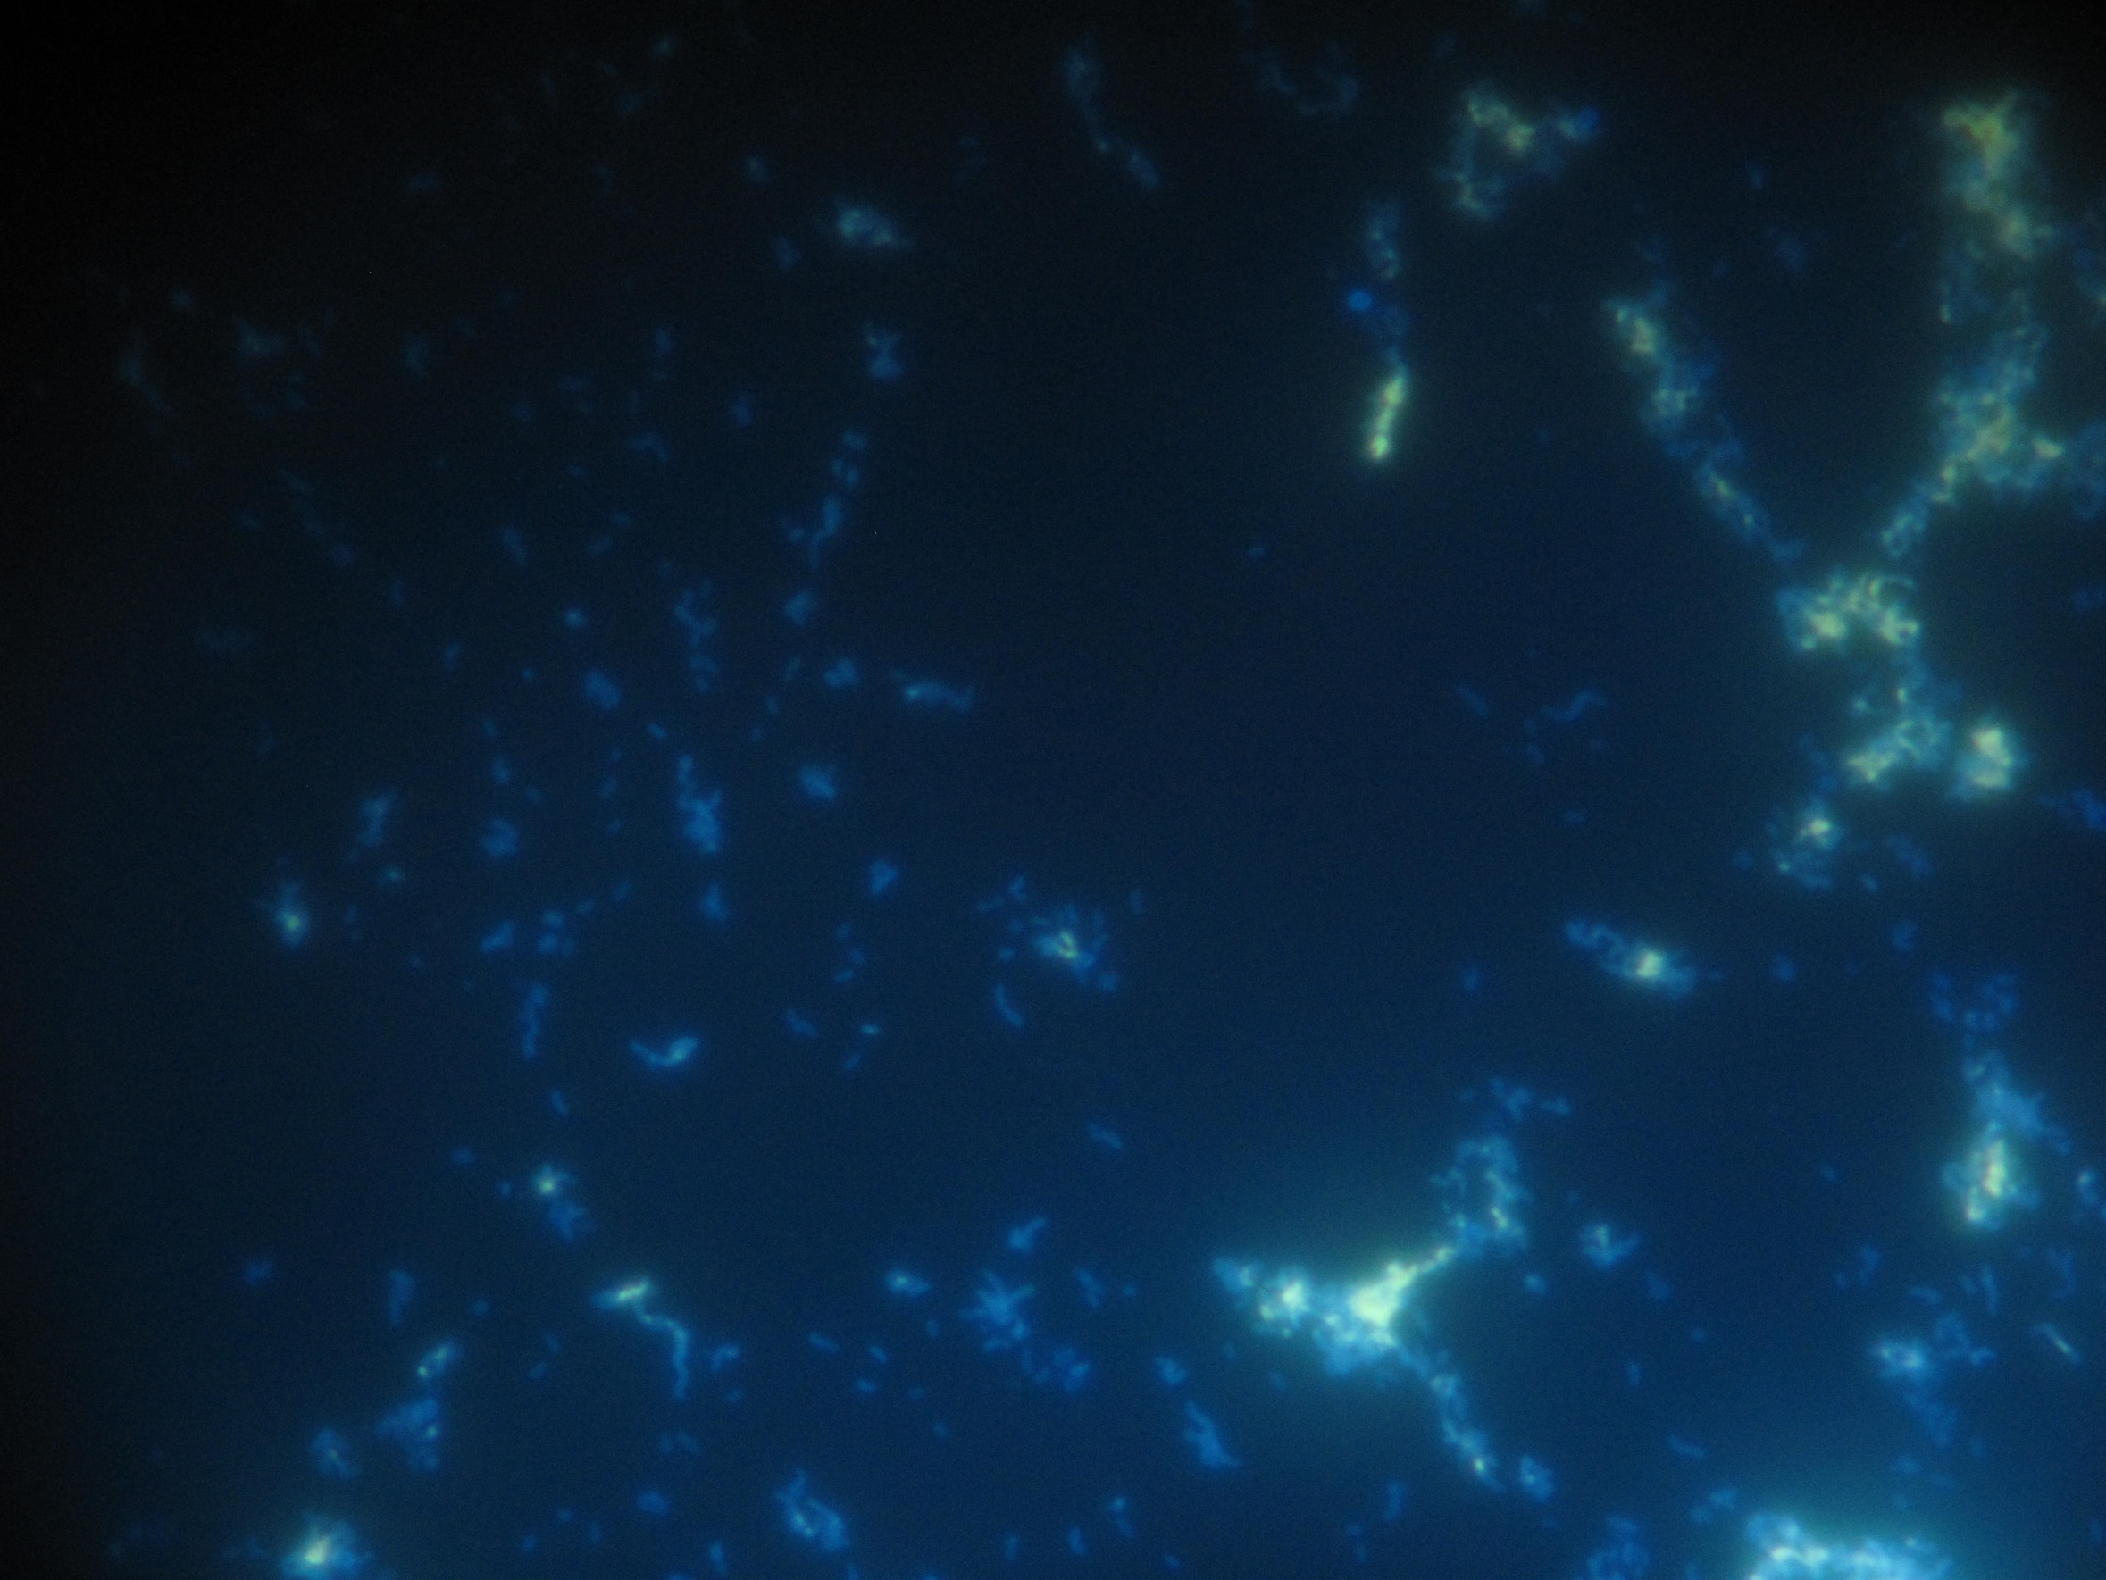
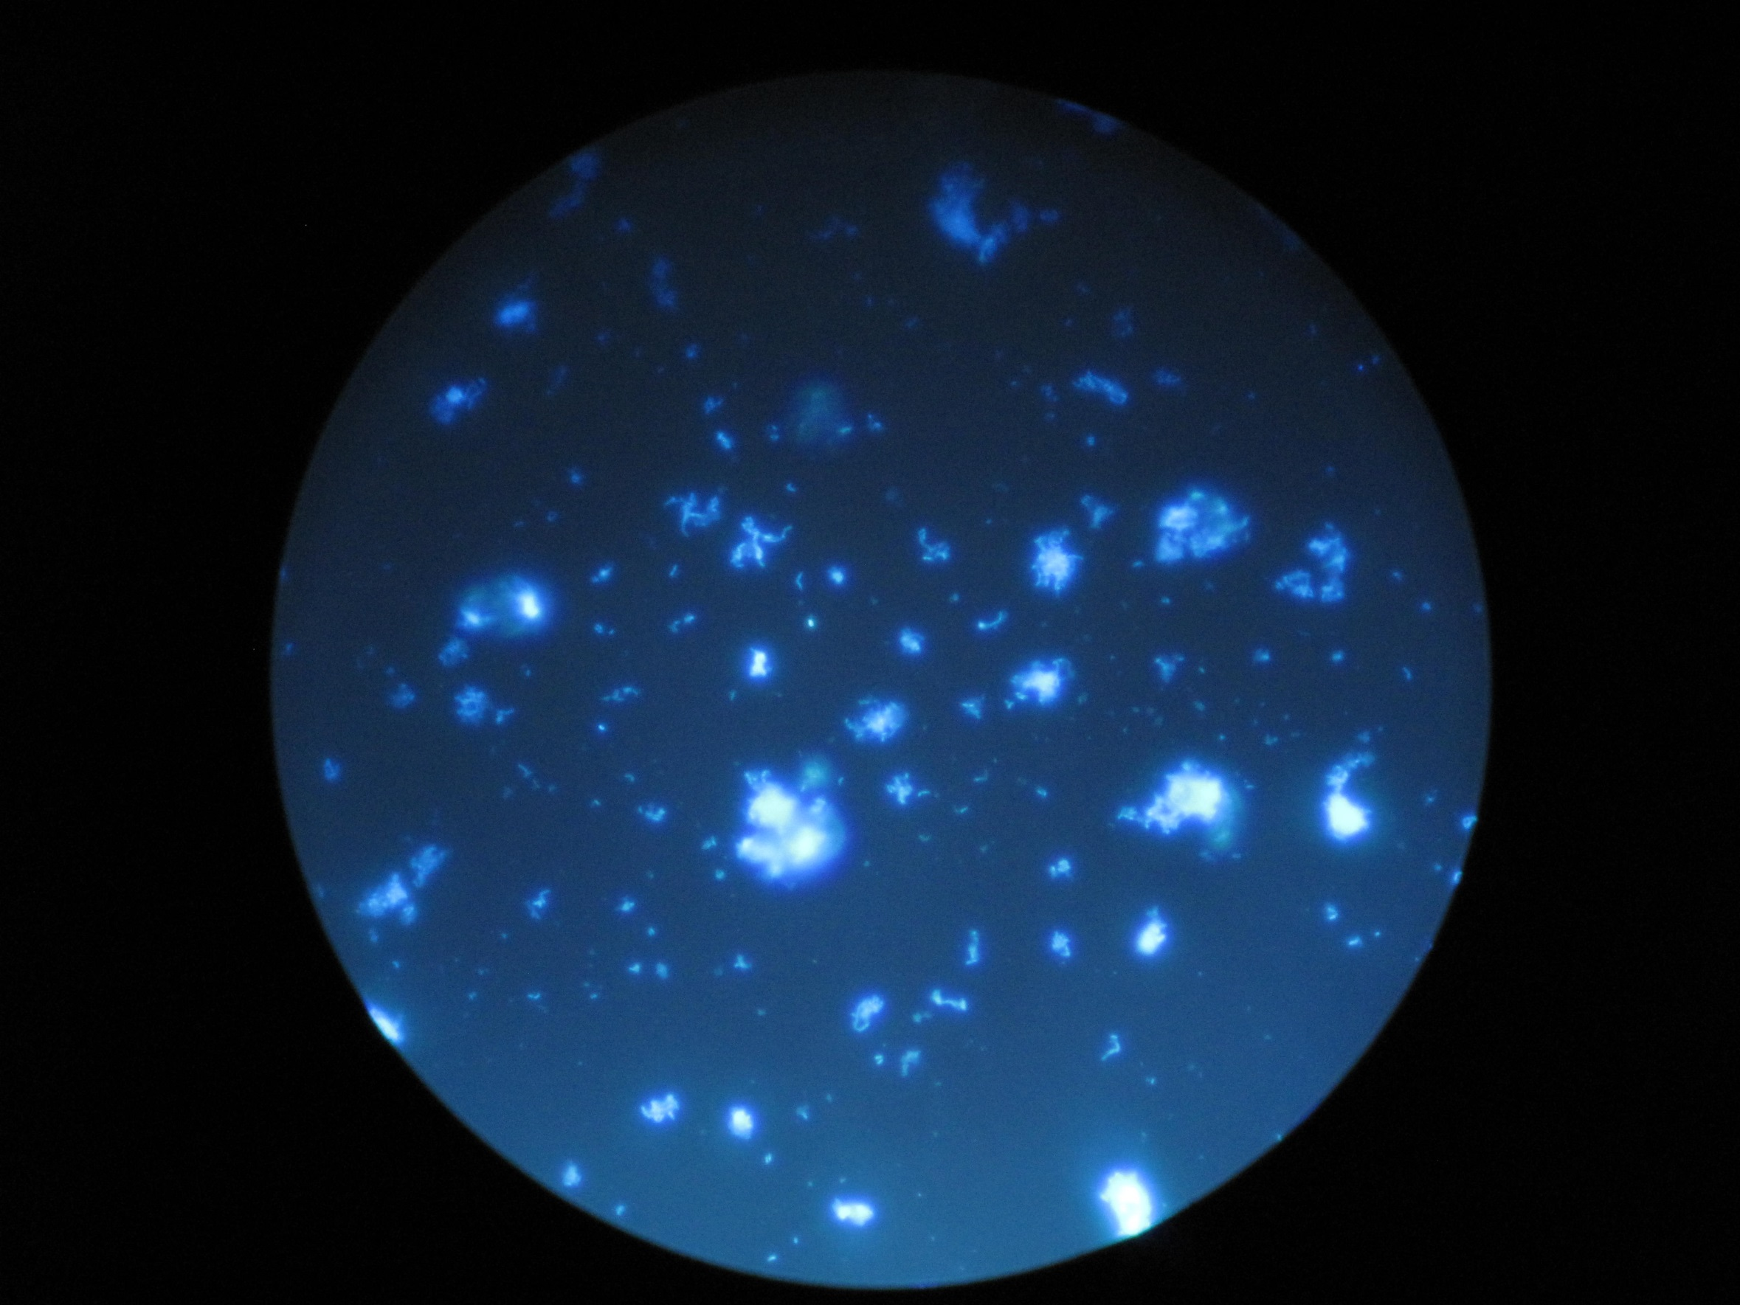
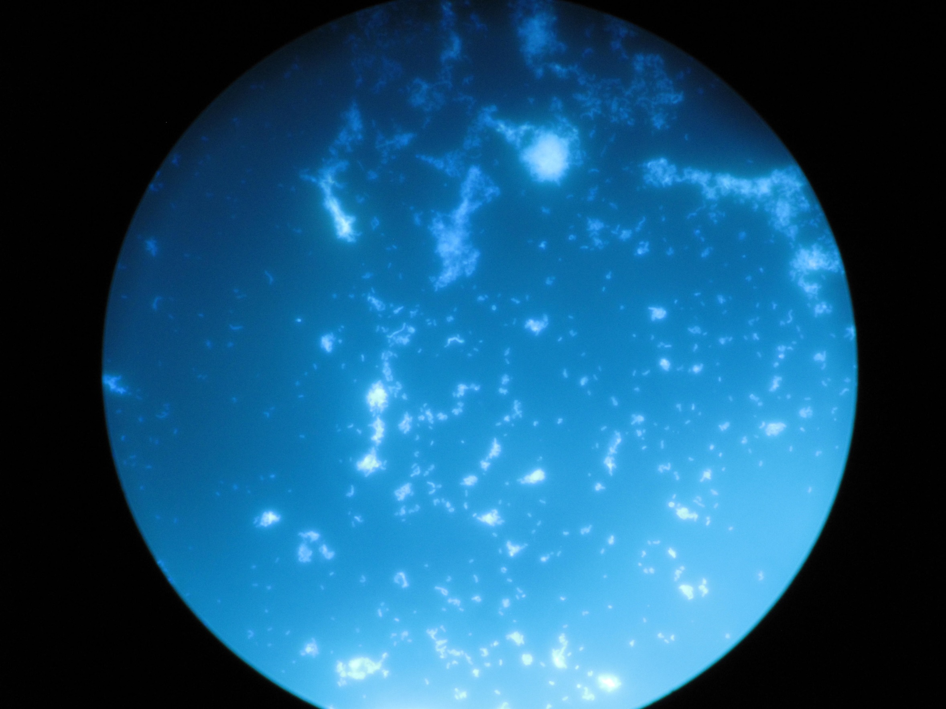
Control
Space

Slide 9
Our Results
There is strong evidence that Arthrobacter will colonize and potentially degrade plastics in space.
Why?
Arthrobacter grew in both mediums
-BUT-
There was only visible colonization on our space nerdles!

Slide 10
Possible Future Studies
What experiments might lend knowledge to benefit this study?
What conditions are best for Arthrobacter?
By indentifying the best growing conditions for Arthrobacter, future attempts of our experiment can be more efficient in facilitating growth.
What by products result from the biodegradation of polyethylene?
By isolating the byproducts of this process, the efficiency of this experiment, and its ability to be done in exposure to humans, can be properly figured.

Slide 11
Thank You Very Much!
Questions?
Mission Pin Designed by Dominika Boczek

Slide 12
Sponsors

