Slide 1
The Effect of Microgravity on Calcium Absorption by Bones
Grade 7, Elkton Pigeon Bay-Port Laker Junior High School Co-Principal Investigators: Chandler Furness, Sarah Hammond, Chelsey Katshor, and Halle Keim Collaborators: Hannah Hammond and Nicholas Wolschlager

Slide 2
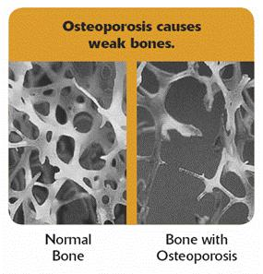
Hypothesis
The decalcified experimental
bone will absorb the calcium
in microgravity. The
decalcified control bone
will absorb the calcium
increasing the bone’s
density on Earth.
http://www.teachengineering.org/view_lesson.php?url=collection/cub_/lessons/cub_human/cub_human_lesson03.xml

Slide 3
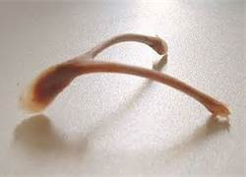
Materials
Buffered saline solution
Ex vivo Gallus domesticus furcula: one section of same bone for control bone on Earth and one section for experimental bone on ISS in microgravity
Natural Spring Valley Calcium 600 mg
http://www.bausch.com/en/ECP/Our-Products/Contact-Lens-Care/Other-Soft-Contact-Lens-Care-Products/Sensitive-Eyes-Plus-Saline-ECP
http://caterpickles.com/2011/09/07/the-hypothetical-wishbone-a-caterpickles-fable/
http://www.walmart.com/ip/23744460

Slide 4
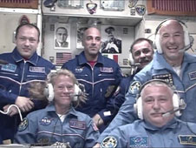
Why Bone Density?
Astronauts lose 15 to 30 %
of their bone density while
in space.
Osteoporosis is a major
issue in modern space flight.
Bones lose calcium, they become
lighter and less dense increasing
the risk of breakage. Proving that
a decalcified bone can absorb
calcium will help improve astronaut
health.
http://www.nasa.gov/mission_pages/station/expeditions/expedition36/e36_052813_launch.html

Slide 5
Procedure
Step 1: Weigh, measure, and micro CT scan control and experimental bones
Step 2: Decalcify both bones in white distilled vinegar
Step 3: Repeat Step 1 and analyze results
Step 4: Soak decalcified control and experimental bones in buffered saline calcium solution for same amount of days for control bone on Earth with gravity and experimental bone on ISS in microgravity.
Step 5: Repeat Step 1 again
Step 6: Compare weights, measurements and, micro-CT scans. Analyze results from control and experimental bones.

Slide 6
Bone Loss in Space
Astronauts face many problems such as osteoporosis.
While in space, a proper diet and exercising helps protect astronauts' bones.
On Earth bone density is lost; in microgravity, this process accelerates.

Slide 7
Conclusion
Without 1g of gravity the human skeleton loses bone mass/density at an accelerated rate.
Calcium supplements help people on Earth, perhaps they could help astronauts in microgravity.
We are using sections from the same bone for the ground and flight experiment, ex vivo. Therefore, we will conduct the ground experiment closer to the flight to protect the integrity of the bone.

Slide 8
Partner Organizations
-Huron Intermediate School District | -National Center for Earth and Space Science Education

