Slide 1
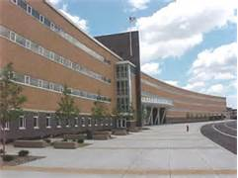
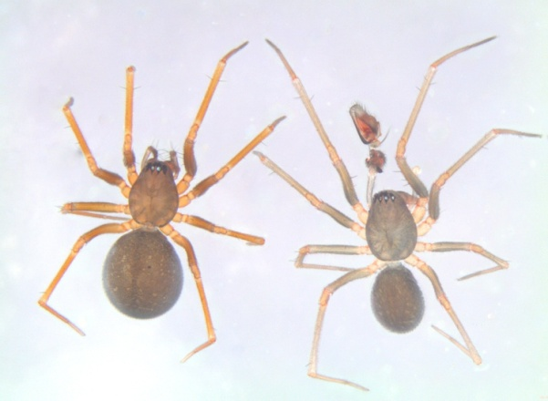
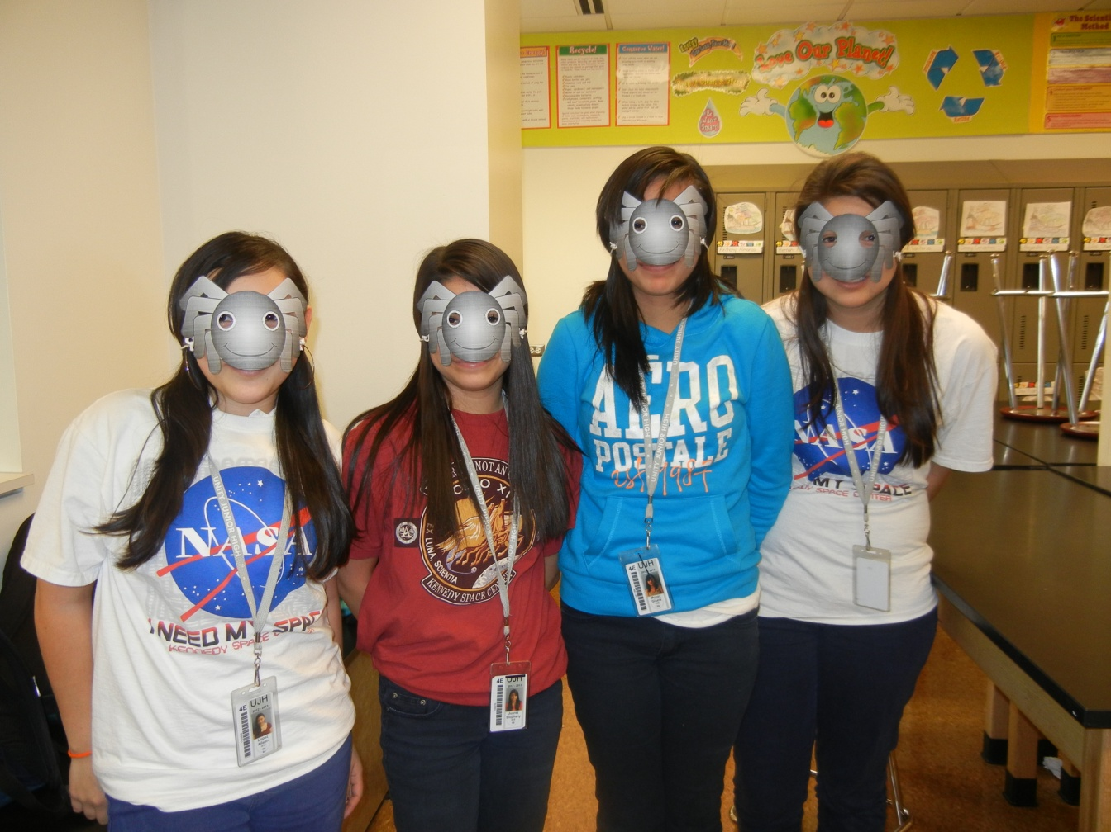
Charlotte Goes to Space
Stephany Juarez, Aileen Lopez, Gisela Munoz, Daniela Ortega Unity Jr High School, Cicero Il

Slide 2
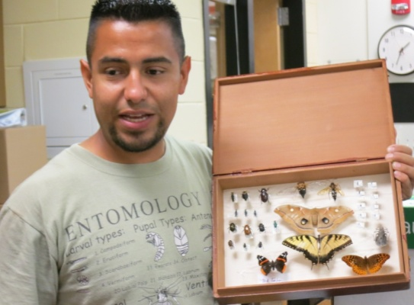
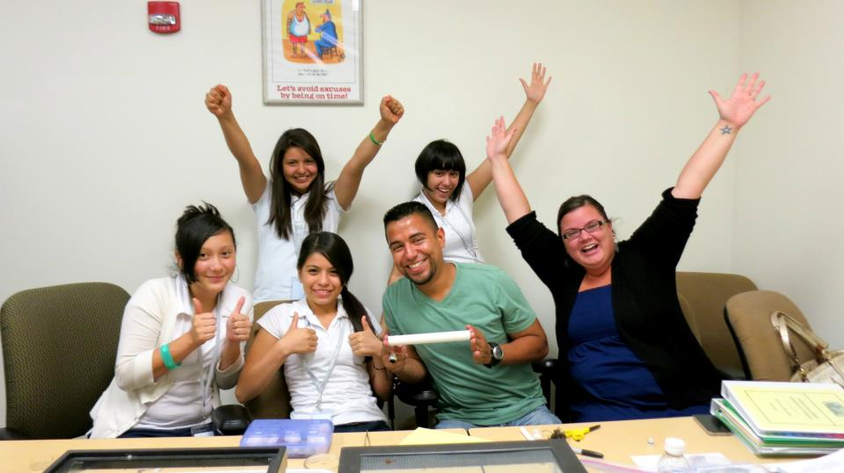
Essential Questions
Can a spider egg survive in microgravity ?
Will a spider’s egg hatch in a microgravity setting ?
Will a spider’s behavior and physical characteristics change ?
Our Initial Design

Slide 3
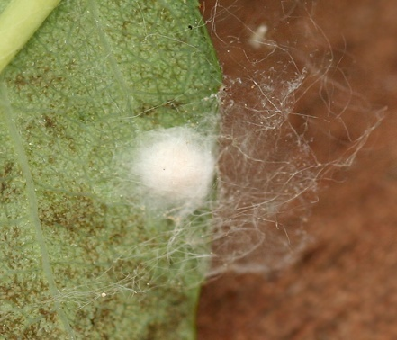
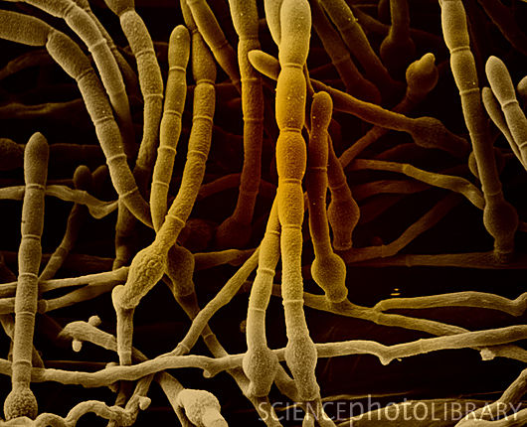
Leaf litter
Dead leaves start to decompose
Isopods help break the leaf litter
Terrariums Setup
Collembola grace on fungus
Spiders produce egg sacs
fungus on its surface

Slide 4
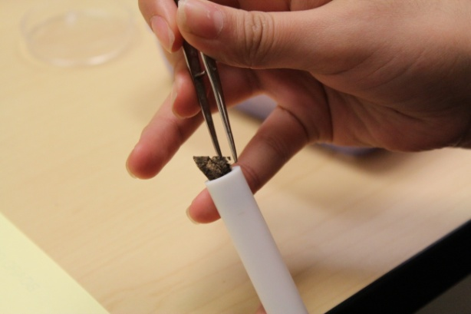
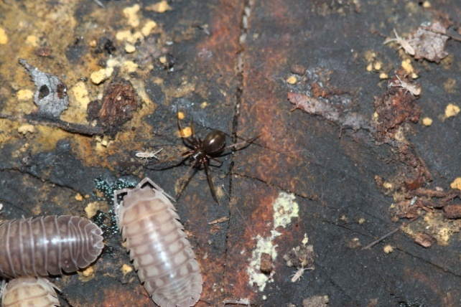
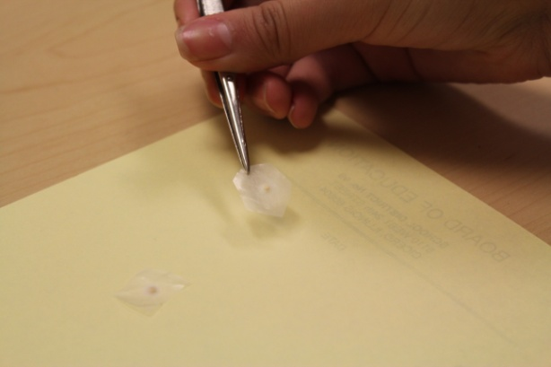
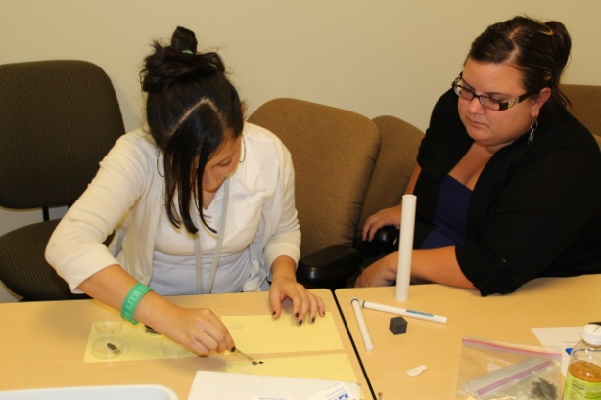
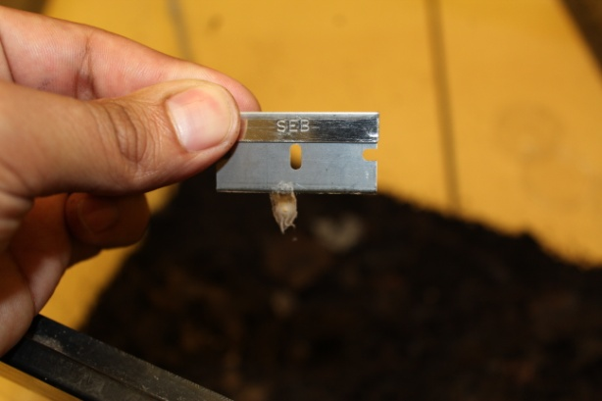
Leaf-litter
Plastic
No substrate

Slide 5
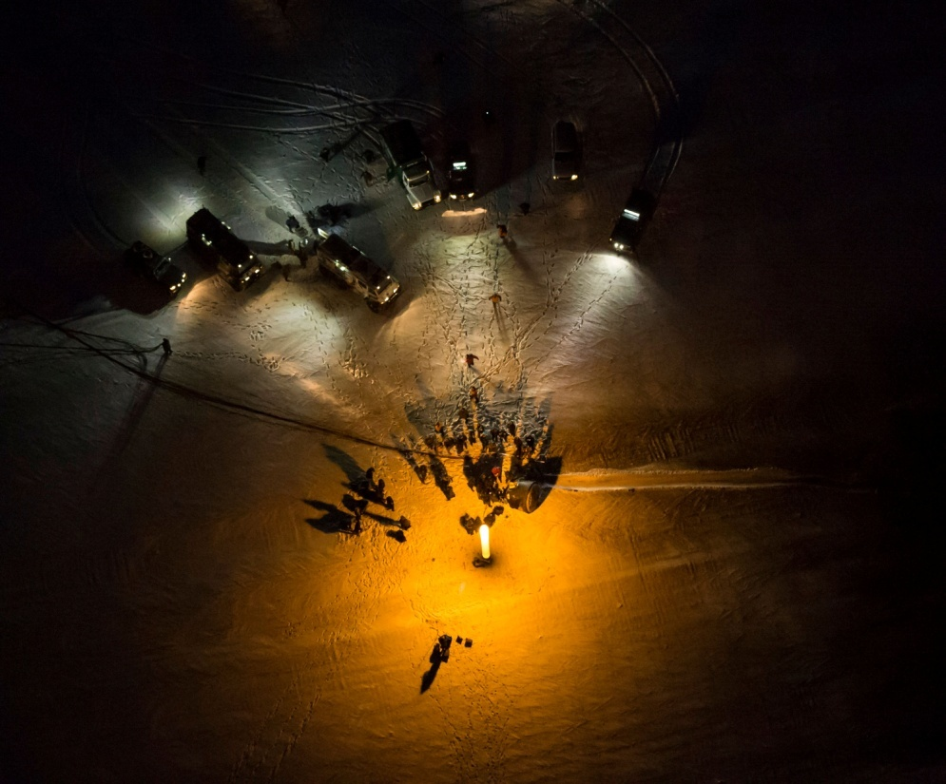
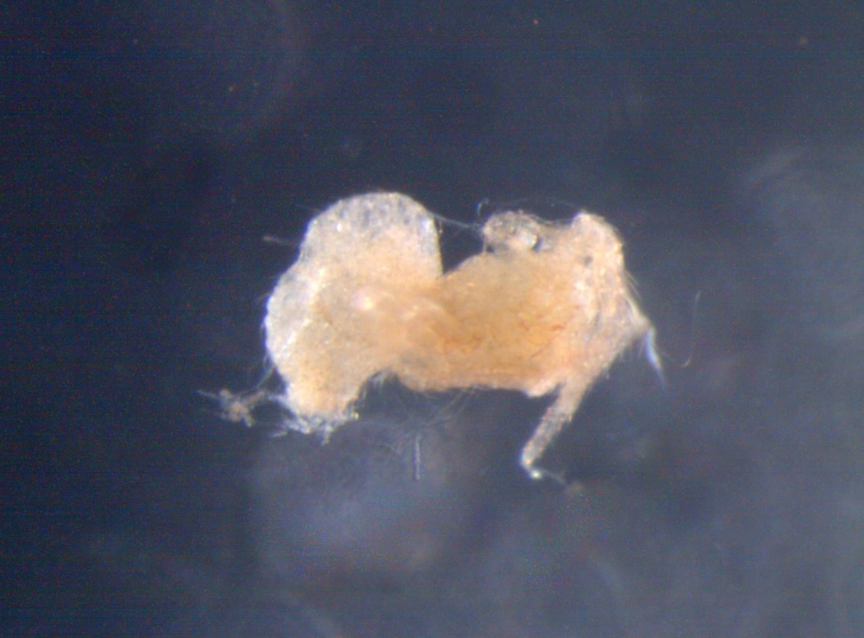
Results
Study if spider egg sacs survive launch?
Yes
Do the spiders develop and hatch in microgravity?
Yes, 2 of the 6 egg sacs had evidence of hatching.
Do the spiders exhibit cannibalism as a food strategy?
Very Likely, 1 very large spider was found.
Do the spiders survive re-entry to earth?
No

Slide 6
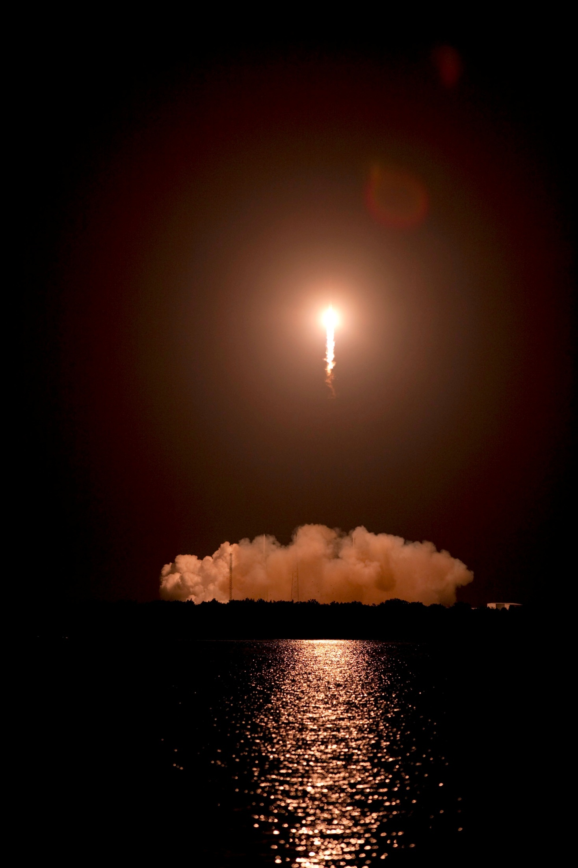
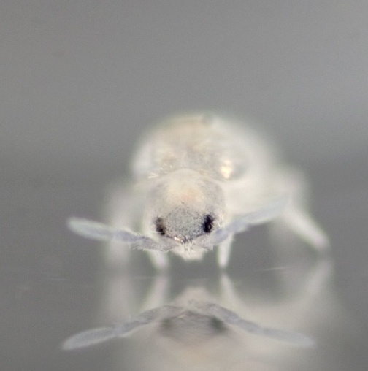
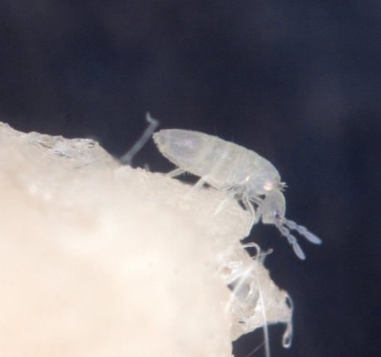
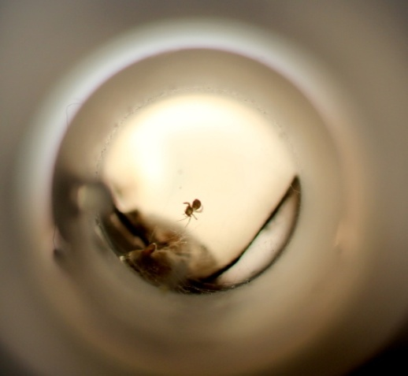
Results
We sent 6 Diplostyla concolor egg sacs.
To our surprise what returned was
Diplostyla concolor
Egg sac
Collembola:
Lepidocyrtus
Fungus
Spider in earth bond control test tube
Mite : Schweibae
Nematodes

Slide 7
In Conclusion
We believe our spiders did not survive re-entry into Earth because :
Moisture
Too much microbial growth
Oxygen levels
Test tube time
What we would change next time :
Predetermine the amount of moisture ?
Different species ?
More replicates ?

Slide 8
Questions

Slide 9
Partner institutions
We would want to thank Cicero School District 99, Unity Junior High School, Exxon Mobil, and the Wise Lab at University of Illinois at Chicago (UIC). Their support made it possible for us to participate in the Student Spaceflight Experiment Program (SSEP). Thanks to the National Center for Earth and Space Science Education (NCESSE) for guiding us throughout the project.

