Slide 1
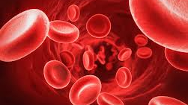
Coagulation of erythrocytes
Team: Hunter Black, Delaney Chariker, Maddy Bessinger
Chris Otap.

Slide 2
Background Information
Erythrocytes (red blood cells) are the vehicles in which oxygen and carbon dioxide travel in.
Platelets contained in the blood sample will coagulate at a certain point in time. Certain substances can be tested to understand the time before coagulation is initiated.
This will hopefully be different than on Earth under the same conditions.

Slide 3
Question and Hypothesis
Question: How long will erythrocytes take to coagulate in a micro-gravity environment?
Hypothesis: If erythrocytes are left in a container in a micro-gravity environment, then the erythrocytes will last nearly 21 days.

Slide 4
Materials
We will need Red Blood Cells to be able to test how they are affected in space.
We will need the additive solution to stop the blood from coagulating.
The analytical equipment is necessary to analyze the red blood cells and how they are affected. We will need to test if the RBCs lose technetium-99m, chromium-51, and indium-111. We will be partnering with the American Red Cross to receive the blood and the additive solution. The Red Cross will also allow us to use their analytical equipment.
A regular blood donor has volunteered to give blood to be used in this experiment.

Slide 5
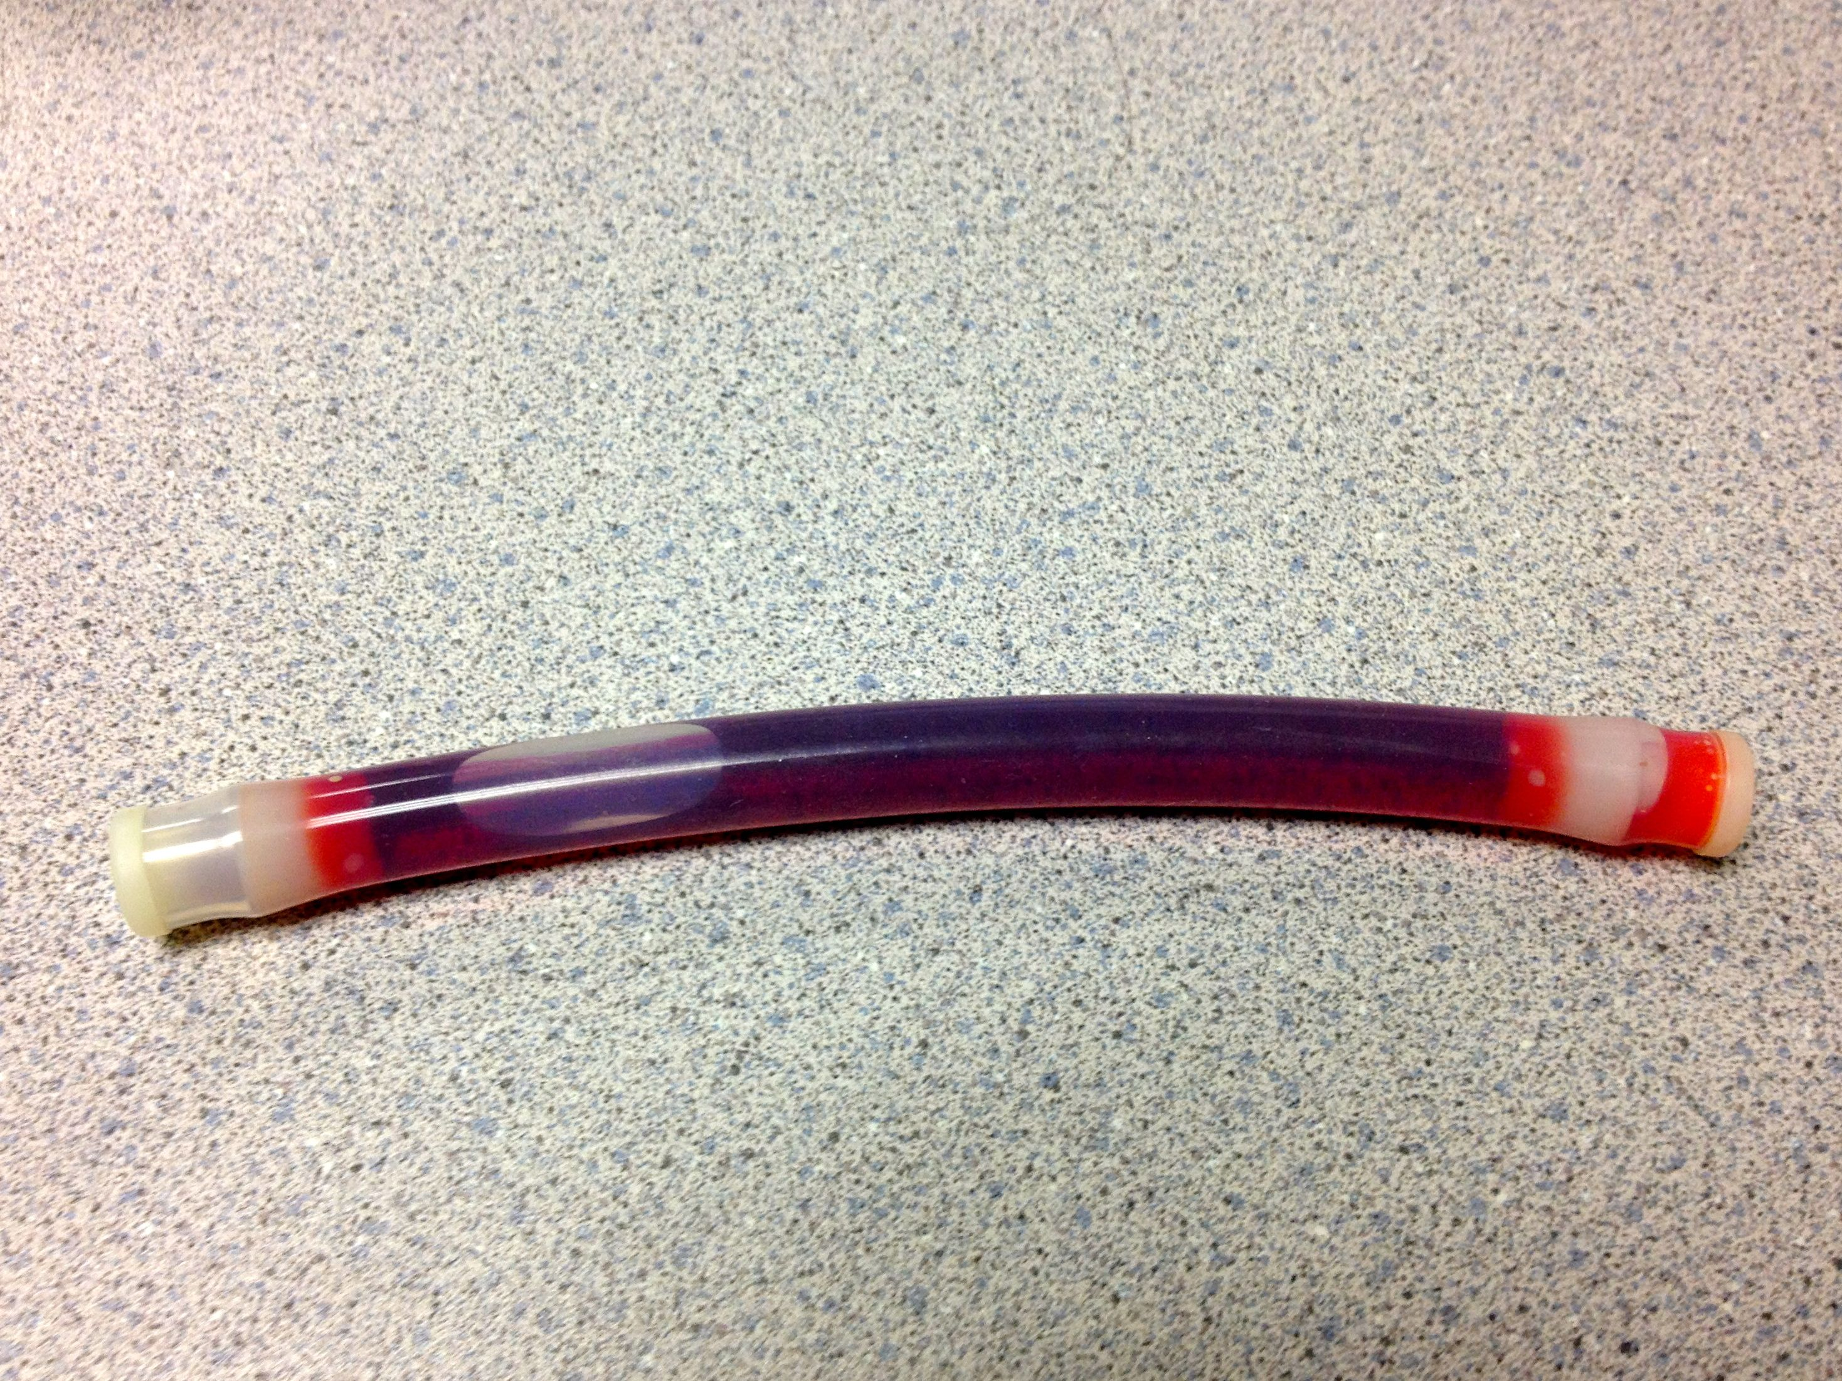
Ground truth experiment
Since our experiment was not selected for spaceflight, our experiment could no longer conform to the research proposal due to financial constraints.
Analytical equipment from the American Red Cross would not be available for the analysis of data. Screened blood from the American Red Cross will not be available.
Using type O blood, we have loaded a Type 1 FME with 8 mL of type O blood and 2 mL of an additive solution.
This Type 1 FME is being kept at room temperature in a secure environment. Blood can be dyed with propidium iodide to check for cellular viability.
We hypothesized that red blood cells would live
longer on the ground than in microgravity. The
average life span of a red blood cell is 120 days
on Earth.

Slide 6
Possible hypotheses
Understanding the coagulation rate of erythrocytes in a microgravity environment will allow for new knowledge that could lead to longer space missions, e.g. Mars.

Slide 7
Acknowledgments
Thank you to the Partners and Sponsors who made this experiment possible:
Partners
Space and Naval Warfare Systems Command (SPAWAR)
Center for the Advancement of Science in Space (CASIS)
National Center for Earth and Space Science Education
College of Charleston
Medical University of South Carolina (MUSC)
National Oceanic and Atmospheric Administration (NOAA)
Sponsors
ISHPI
CASIS
Palmetto Scholars Academy Board Members
Palmetto Scholars Academy Families

