Slide 1




Effectiveness of Hydrogen Peroxide on Aspergillus Niger Growth in Microgravity
East Lyme Middle School
East Lyme, CT
Makaih Olawale
Noah Barnhart
Brandon Hall
Nick Hyde
Notes:
NICK

Slide 2
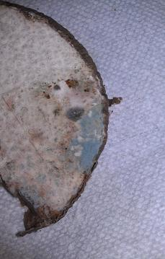
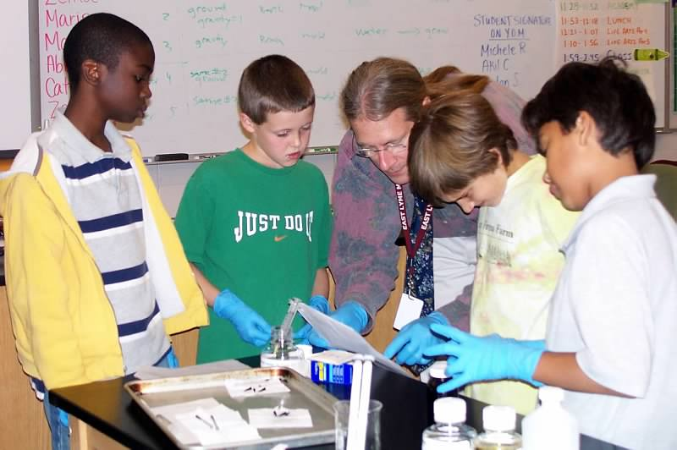
Initial to Final Experimental Design
“Does hydrogen peroxide eliminate mold in space?”
Initial
Yam
Unknown mold
Hydrogen Peroxide
Final
Preparation on Earth
H₂O₂ in ampoule 1
A. niger spores in ampoule 2
Malt extract broth in FME
Aboard ISS
D – 3: Astronauts break ampoules to activate FME’s contents
Notes:
NICK

Slide 3
Comparison of Experimental Designs
 | Initial experiment design | Final experiment | Comments on change
Food type | Yam | Malt extract broth | Better mixing Good for Aspergillus niger
Food amount | Lots | 4 mL | Mold may starve as it grows
Mold species | Unknown | Aspergillus niger | Single species Safe to handle
Mold – Initial amount | Unknown | 80 CFU’s | Exact control Solid tablet
Oxygen | Unlimited | 3.32 mL | Mold is aerobic and needs air May “suffocate” and die as it grows
Time for observations | Unlimited | About 2 weeks | Activate tube as late as possible Mold may over-populate FME and die
Concentration of hydrogen peroxide | 3% | 30% diluted to 5% | Unchanged
Pressure build-up from hydrogen peroxide | None | Builds pressure | May cause FME to leak But provides oxygen for aerobic mold
Notes:
MAKAIH

Slide 4
After Flight Analysis
Solution Test
  Was the solution clear or cloudy?
Agar Plate Test
  Put solution on agar plate
  Incubate agar plates for 11 days
  Inspect agar plates
      clear or black fuzz?
Notes:
MAKAIH

Slide 5
Results Based on Solution Appearance
 | ISS FME with peroxide | Ground control with peroxide | Ground control with water
Hypothesis - Will mold grow in FME? | Will NOT grow | Will NOT grow | Will grow
Observation - Solution appearance | Clear | Clear | Cloudy
Interpretation | No growth in FME | No growth in FME | Yes mold grew in FME
Conclusion | Supports hypothesis | Supports hypothesis | Supports hypothesis
Notes:
NOAH

Slide 6
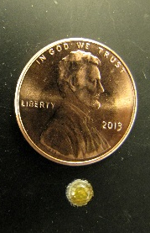
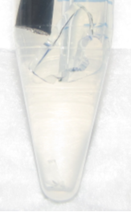
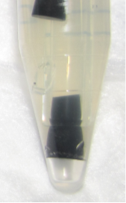
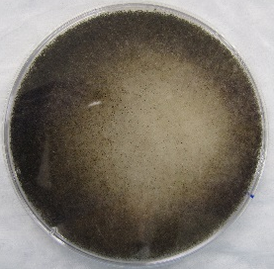
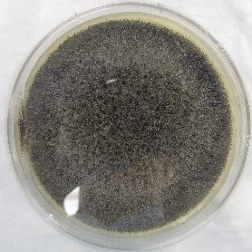
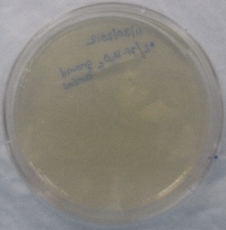
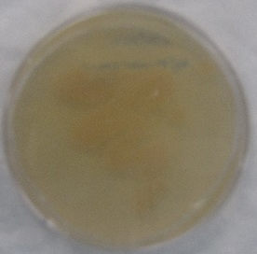
Results Based on Culture on Agar Plate
 | Mold tablet control | ISS FME with peroxide | Ground control with peroxide | Ground control with water
Hypothesis - Will mold grow on agar plate? | Will grow | Will NOT grow | Will NOT grow | Will grow
Observation – Plate appearance | Black fuzz | Black fuzz | Clear plate | Clear plate
Interpretation | Mold grew | Mold grew on plate | No mold growth | No mold growth
Initial Conclusion | Control works | Contradicts hypothesis | Supports hypothesis | Contradicts hypothesis
Observation - Did FME leak? | ----- | FME leaked | No leak | No leak
Possible reason | ----- | Mold from outside of FME to plate | ----- | Mold grew in FME but died before culture
Notes:
NOAH

Slide 7
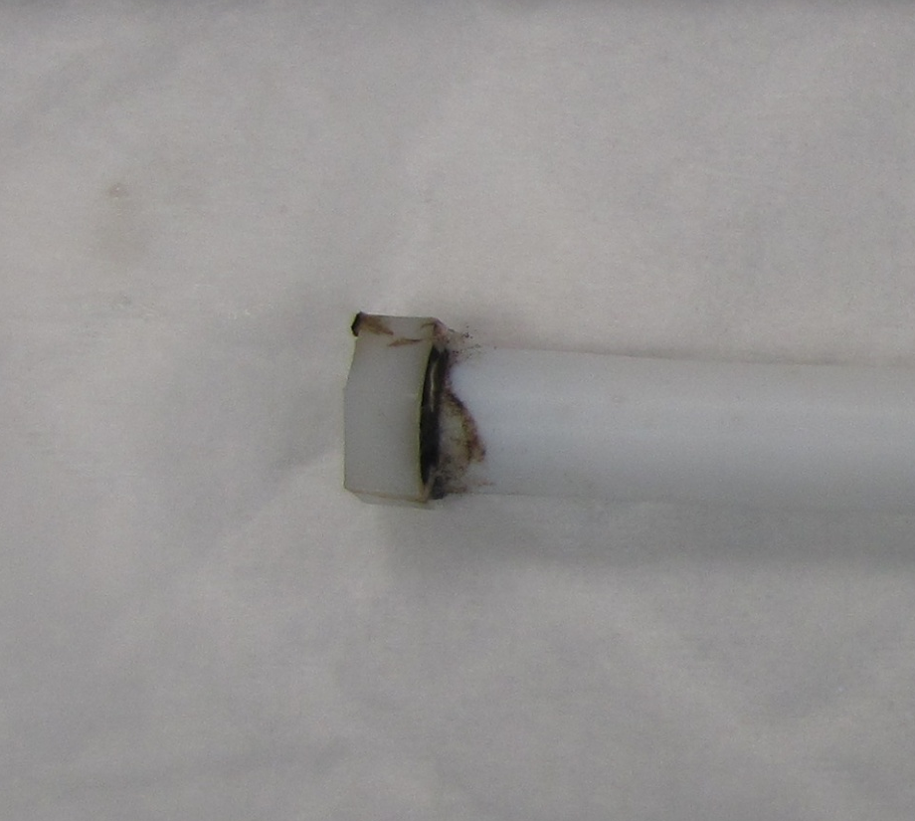
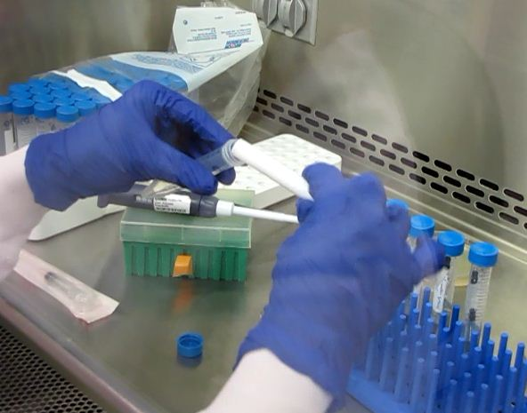
Thinking Outside the Tube
Pressure build up from H₂O₂ caused FME to leak
Mold from outside of FME contaminated culture tube and agar plate
Notes:
BRANDON

Slide 8
Conclusion
Based on the solution appearance test, H₂O₂ eliminates mold in space
BUT when the scientist put ISS FME into the culture tube, it contaminated the opening of the plastic vial
Culture plates did not confirm solution appearance test due to:
    Improper sterilization
    Water ground control cells died - ran out of food or air
Changes for next run
  Tighten FME cap more to better hold pressure
  Sterilize the outside of the FME before opening
Notes:
BRANDON

Slide 9







Acknowledgements
Ms. Maria Brown
Dr. James Roussie
Dr. Richard Barnhart
Mr. Glenn PenkoffLidbeck
Pfizer Foundation Matching Grants and Volunteer Grants Programs
Notes:
NOAH

