Slide 1
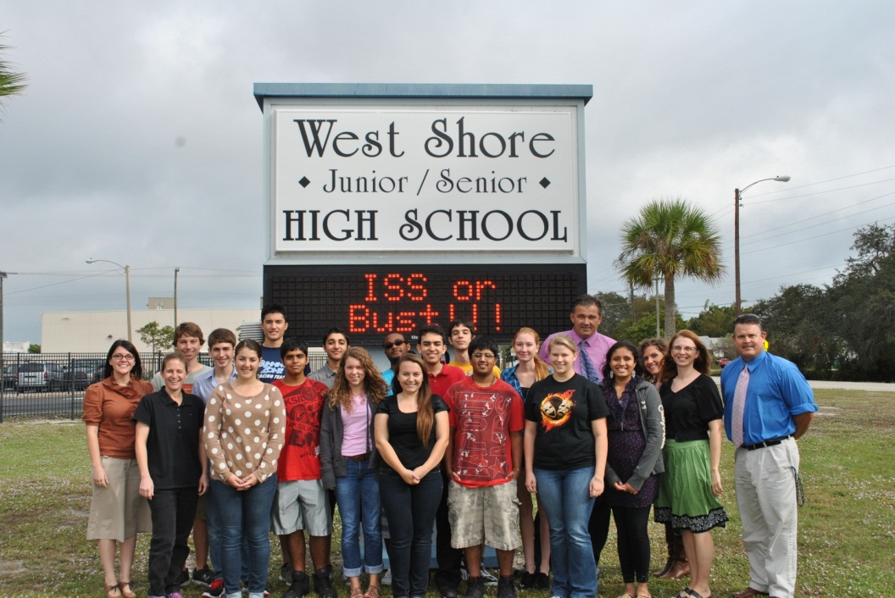
National Center for Earth & Space Science Education Student Spaceflight Experiments Program Mission 3 to the International Space Station
Title
A Study of How Microgravity
Affects the Enzymes in
Amyotrophic Lateral Sclerosis
(ALS) Using the Model of
Papain and Gelatin
Teachers in Space/Space Frontier Foundation Community
Students Working on the Project
Rashad Abdulla Robert Edmiston Jaclyn Martin Krunal Patel Sunny Saini
Varun Bansal Olivia Escandell Anuj Mehindru Luke Redito Hannah Schroeter
Caleb Bryant David Foster Genna Owen Carissa Sage Sanju Vardhan

Slide 2
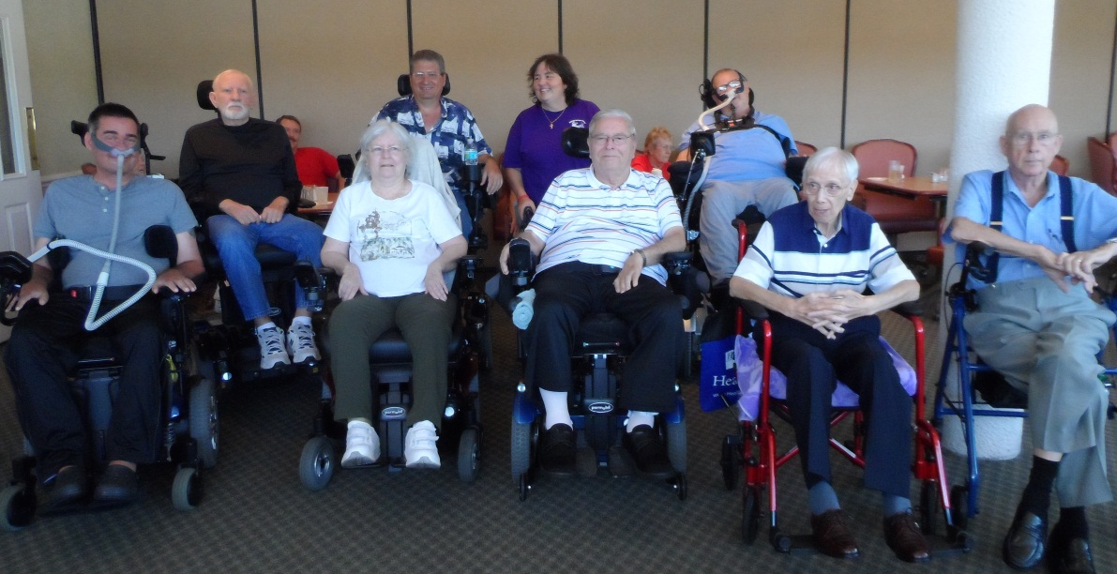
ALS Basics
Glutamate is an amino acid that acts as a neurotransmitter.
In ALS patients, glutamate found in the synaptic cleft does not get broken down, but builds to toxic levels, eventually causing neurons to die.
As neurons die, ALS patients lose control of voluntary muscles, eventually leading to death.

Slide 3
Proposal Summary
Researchers wanted to better understand ALS and raise awareness of the disease when their teacher, Jason Whitworth, was diagnosed.
This experiment will serve as a model of the enzymatic breakdown of glutamate in the synapse.
It is our hypothesis that an enzyme will be able to function more effectively in a microgravity environment.

Slide 4
Determining Amounts for Trials
Amount Papain | Amount Ascorbic Acid | Absorbance
0.1 g | 0.1 g | 0.640
0.2 g | 0.2 g | 1.340
0.3 g | 0.3 g | 1.180
0.5 g | 0.5 g | 1.720
Amount Papain | Amount Ascorbic Acid | Absorbance
0.1 g | 0.2 g | 0.454
0.2 g | 0.2 g | 0.584
0.3 g | 0.2 g | 0.582
0.5 g | 0.2 g | 0.830

Slide 5
Fluid Mixing Enclosure (FME) - Type 3 by NanoRacks, LLC
Main Volume = 5 ml Gelatin
(concentration 2% by mass)
Short Ampoule A = 0.2 g of powdered papain extract
Short Ampoule B = 0.2 g of powdered ascorbic acid

Slide 6
Procedures
Other than location, the procedures are identical for both the FME on board ISS and the FME on Earth.
A = 0 (arrival at ISS): Break Short Ampoule A and shake vigorously for 20 seconds to mix its contents (papain extract) with the Main Volume (gelatin). This step initiates the reaction.
A + 2 Days: Break Short Ampoule B and shake for 20 seconds to mix its contents (ascorbic acid) with the rest of the FME. This step terminates the reaction.

Slide 7
Data Collected in Ground Trials
FME | Amount Papain | Amount Ascorbic Acid | Amount Gelatin | Absorbance
FME #1 | 0.5 g | 0.5 g | 5 ml | 0.584
FME #2 | 0.5 g | 0.5 g | 5 ml | 0.584
FME #3 | 0.4 g | 0.4 g | 5 ml | 0.530
FME #4 | 0.4 g | 0.4 g | 5 ml | 1.150
FME #5 | 0.2 g | 0.2 g | 5 ml | 0.570
Vials | Amount Papain | Amount Ascorbic Acid | Amount of Gelatin | Absorbance
Vial #1 | 0.2 g | 0.2 g | 5 ml | 0.562
Vial #2 | 0.2 g | 0.2 g | 5 ml | 0.510
Vial #3 | 0.2 g | 0.2 g | 5 ml | 0.430

Slide 8
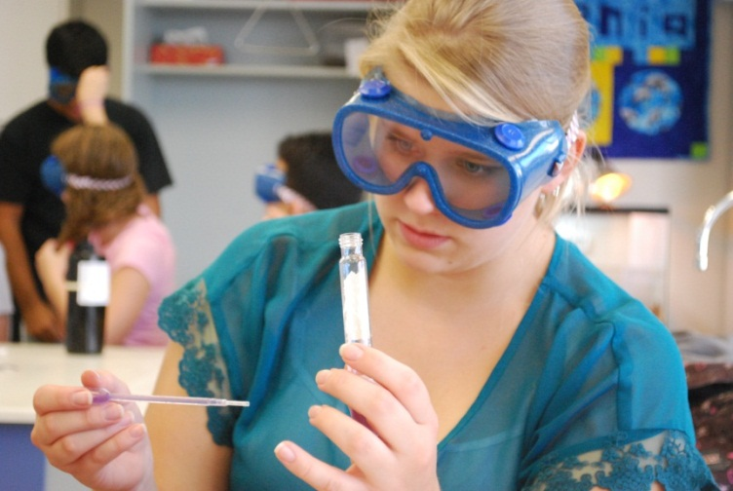
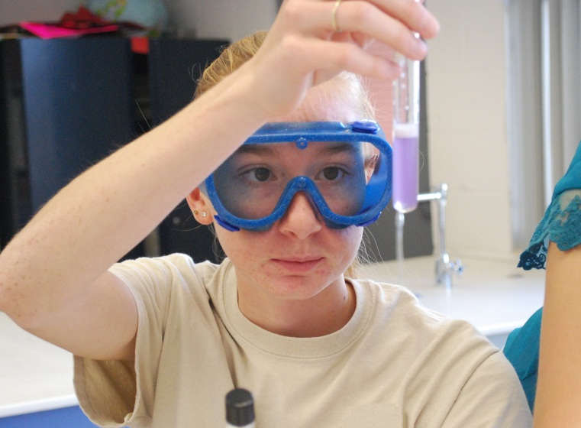
Analysis
The samples will undergo the Standard Biuret Protein Assay to detect the amount of protein remaining in both the ISS and ground FMEs.
The Biuret reagent will turn purple in the presence of protein or pink when exposed to short-chained polypeptides.

Slide 9
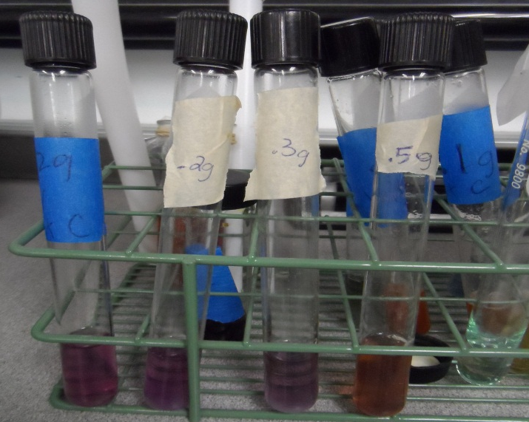
Analysis
The color change of the mixture will be measured using a spectrophotometer and compared to samples that reacted on Earth.
Efficiency of the enzyme will be measured by the amount of protein remaining in the sample after the reaction is complete.

Slide 10
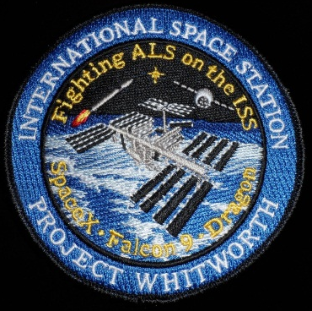
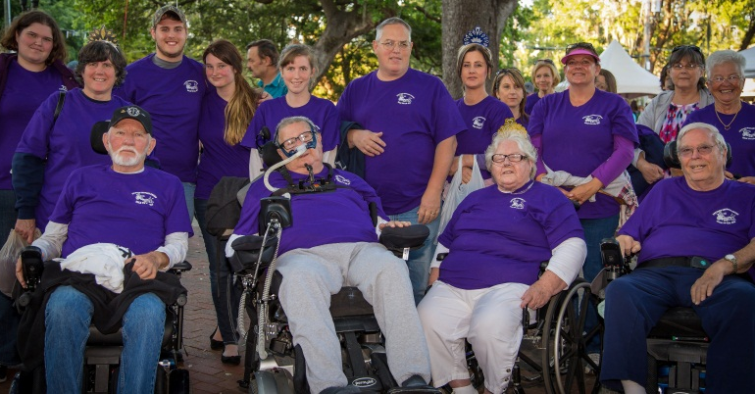
Our Mission
Increase Public Awareness of ALS
Media Coverage
Present at Smithsonian National Air and Space Museum
Write to state representatives
Raise funds for the ALS Community
Sale of mission patches, t-shirts, and bracelets
Participate in events (Jason’s Run, Walk to Defeat ALS)
Help the ALS Community
Attend monthly support group meetings
Provide supplies (Vials of LIFE, electronic medical history bracelets, equipment for loan closet, etc.)

Slide 11
Thank You!
We would like to express our gratitude to the following:
AeroInstitute National Institutes of Health
Airship Ventures NanoRacks, LLC
ALS Association Florida Chapter National Aeronautics and Space Administration
Apogee Books NCESSE
Boeing Company Palmdale Hotel
Brevard Support Group Paralyzed Veterans of America
California Near Space Project Skylark Soaring
Celestial Circuits Smithsonian National Air and Space Museum
Columbus Space Program Student Spaceflight Experiments Program
Embry-Riddle Aeronautical University Space Frontier Foundation
Federal Aviation Administration Space Portal at the NASA Research Park
Johns Hopkins University SpaceX
Masten Aerospace Teachers in Space
Mojave Air & Space Port XCOR Aerospace
NASA AESP zero2infinity

