Slide 1
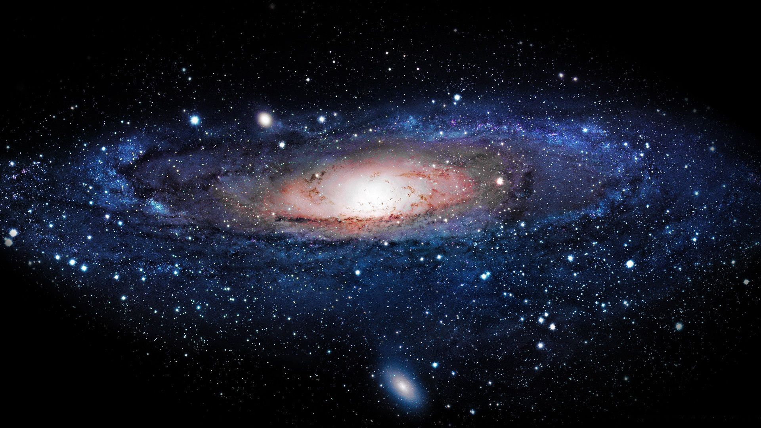
EFFECT OF MICROGRAVITY ON THE ANTIBIOTIC RESISTANCE OF P. AREUGINOSA
Mitchell Hee, Jennifer Jiang, Jasmine Kuo, Annie Surman
San Marino High School
San Marino, California

Slide 2
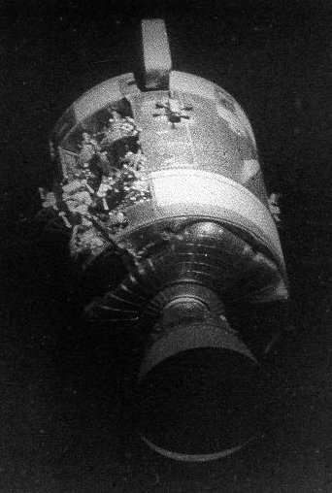
Background
Astronaut Fred Haise infected by P. aeruginosa on Apollo 13 (1970)
Bacteria contaminated water supply
Spaceflight is known to decrease human immune response
Affects T-Cell production

Slide 3
Pseudomonas aeruginosa
facultative anaerobe
innate resistance to variety of antibiotics
can easily develop new resistance
often found in soil
very few nutritional requirements
affects those with compromised immune system or exposed tissue

Slide 4
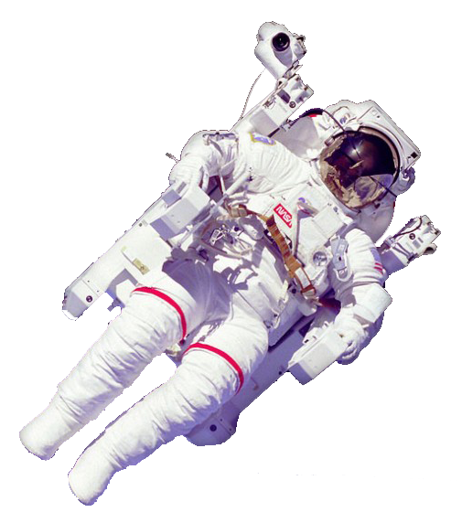
Bacteria
Microgravity
?

Slide 5
Materials
Type 3 FME
Main Volume: 5.50 ml of broth medium
0.5% peptone
0.3% chicken extract
0.5% NaCl
0.5% arabinose
Short Ampoule A: 1 mg freeze-dried P. aeruginosa
Short Ampoule B: 0.512 ml of 0.5 mg/ml L-Valine in distilled water
A
B

Slide 6
Assembly procedures
Ampoule B: L-Valine
Ampoule A: P. aeruginosa
Growth Medium

Slide 7
Experiment procedures
Initiation; crack Ampoule A – A+1
Termination; crack Ampoule B – A+3
Upon return to earth:
Samples from flight and home combined with isoleucine to initiate growth
Plated on agar
Allowed to reproduce overnight at 37°C
P. aeruginosa
Isoleucine
Antibiotic discs

Slide 8
Zone of Inhibition (mm)

Slide 9
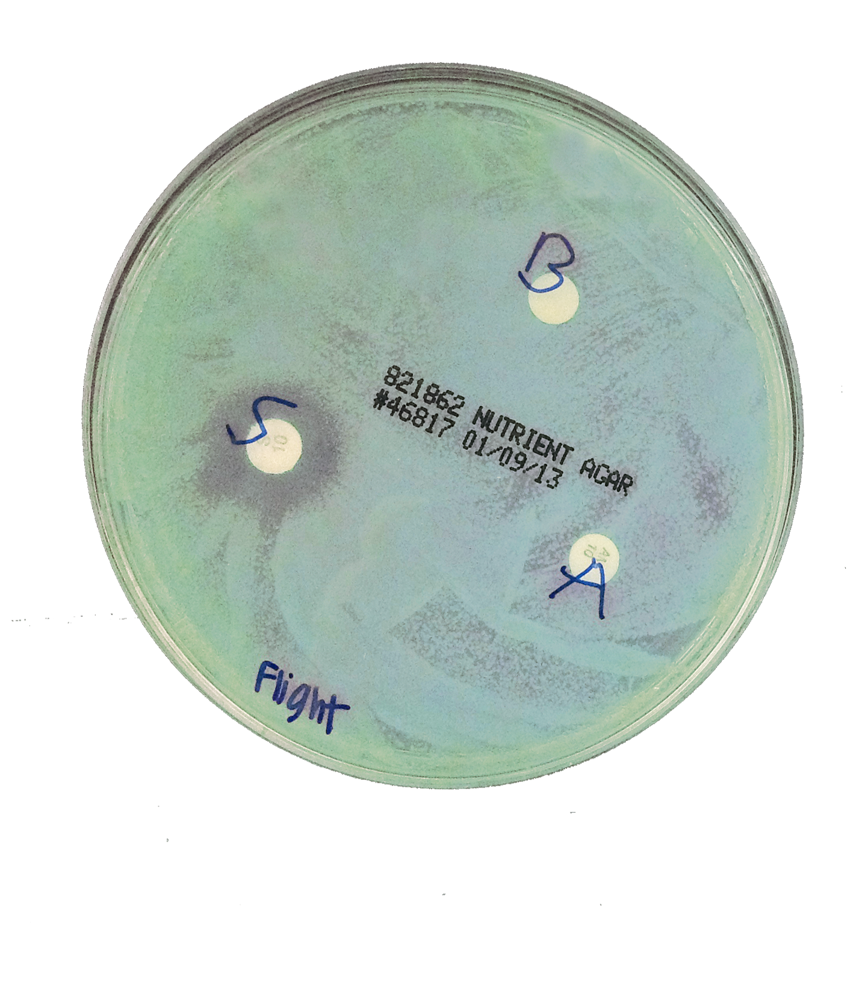
Analysis/Conclusion
P. aeruginosa is:
More resistant to streptomycin and gentamicin
Less resistant to ciprofloxacin
Remained resistant to ampicillin (ground and flight)
Inaccuracies due to:
A mishap in experiment procedures
Broken Teflon tube
Microgravity aids the growth of P. aeruginosa
Allows for suspension in growth medium

Slide 10
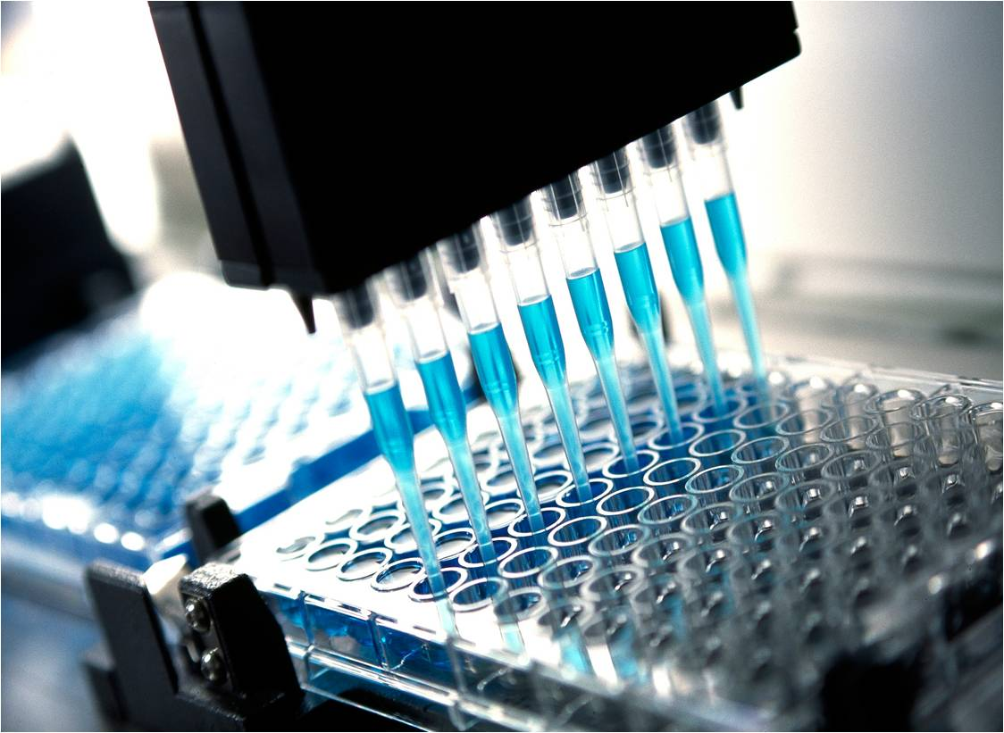
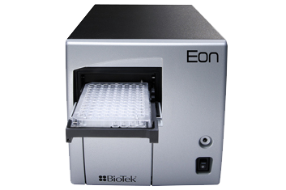
Further steps
Measure minimum inhibitory concentration
Indicator to compare growth
Use of spectrophotometer
Change antibiotics to correct redundancy

Slide 11
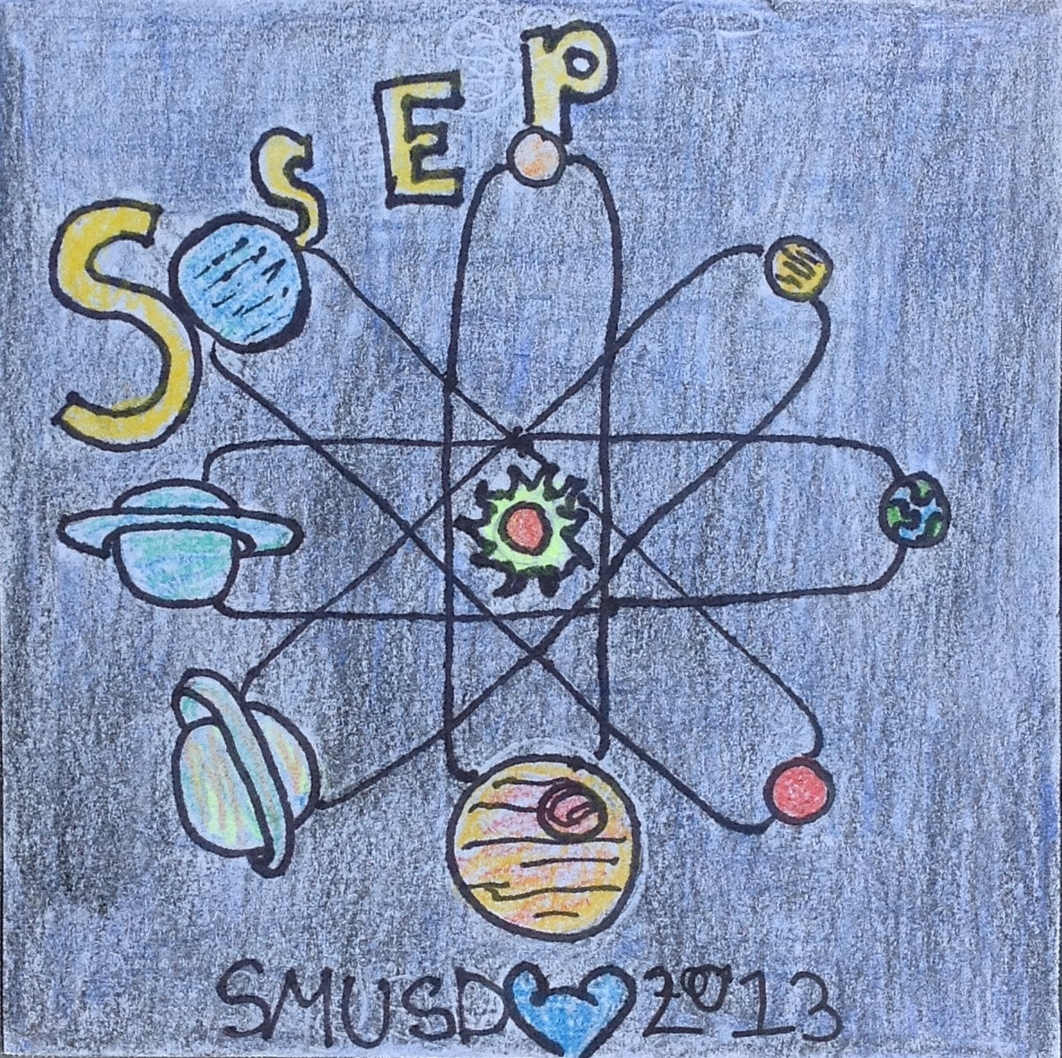
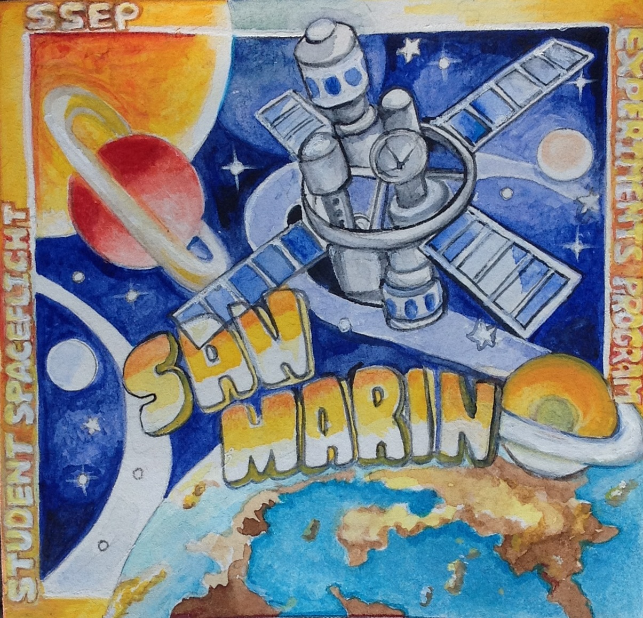
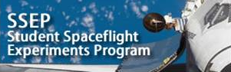
Acknowledgements
Mr. Wyeth Collo
Dr. Ali Khoshnan
SSEP
Nanoracks
California Institute of Technology
The Smithsonian Institution

